Slide 1

Coast Care Bay of Plenty
Kaituna 2024
Challenges, opportunities, successes and observations

Slide 2
Coast Care Kaituna
Te Tumu, Maketū, Pukehina, Ōtamarākau
Multiple tenures – WBOPDC, DOC, Tangata whenua, Linz, Kiwirail, Private land etc.
Varied coastal morphology – low dunes, high dunes, sandspits, sedimentary rock and cliffs.
A range of pressures – coastal squeeze, pest plants, vehicles etc.
Collaborative – Maketū Wetland Society, WBOPDC, schools, volunteers.

Slide 3
Challenges, opportunities, successes and observations
Prioritisation – form and function, biodiversity, continuity, public demand, easy wins, accessibility, tenure. Bit of a balancing act.
Data management, monitoring.
Individual volunteers and managing the ‘patchwork’.
Site prep (scrape and bury? Spray?), ongoing maintenance (dependent on tenure and obligations/commitments, as well as ongoing site pressures). Weeds, coastal squeeze, erosion (only an issue due to squeeze and degradation). Limited time and $$.
Notes:
Prioritisation is a challenge, multiple factors feeding into decision making. Database is getting better and better.

Slide 4
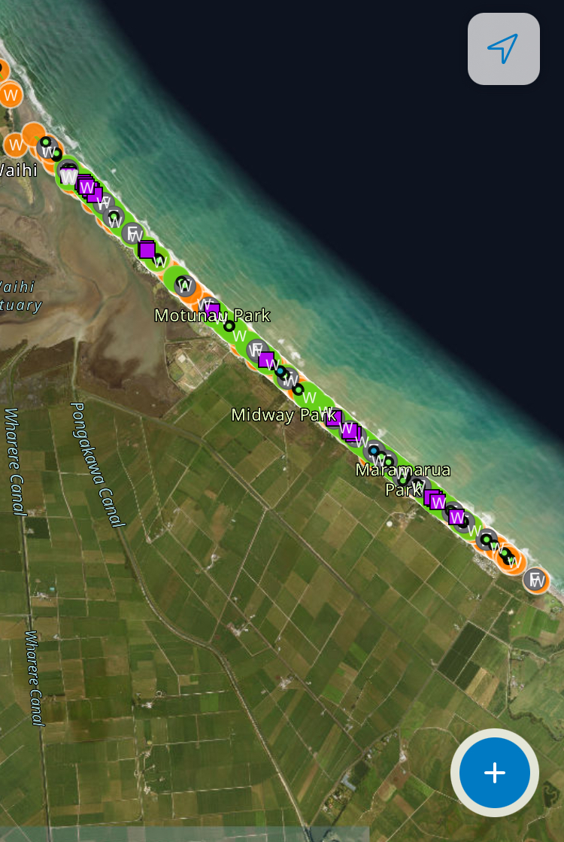
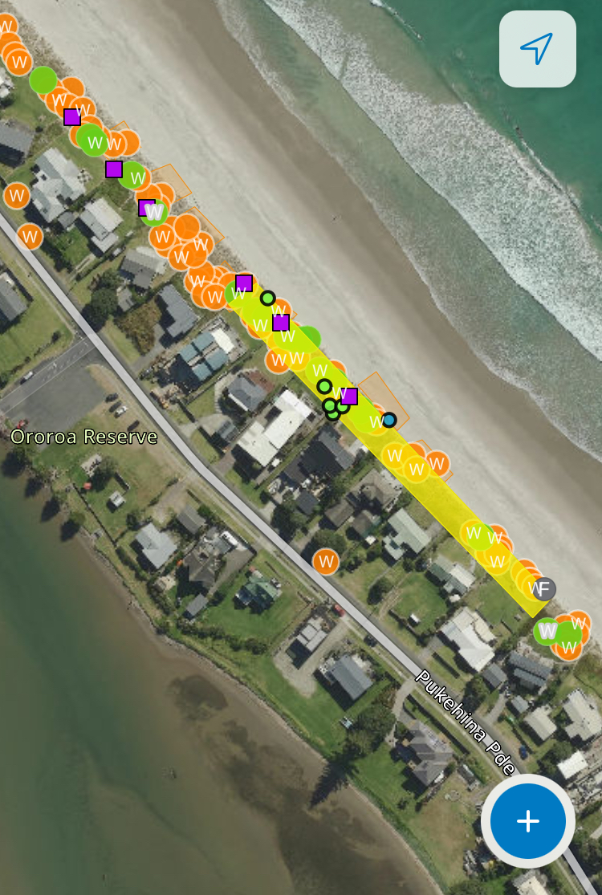
Photos!
Notes:
Great database. Shows Pukehina coastal squeeze. Serious amount of effort over the years, especially from individual volunteers, but very hit and miss long term. Reinvasion of weeds, erosion, encroachment, owners changing, holiday homes with disinterested owners – who’re not obliged to be Coast Carers! Resulting dune patchwork along the beach. Facilitating form and function the key here to promote resilience and foredune recovery, but also good population of shore skinks despite modifications. Use of photopoints for monitoring.

Slide 5
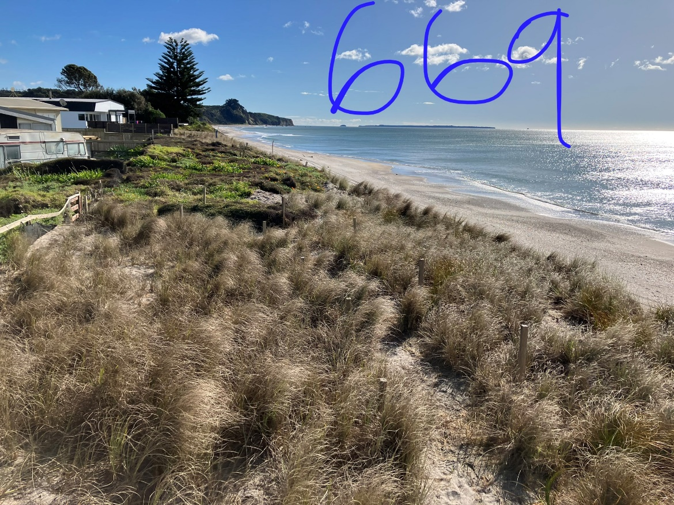
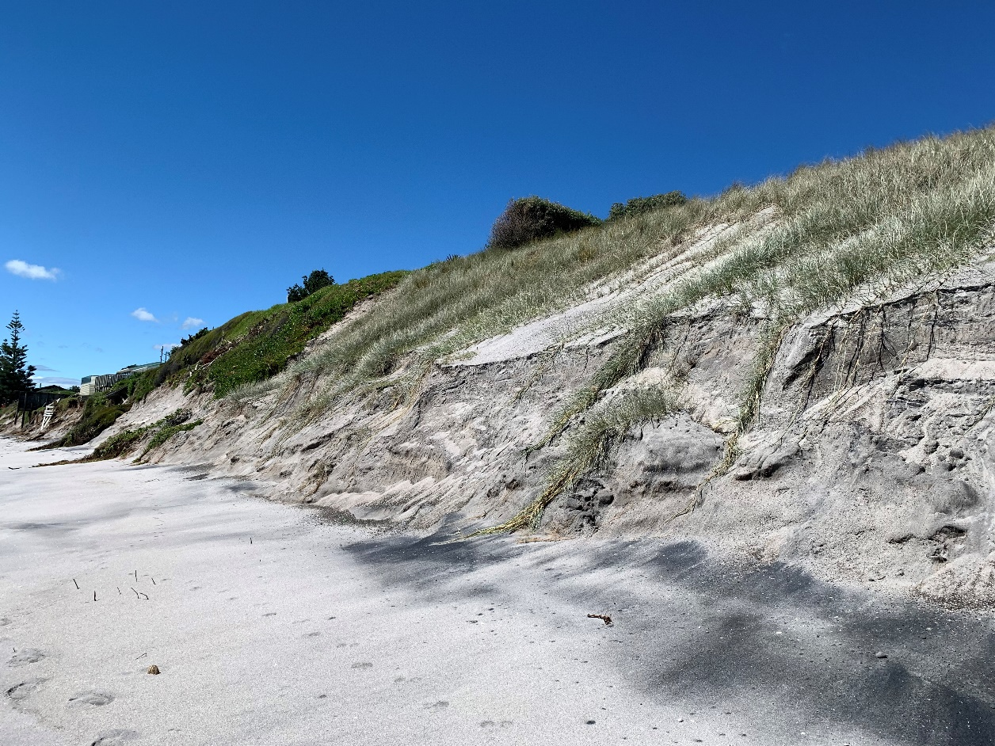
Notes:
The Pukehina mosaic

Slide 6
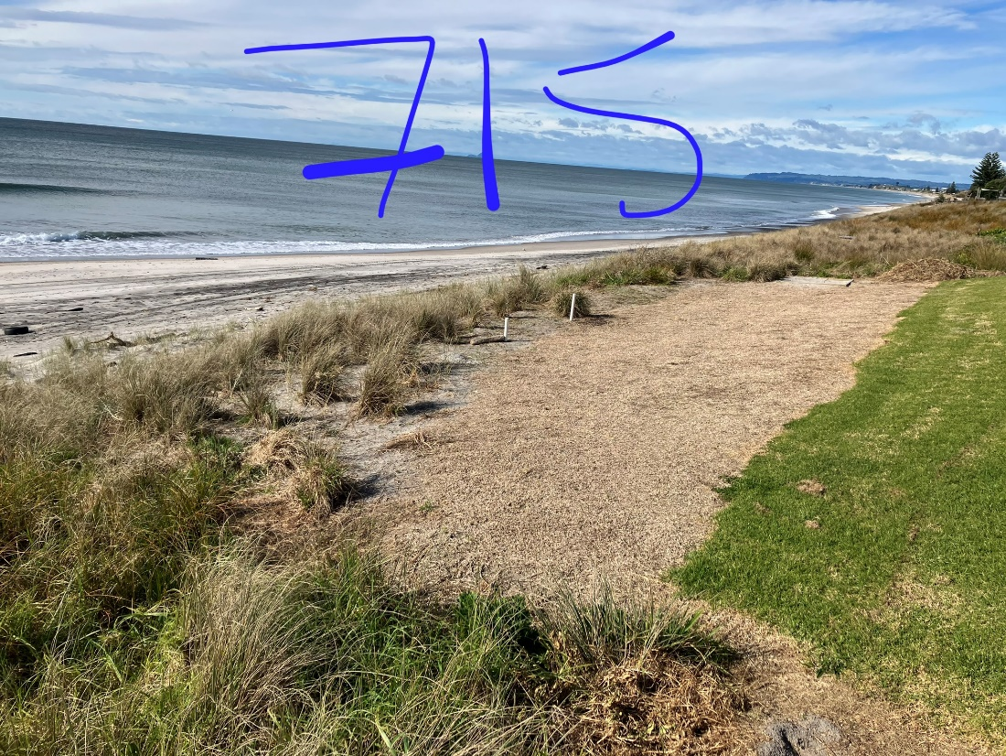
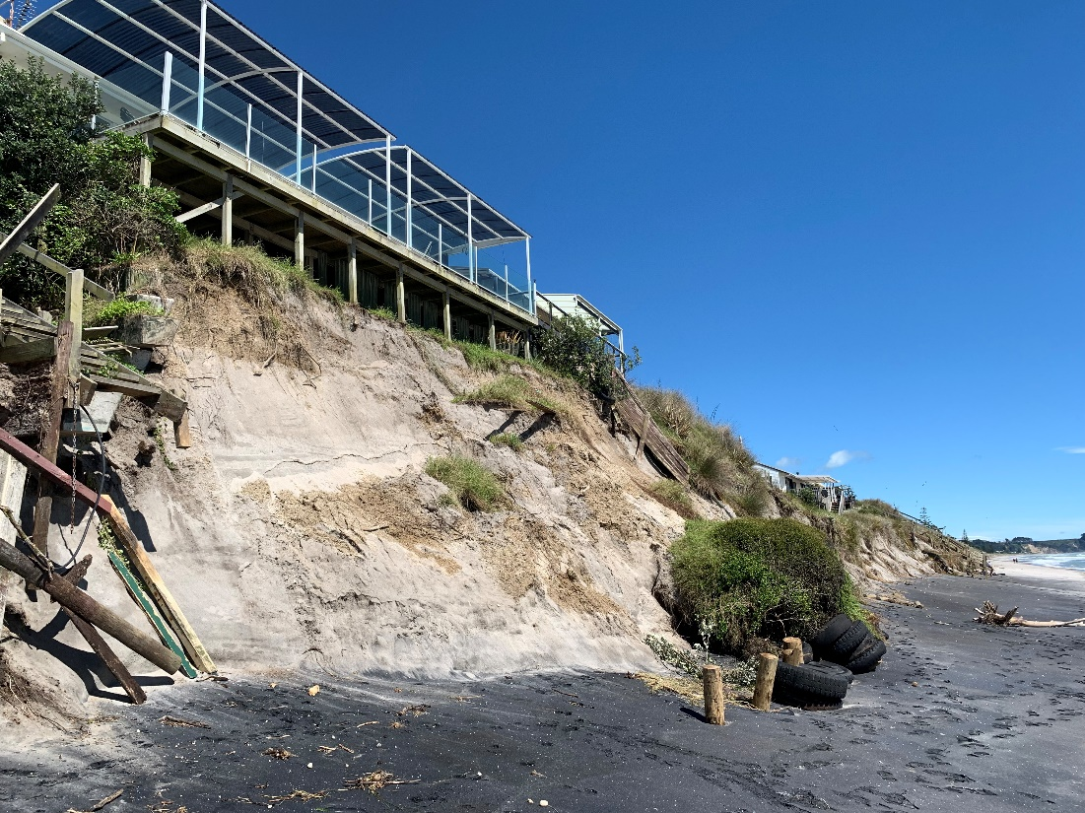
Notes:
Extend the buffer as far as possible! Tricky job reverting compacted lawn to frontal dune. Serious squeeze meaning erosion is an issue.

Slide 7
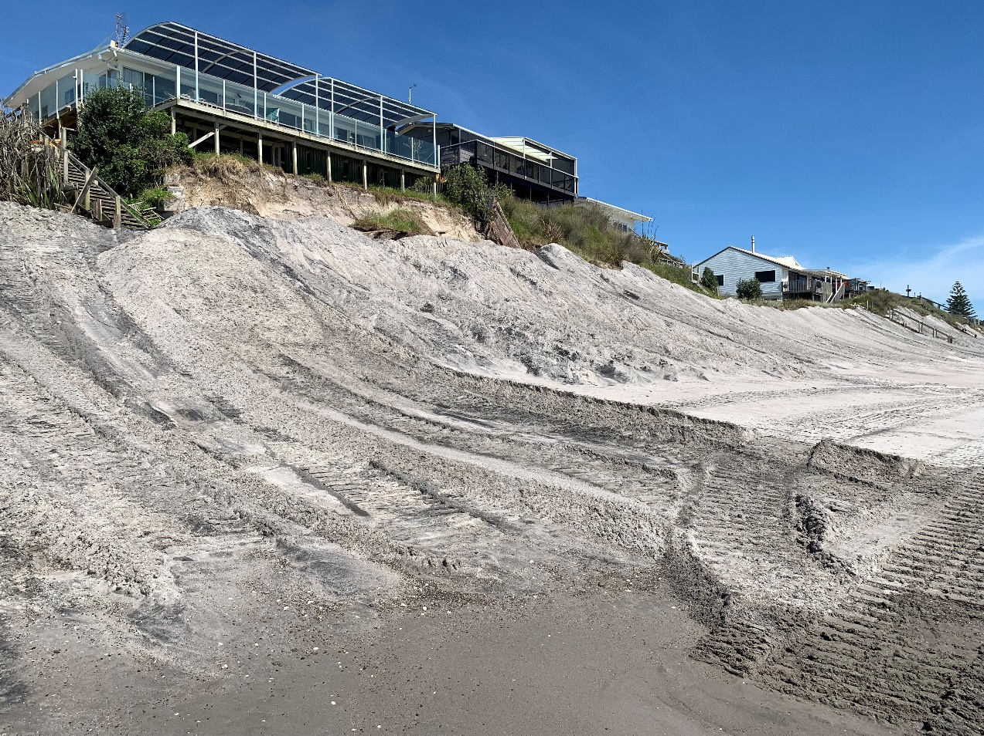
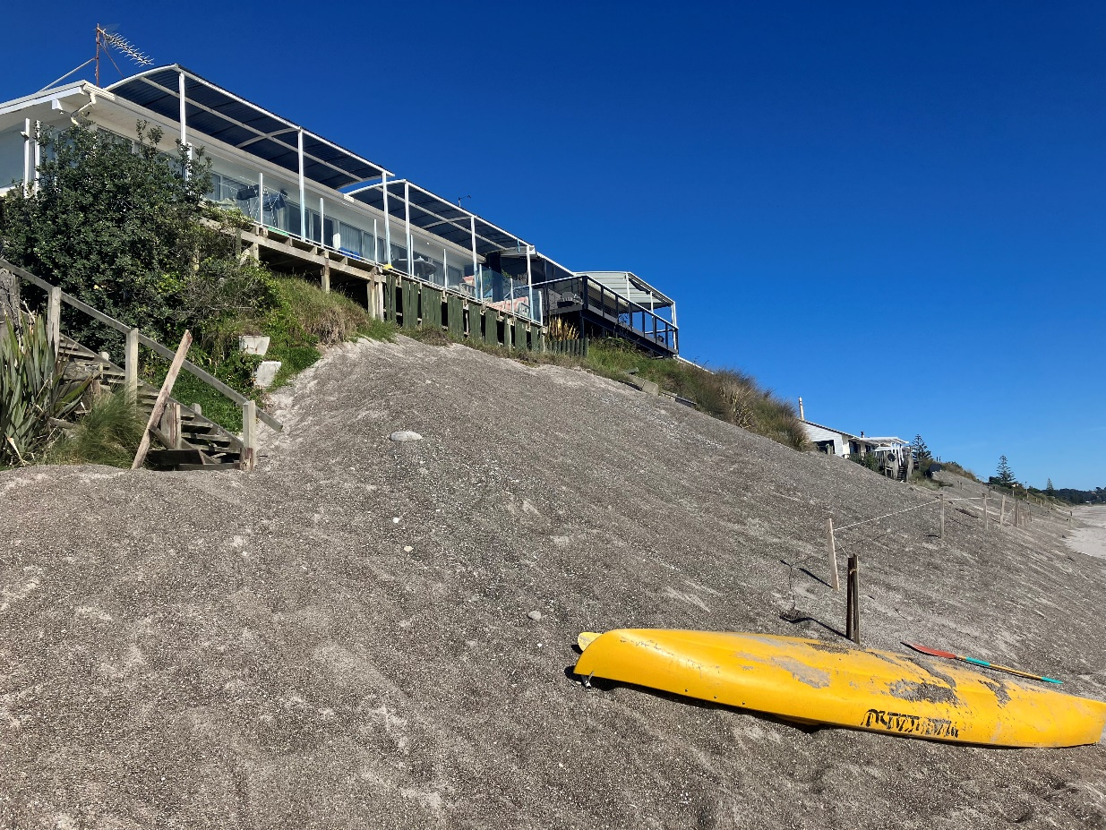
Notes:
PRRA facilitate remedial push up work. Allowed to settle then can be planted. Spot the difference!

Slide 8
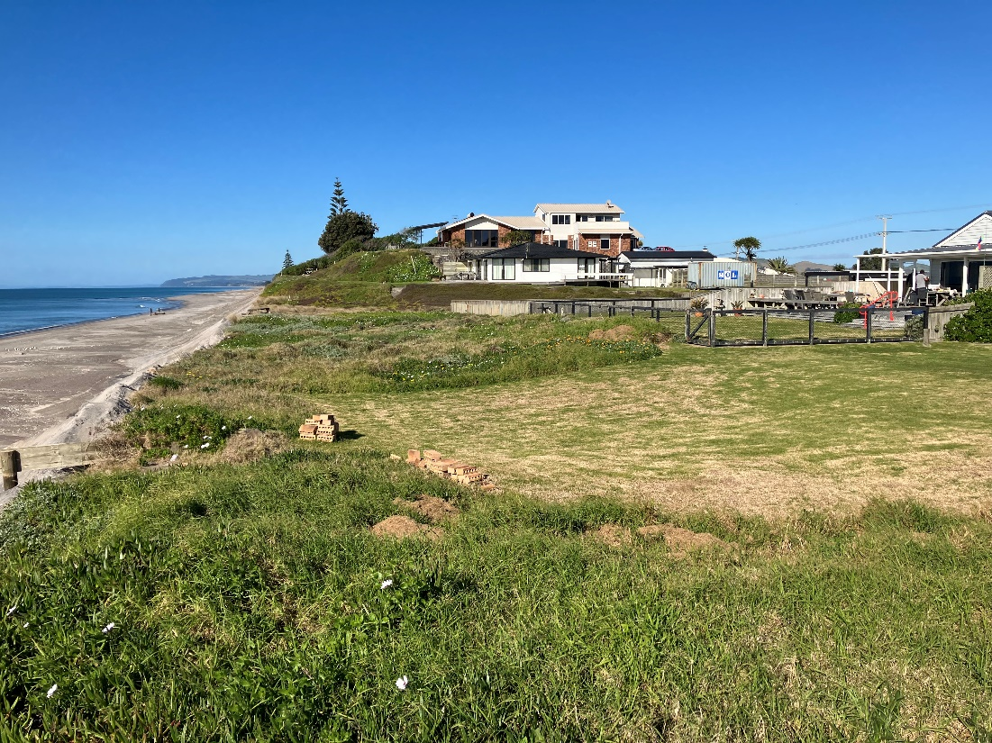
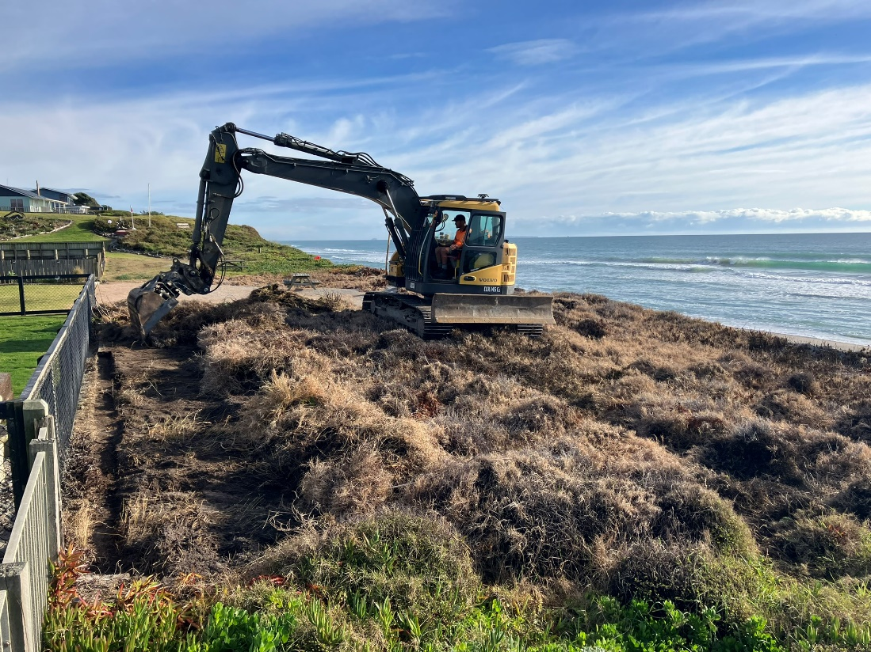
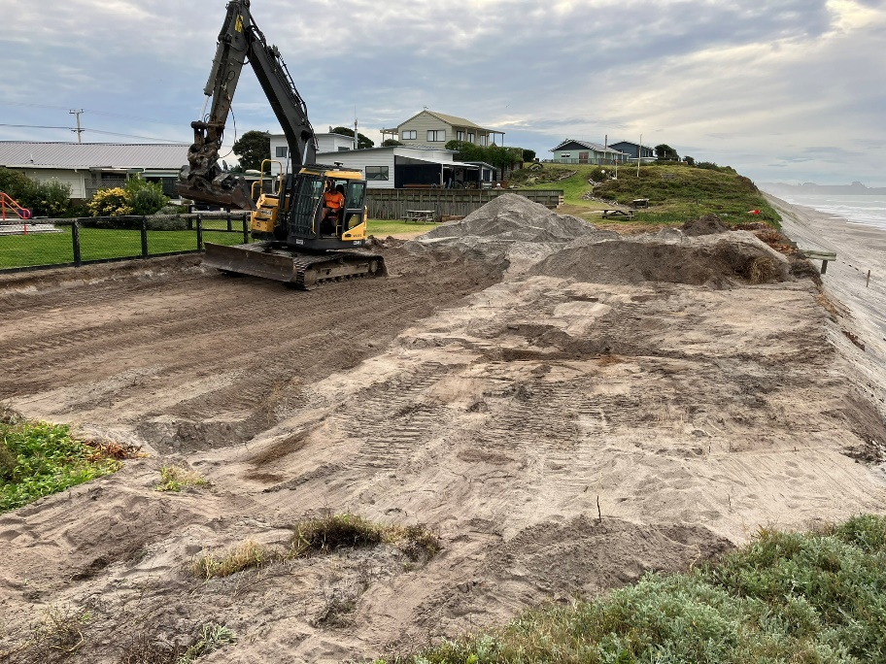
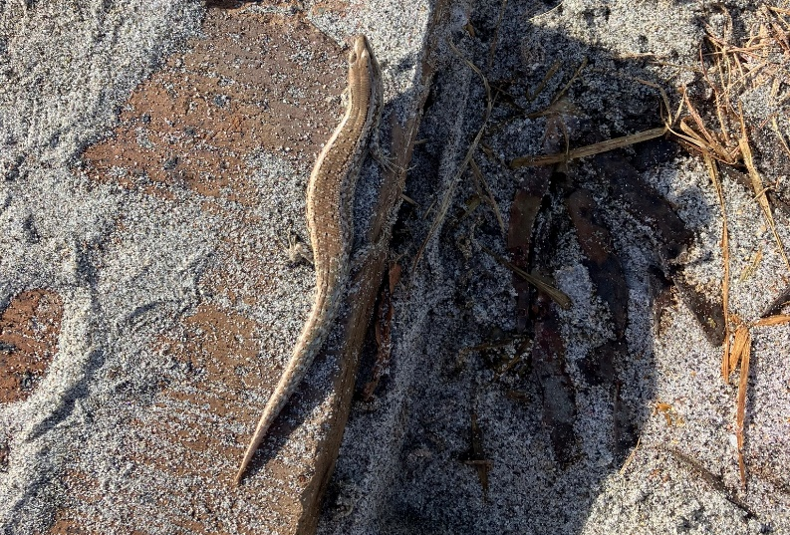

Slide 9
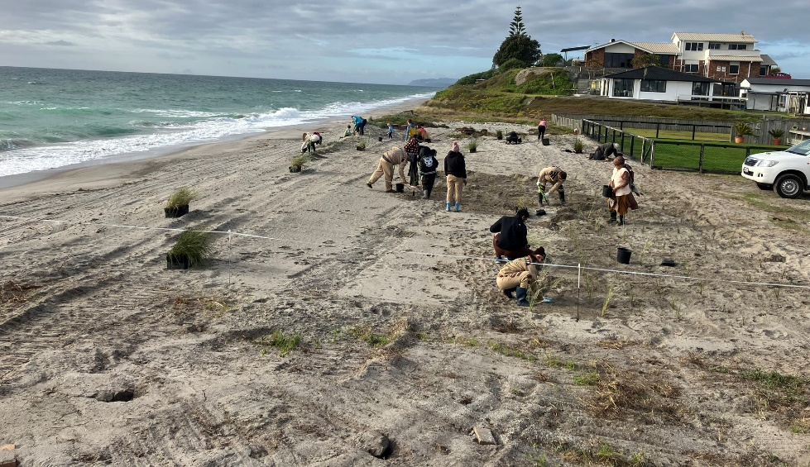
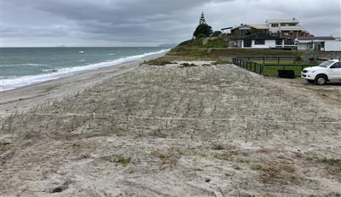
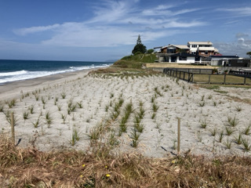
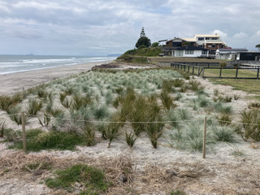

Slide 10
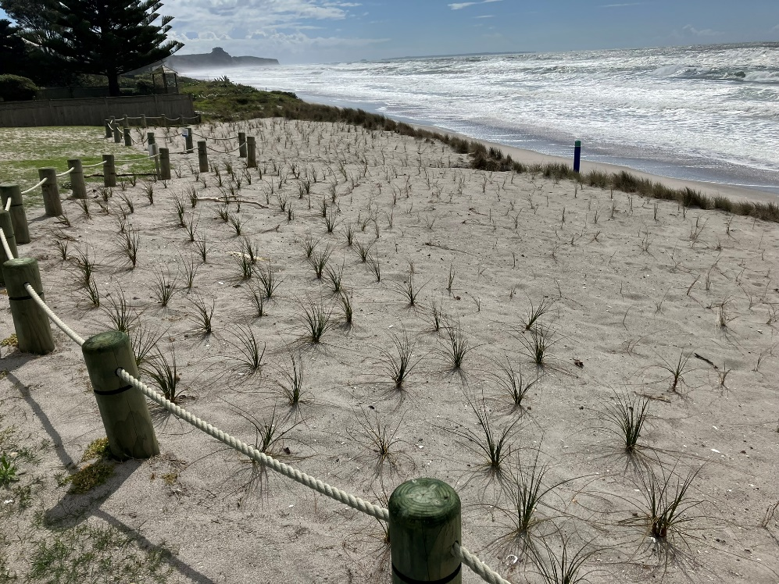
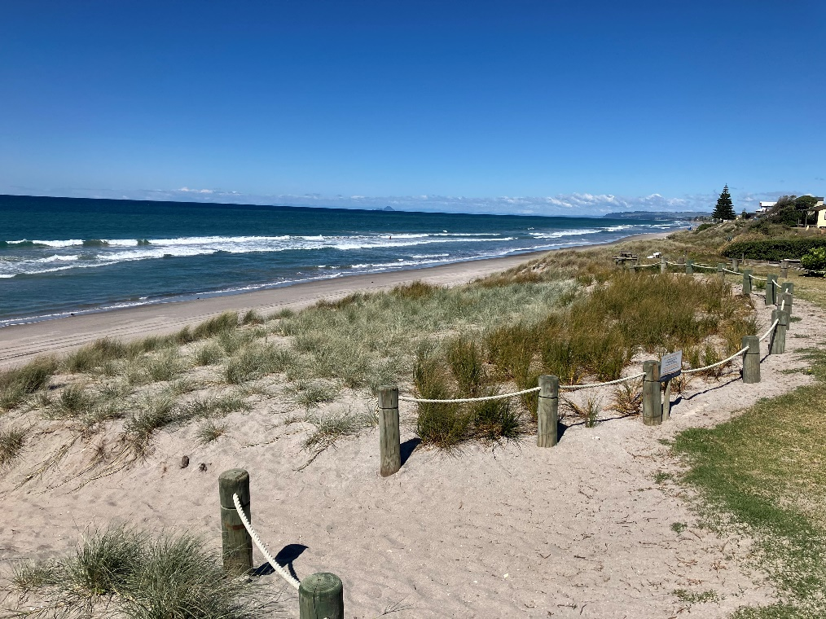
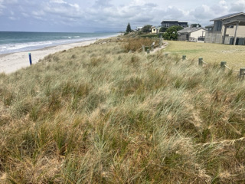
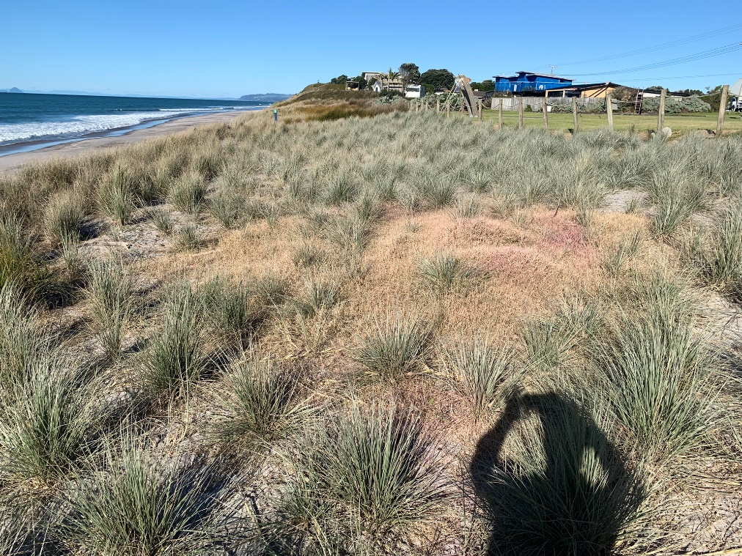
Notes:
Scrape and bury a very useful approach, but expensive and intensive. Ongoing maintenance still needed!

Slide 11
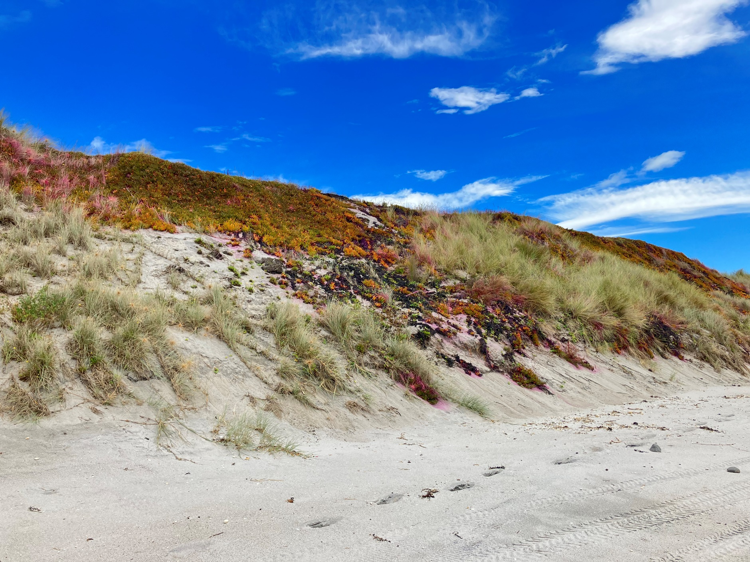
Notes:
Easy wins? Only ice plant to tackle, some marram to worry about another day…

Slide 12
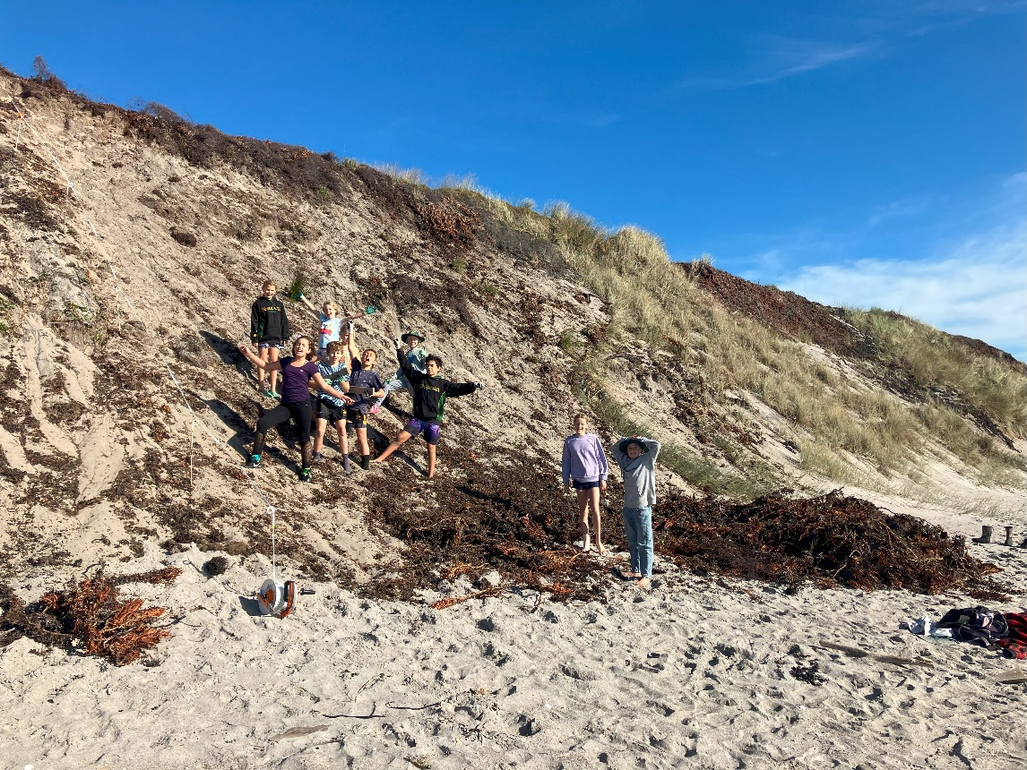
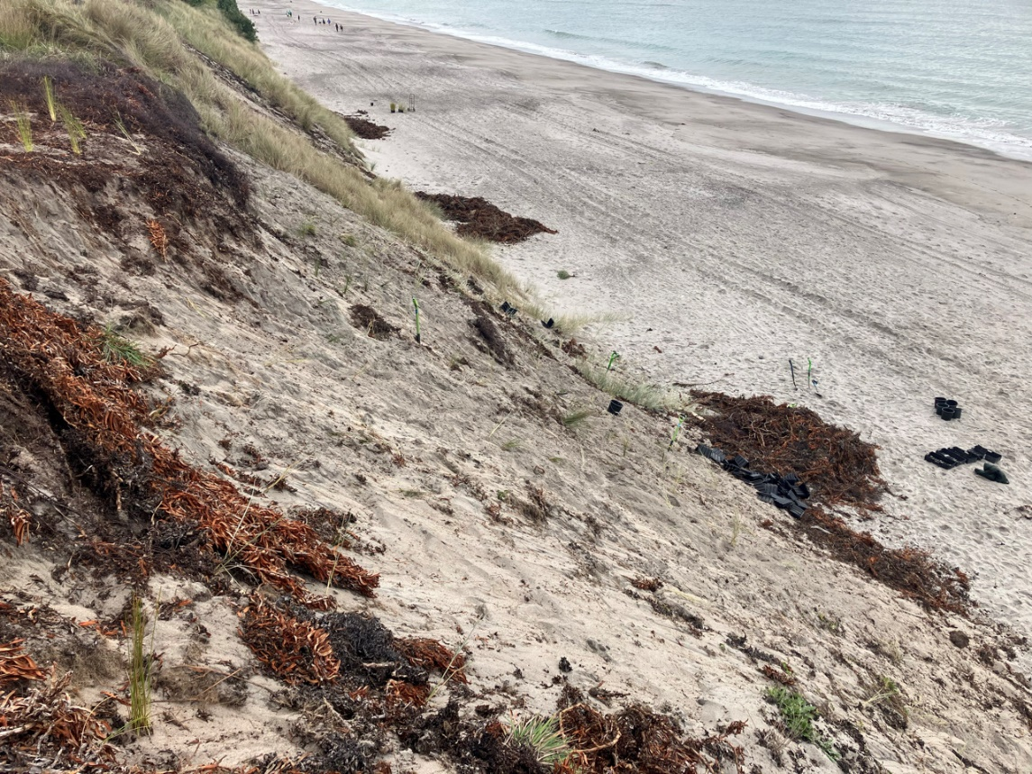
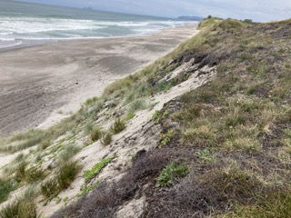
Notes:
Yes and no! Plan B to drag it all down then plant. Definitely dead after 2 sprays of brushkiller. Scary steep. Very tricky planting and a bit patchy but coming away.

Slide 13
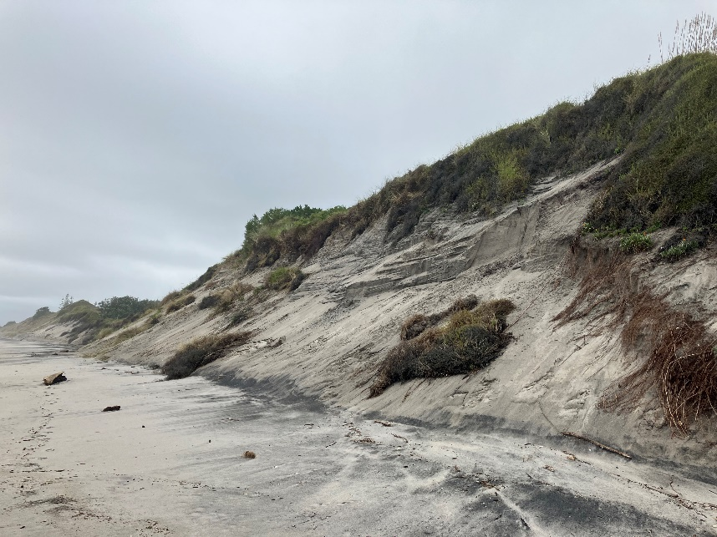
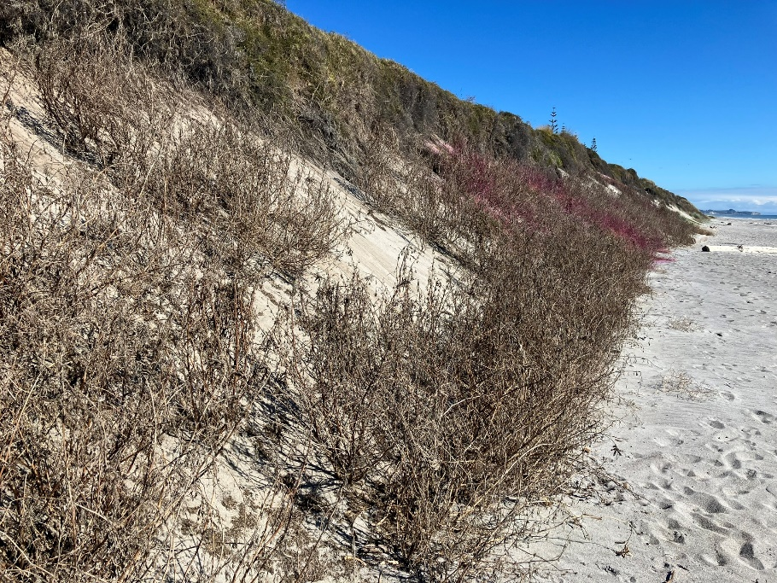
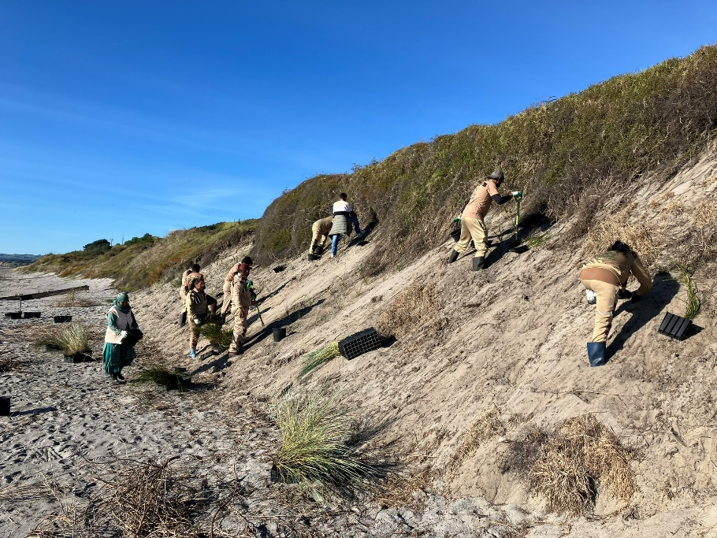
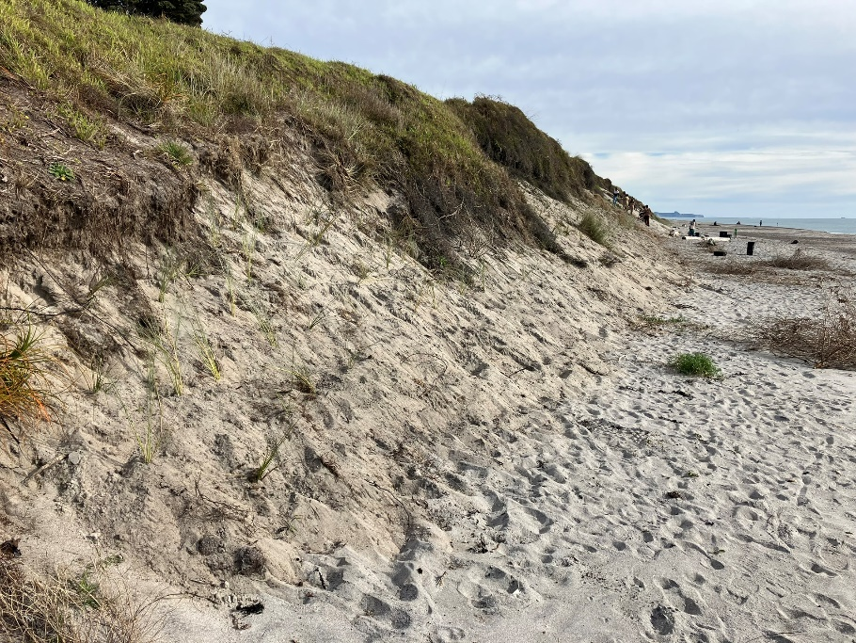
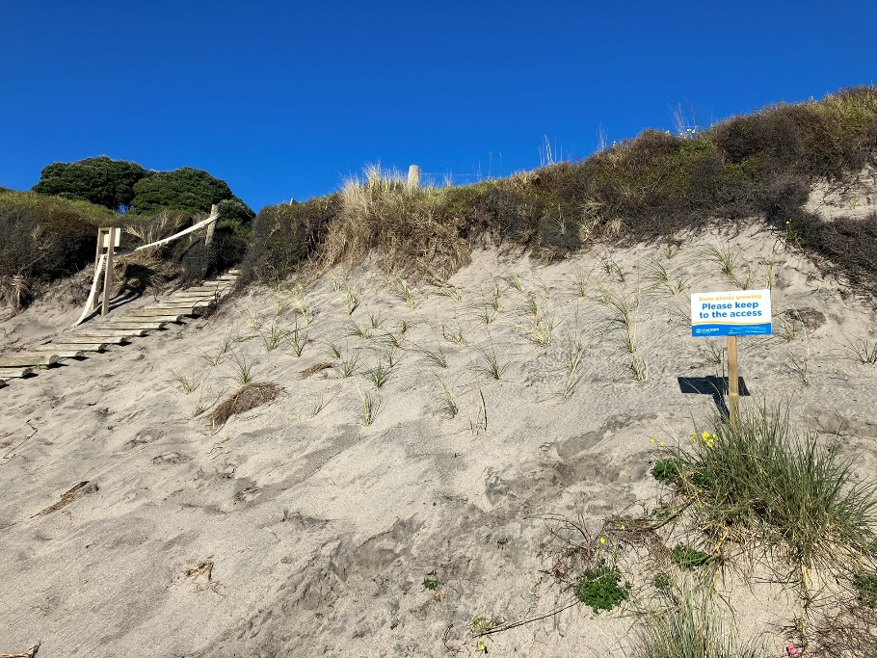

Slide 14
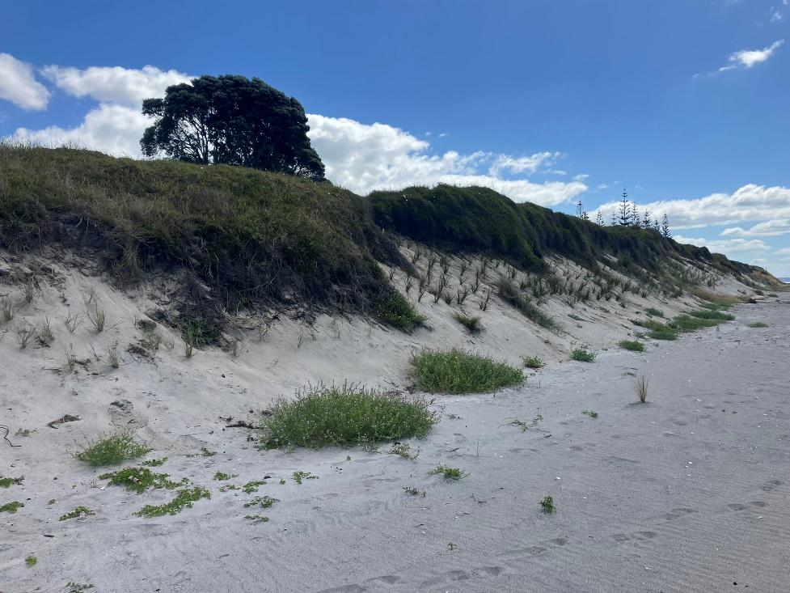
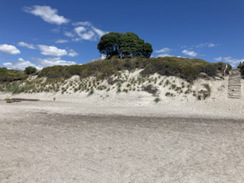
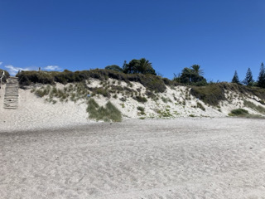

Slide 15
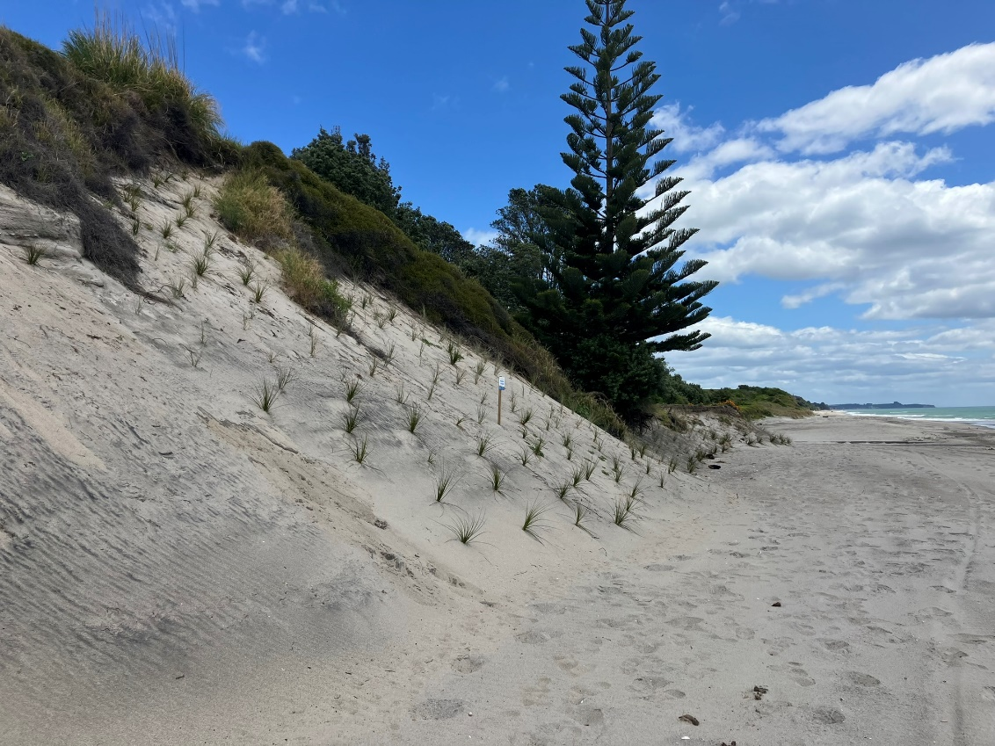
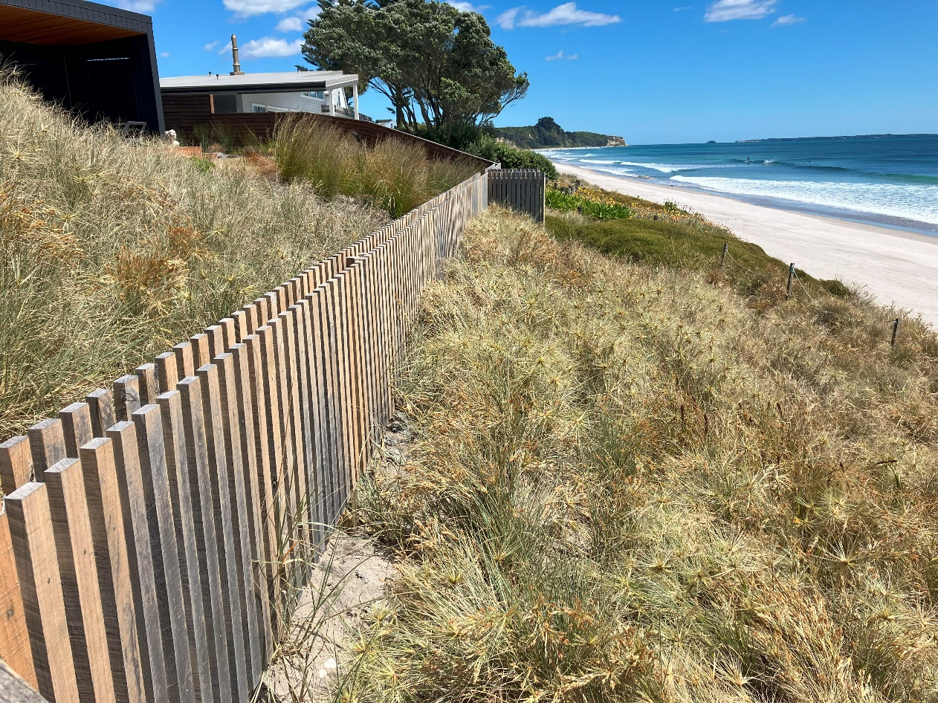
Notes:
Individual champions. Sometimes in hard-to-reach places.

Slide 16
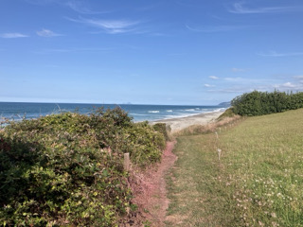
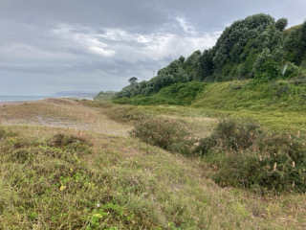
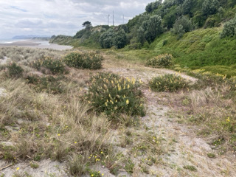
Notes:
Attempting chemical control on grass weeds.

Slide 17
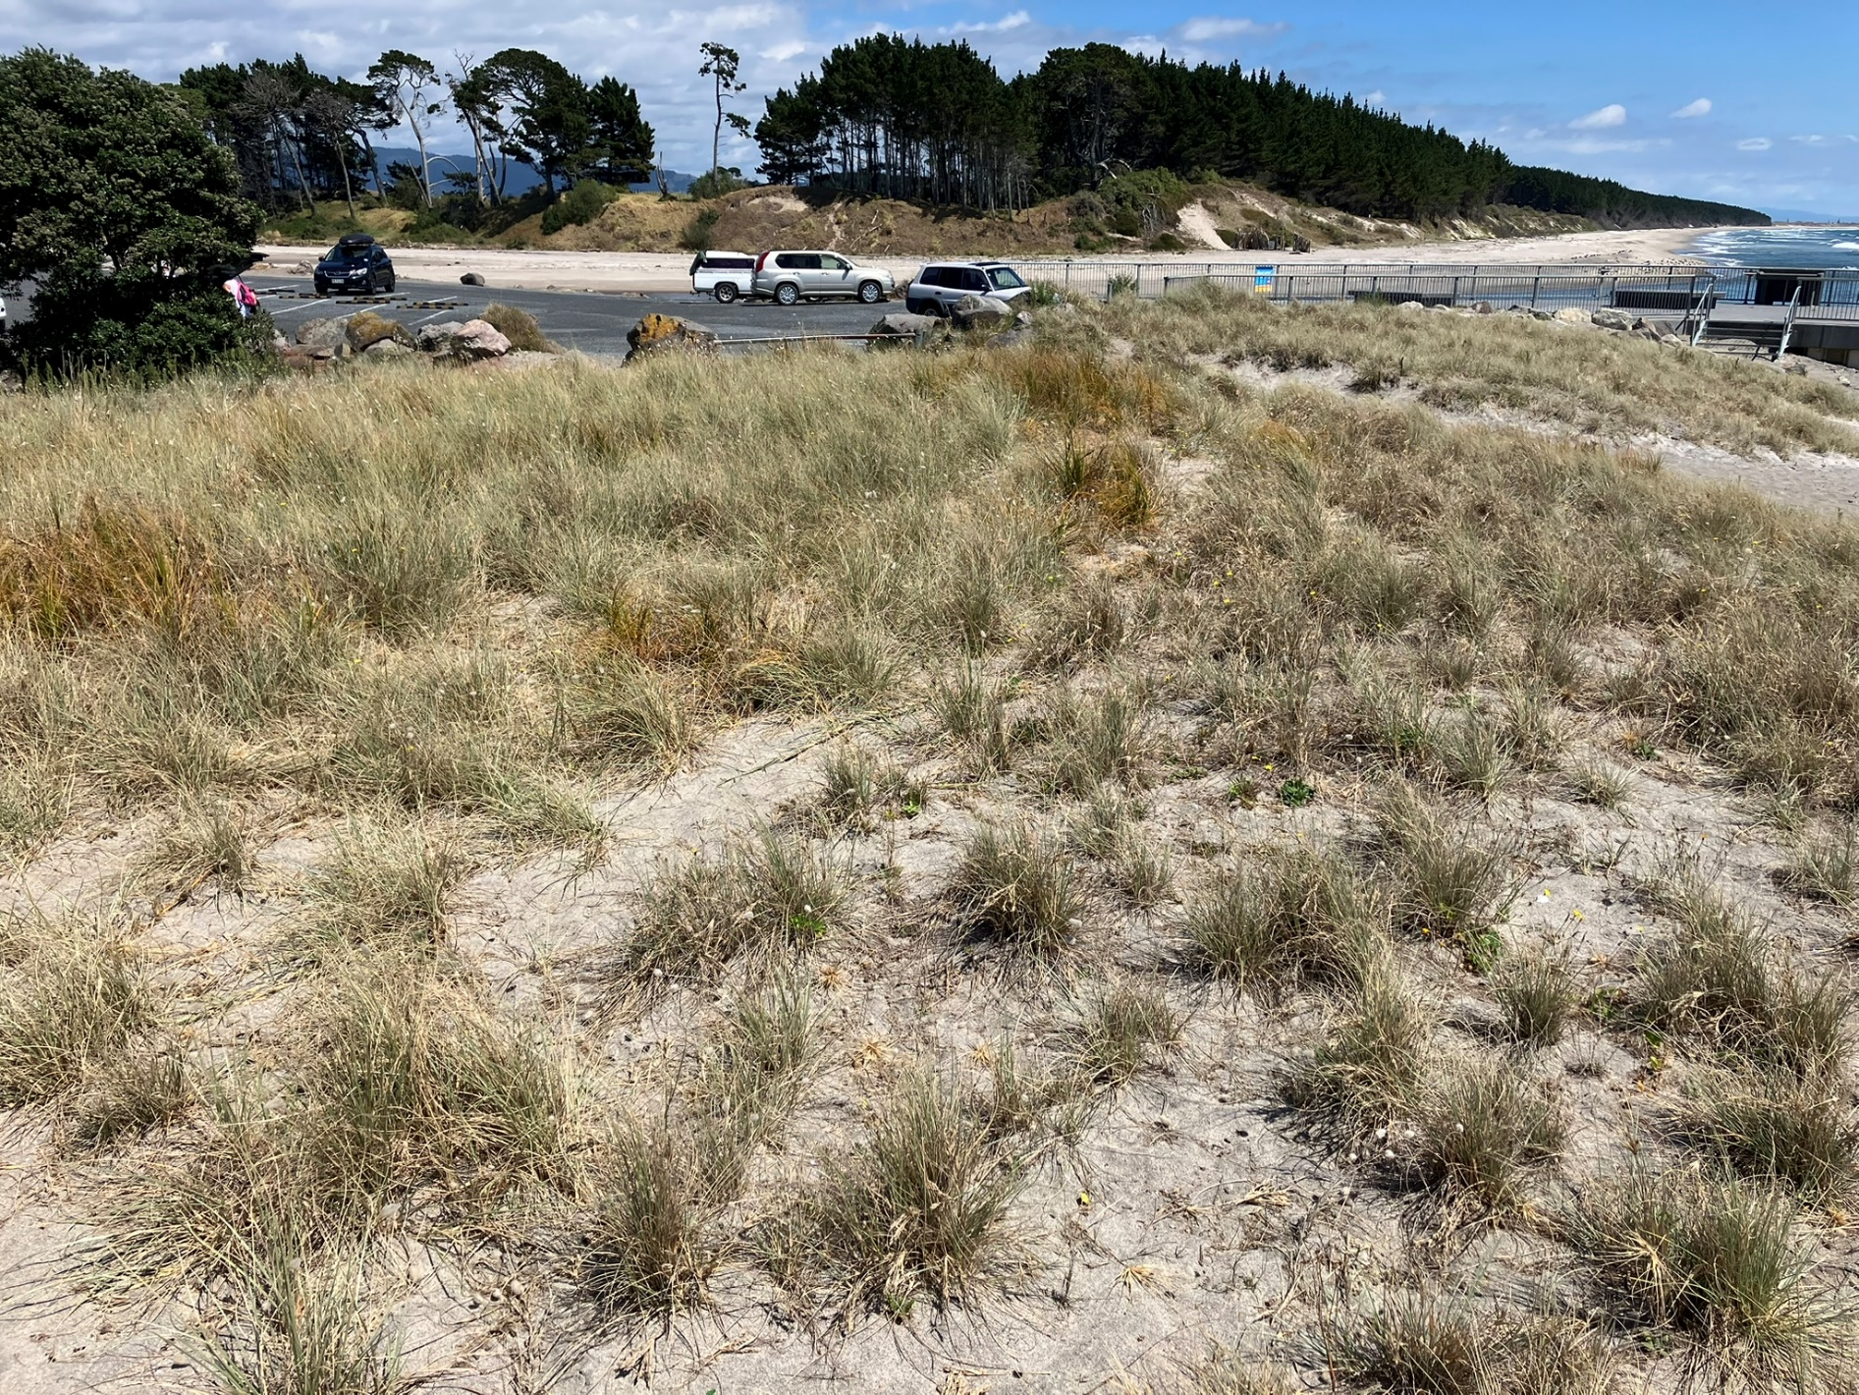
Notes:
Managing expectations. 2023 scrape and bury site looking lush a year and a half on vs. established natural looking area to the right – not gappy and in need of more plants!

