Slide 1
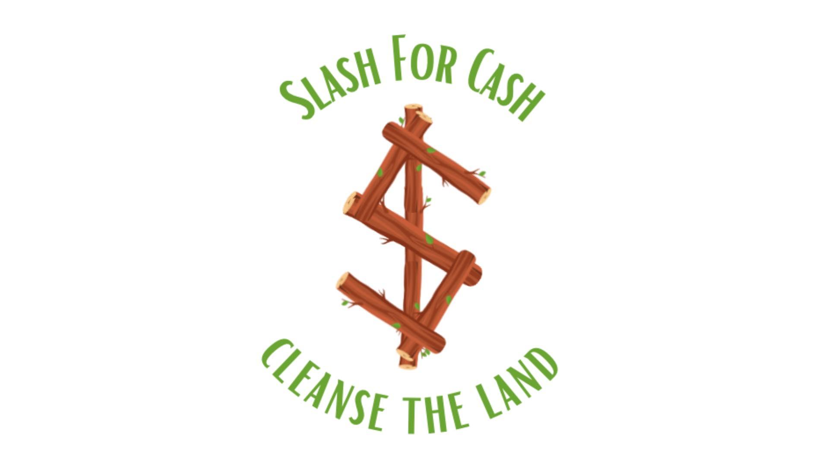

Slide 2
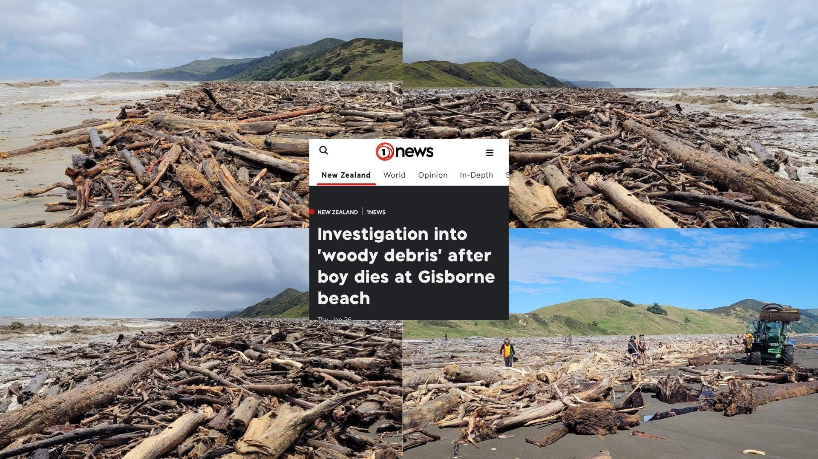

Slide 3
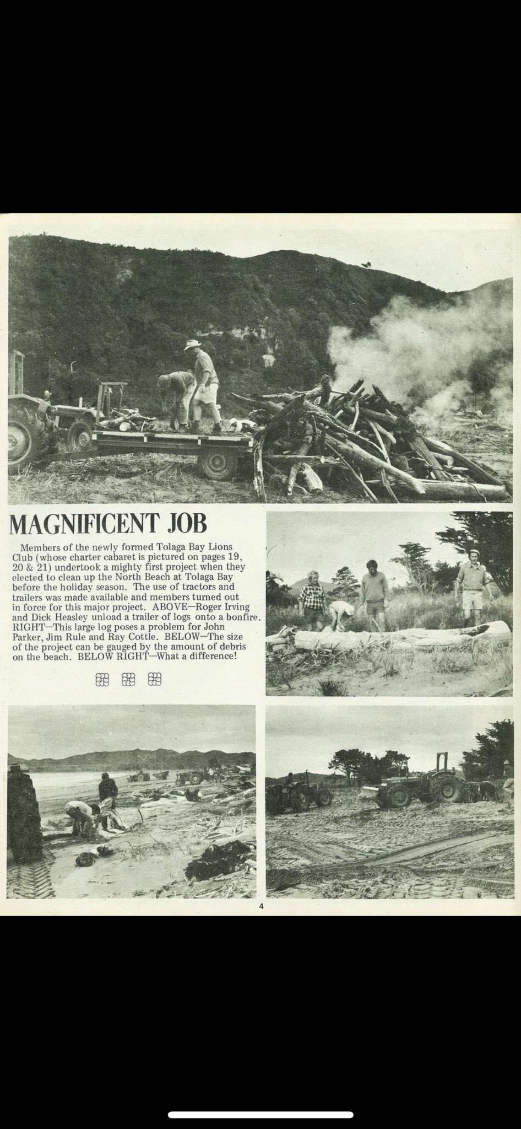

Slide 4
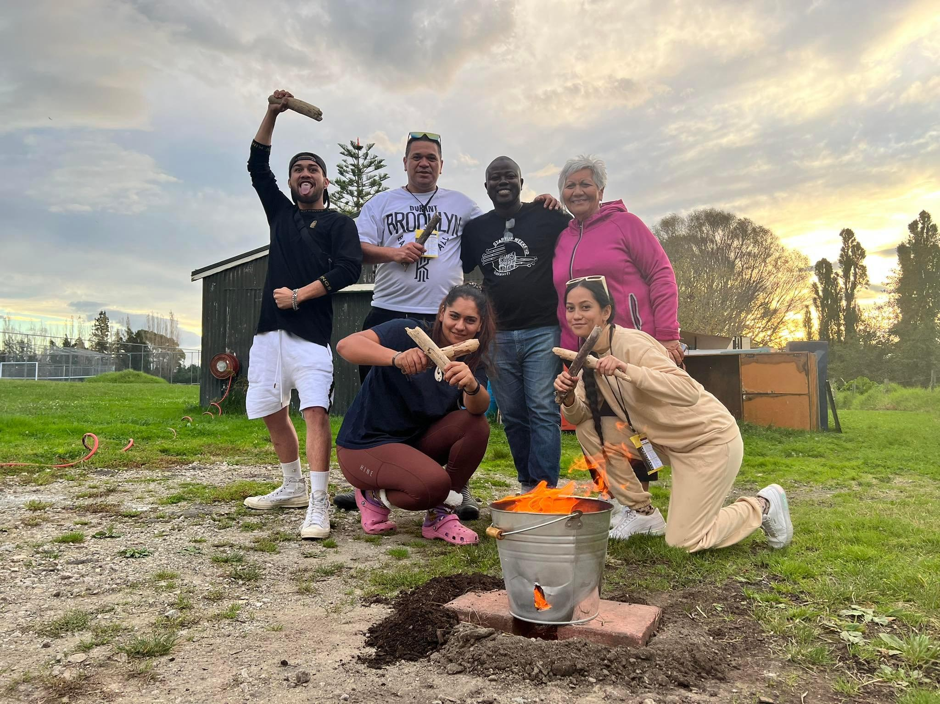
Founding Team Members
L-R (Standing)
Paul Tekahu (based in Wairoa)
Matene Maraki (based in Gisborne)
Thabiso Mashaba (based in Uawa)
Pane Kawhia (based in Ruatoria)
L-R (Kneeling)
Kyrah Dewes (based in Tikitiki)
Hine Aio Apatari (based in Wairoa)

Slide 5
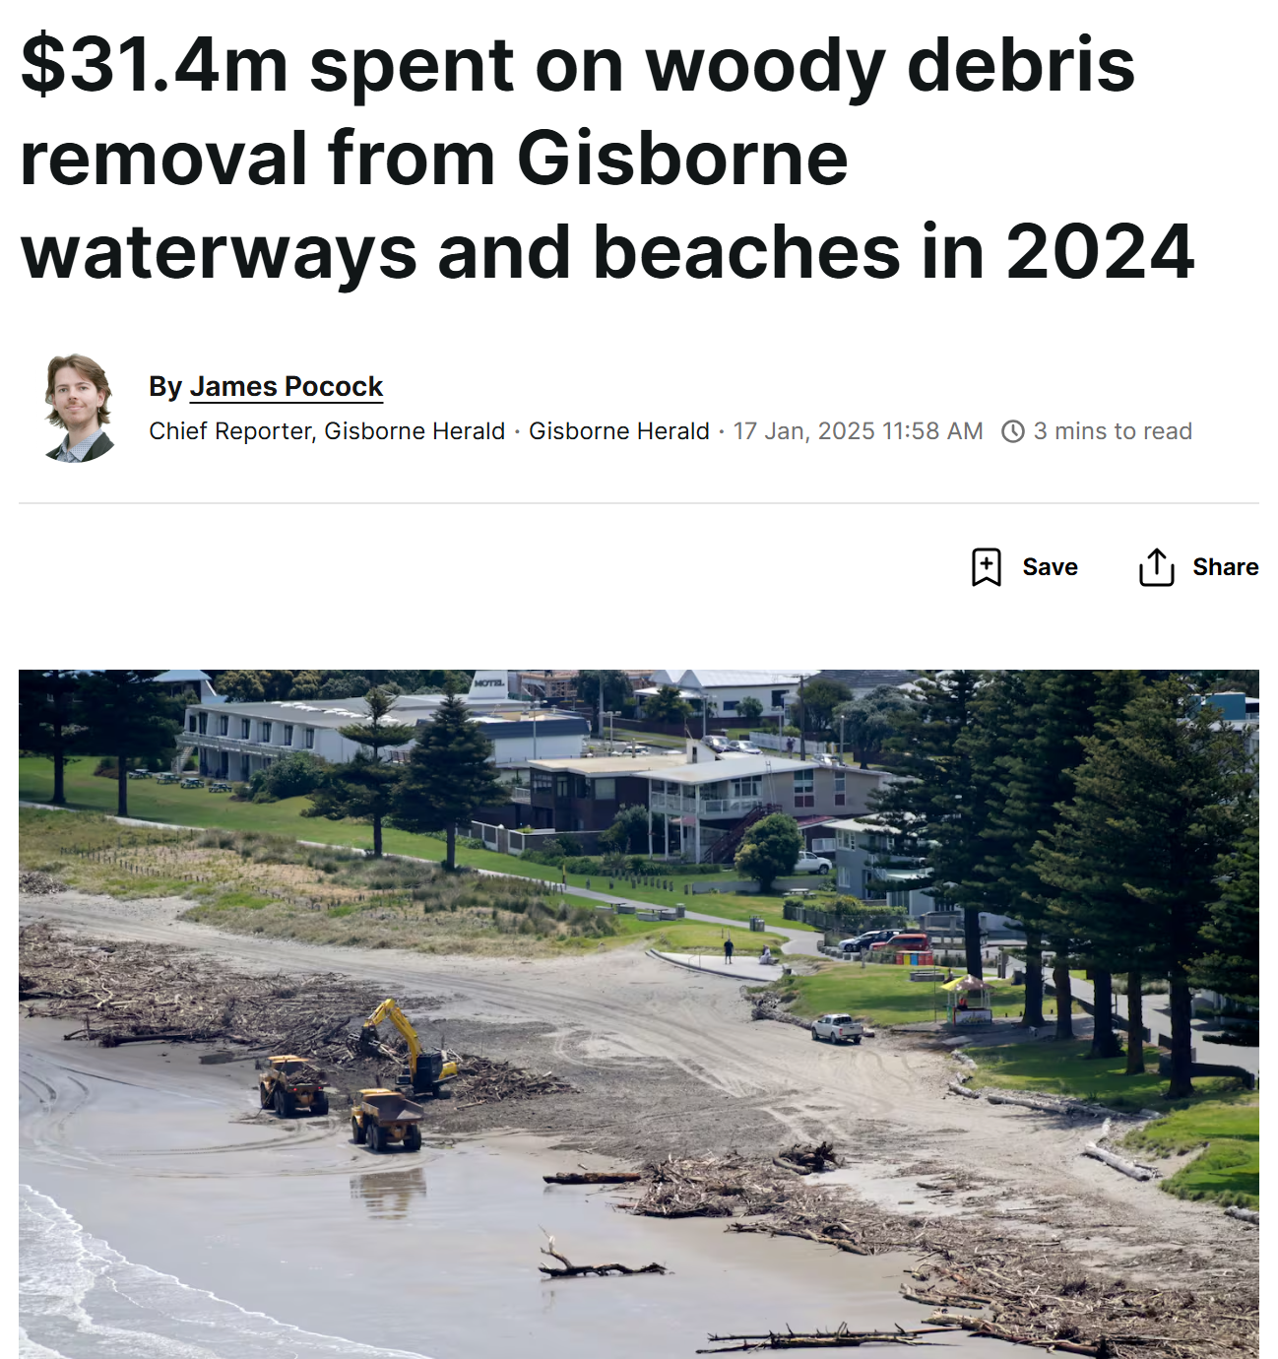

Slide 6
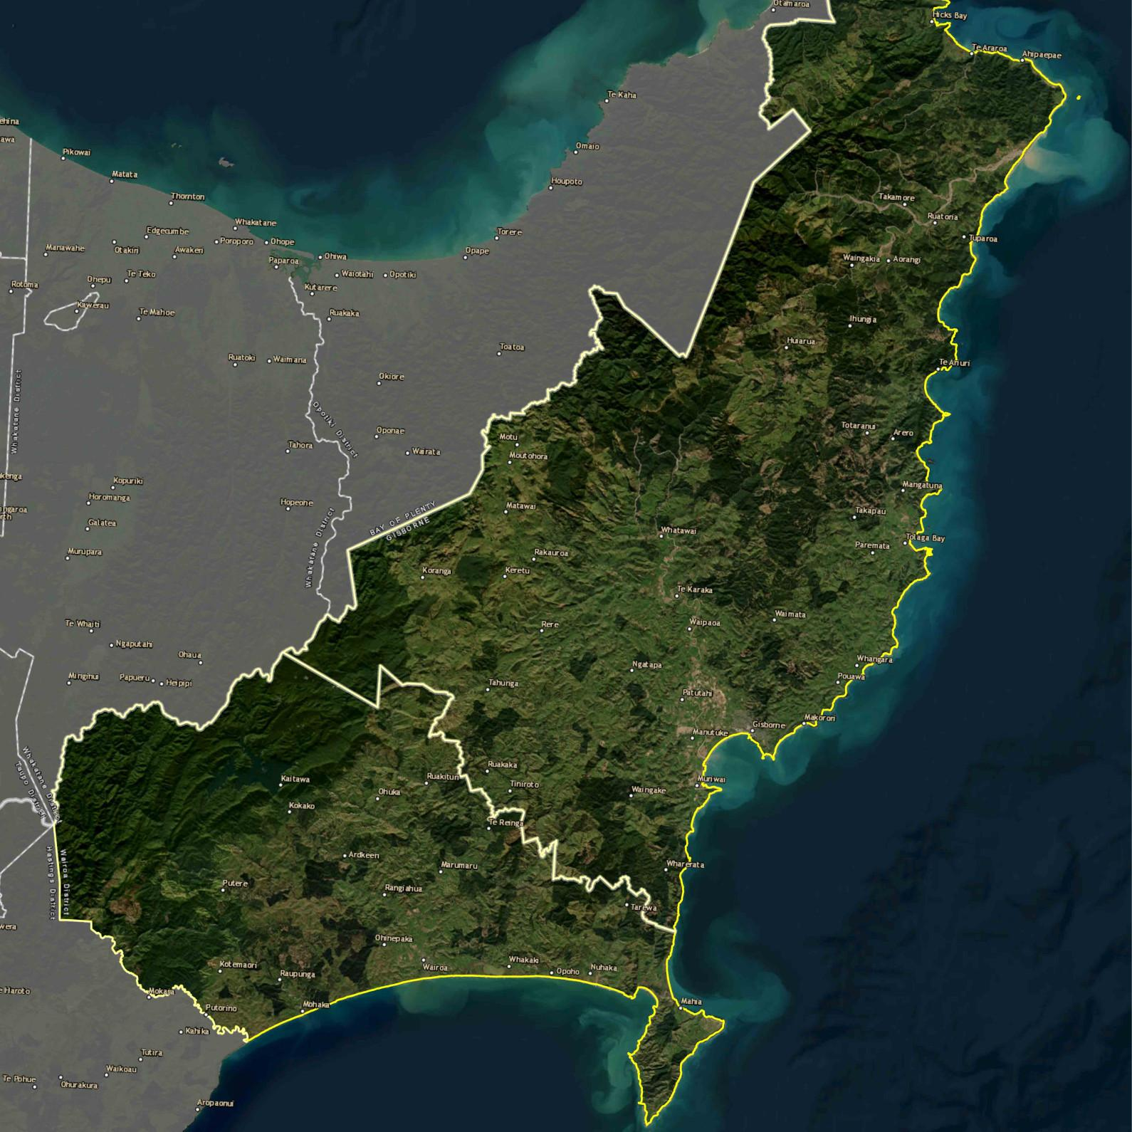
What we do / Benefits
1. Remove and Clean Up Slash
2. Repurpose Slash
3. Climate Change Mitigation
4. Heal Eroded and Flooded Land
5. Protect Soil from Future Flooding and Erosion
6. Make Clean Cooking Fuel
7. Provide Job Training Opportunities and Full Time Employment Opportunities
8. Heal the Land and Heal the Whanau

Slide 7
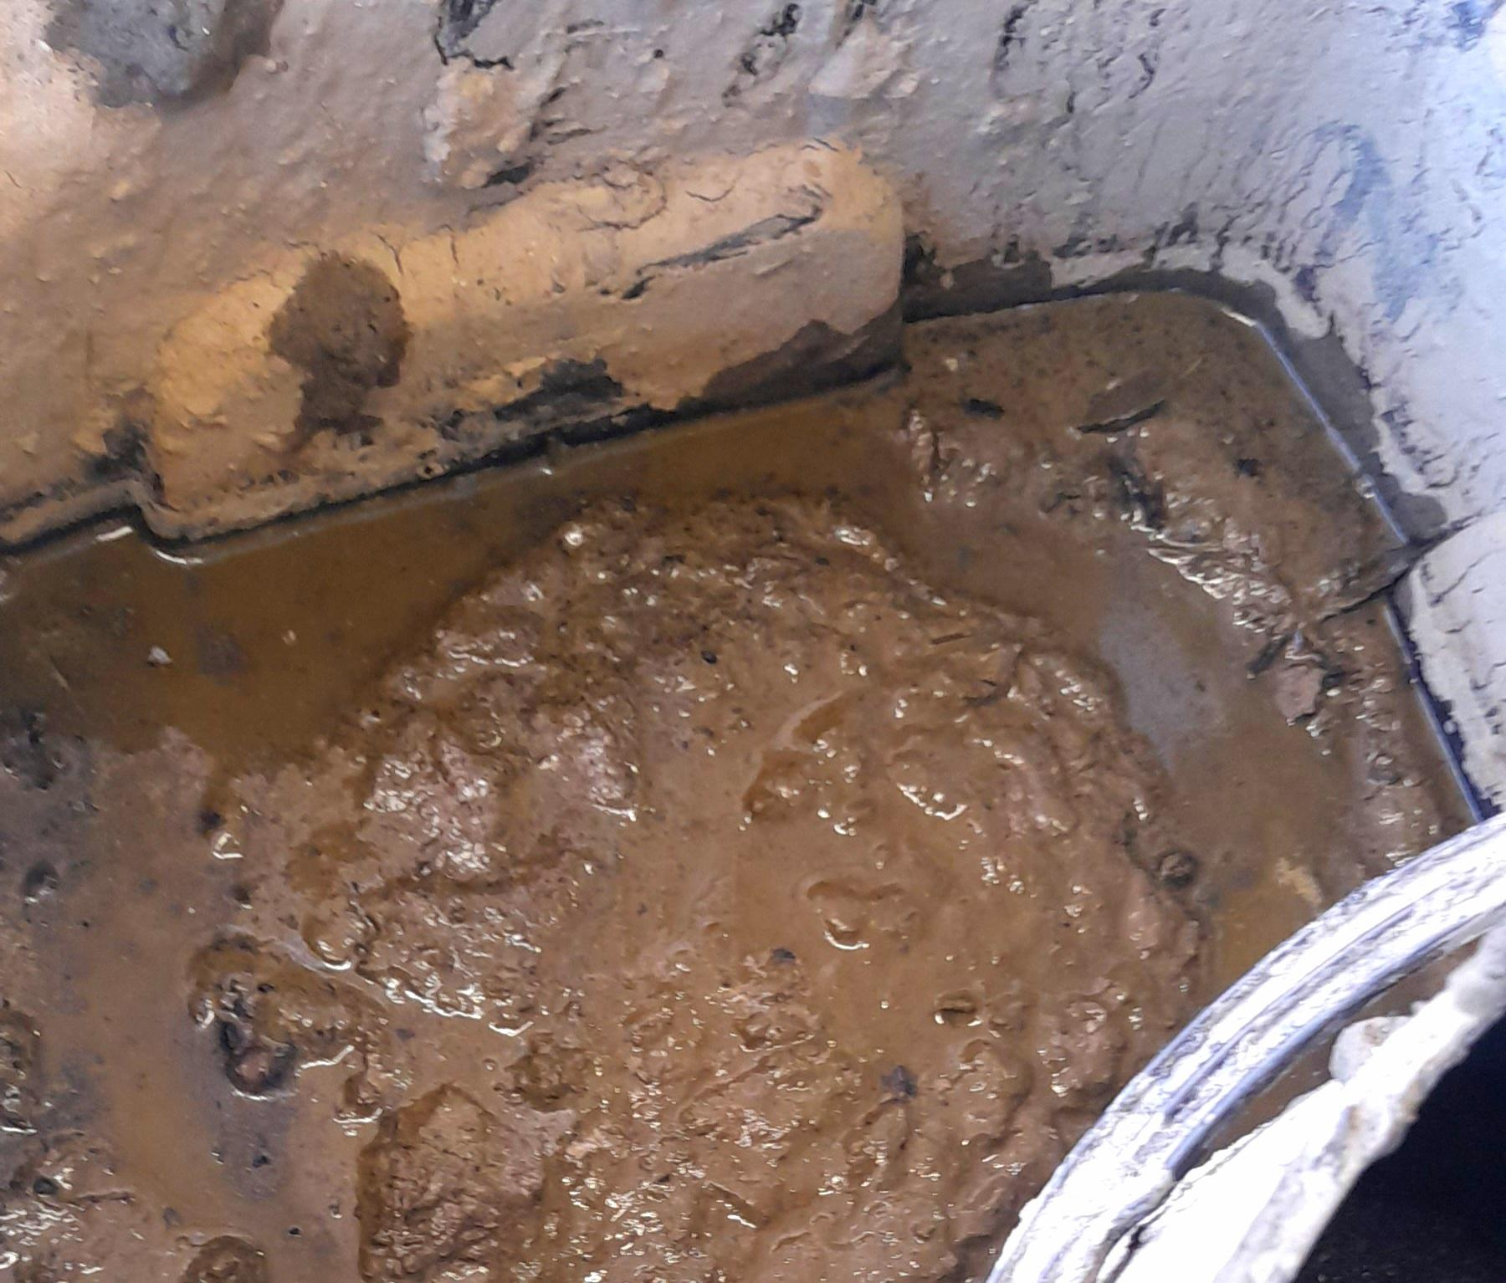
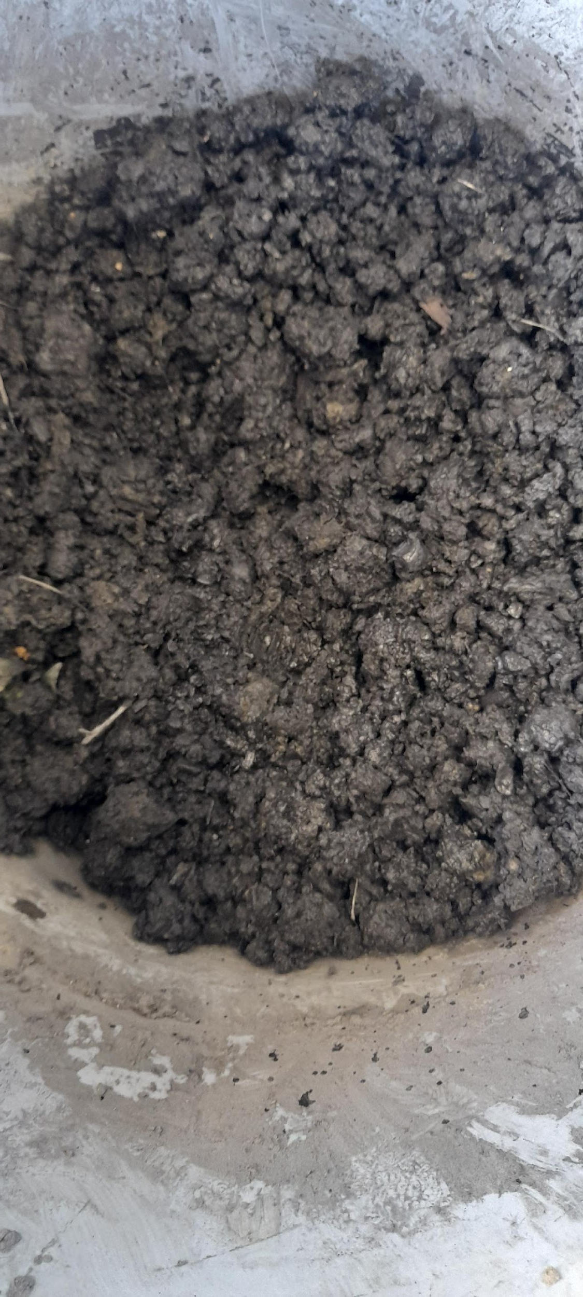
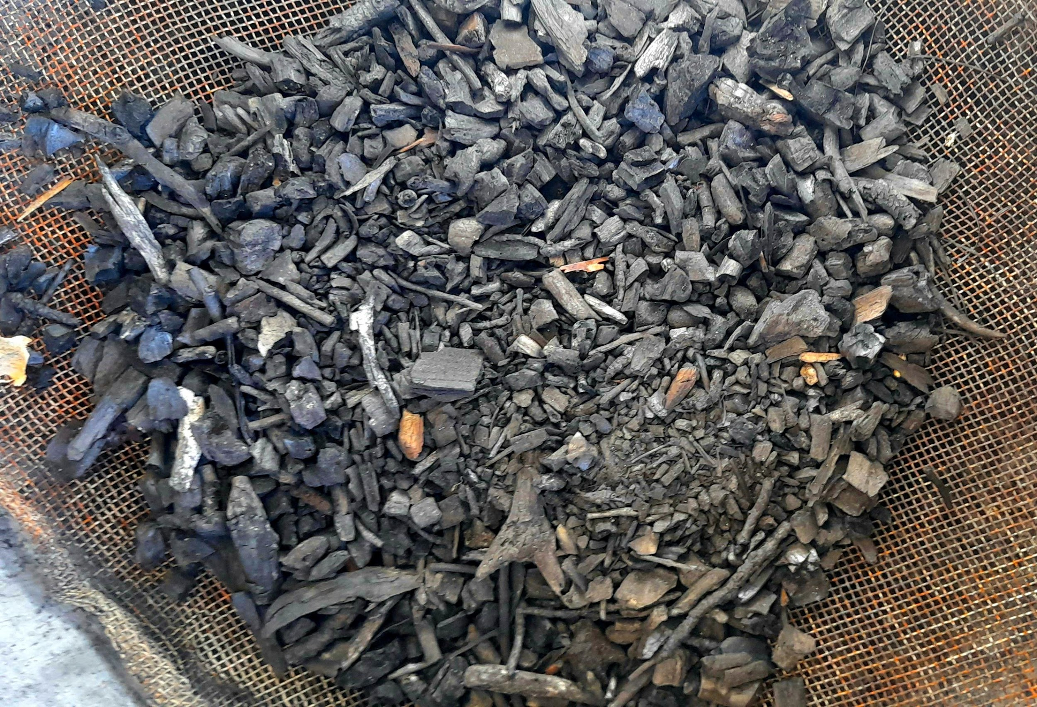
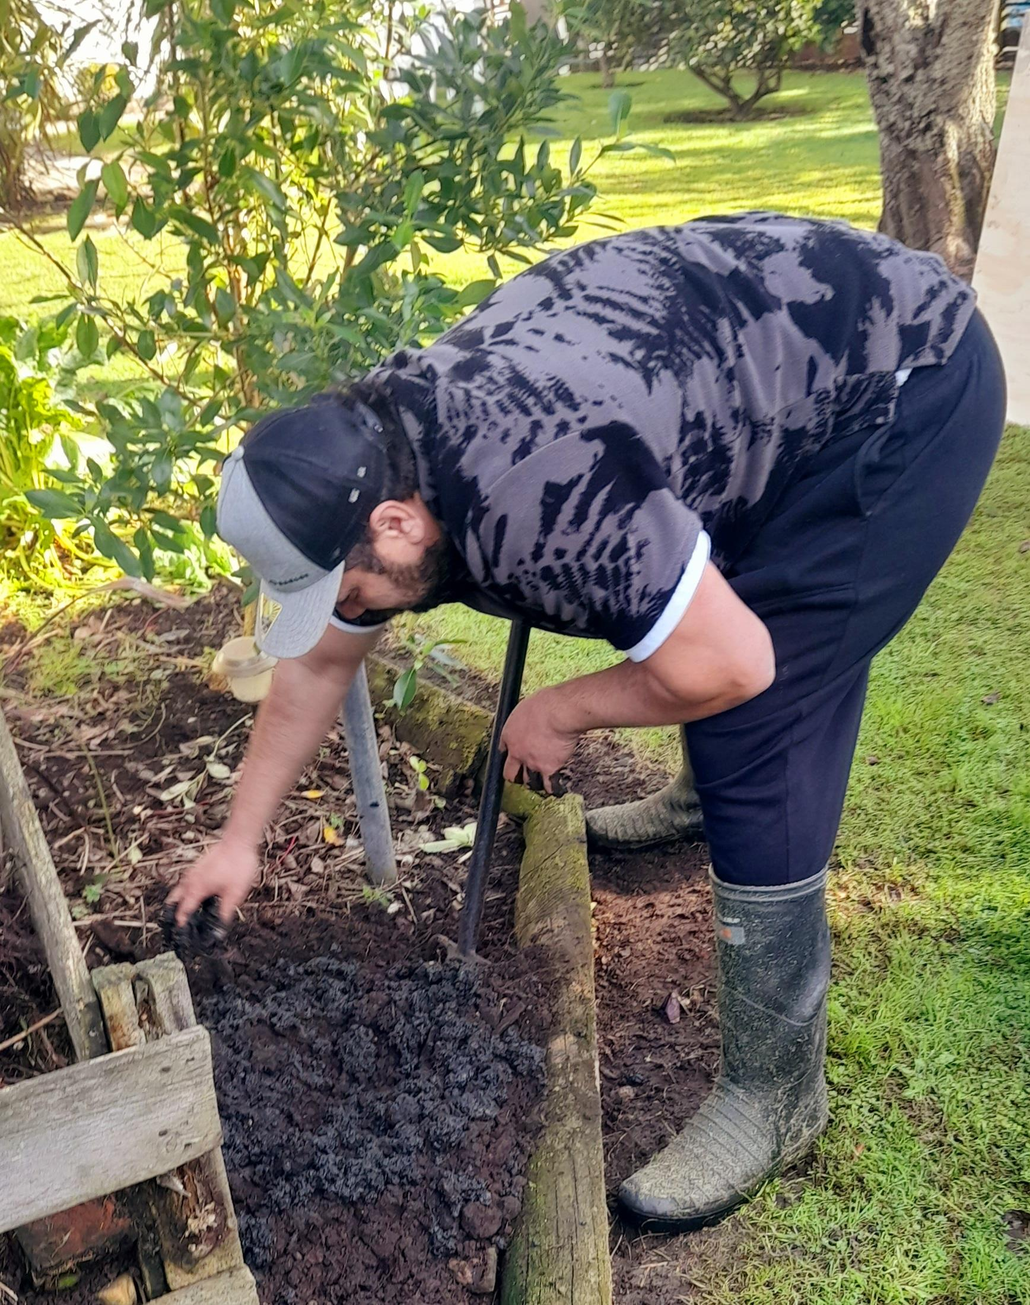
Organic Biochar Fertilizer

Slide 8
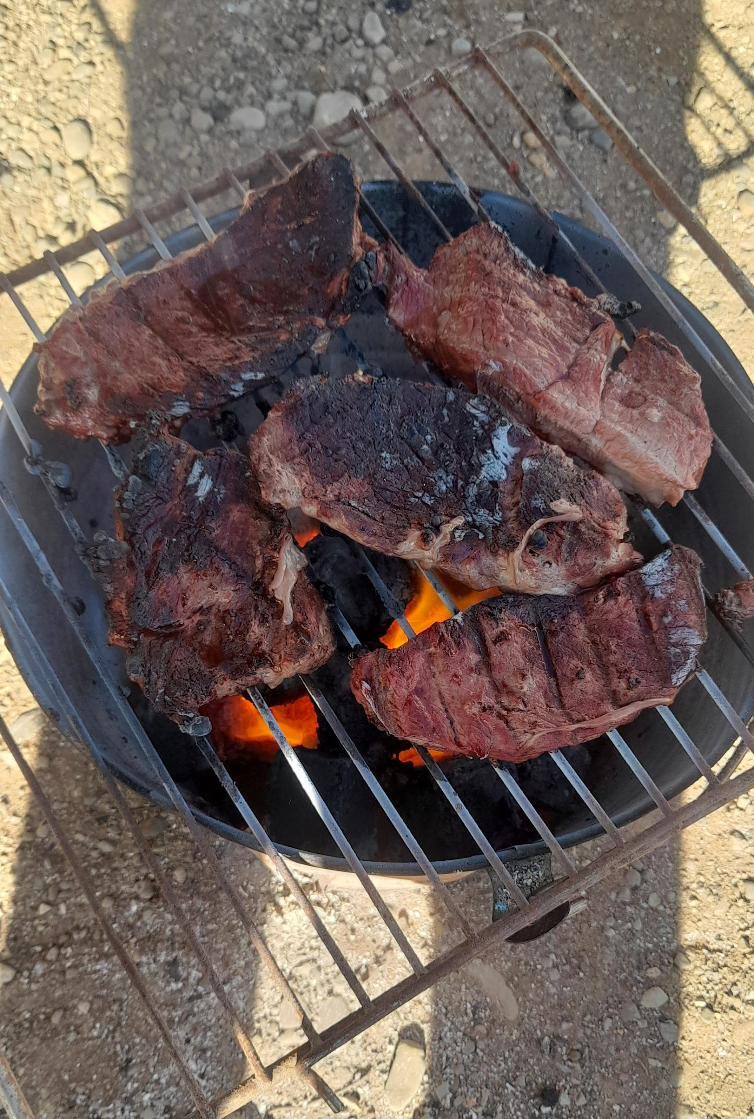
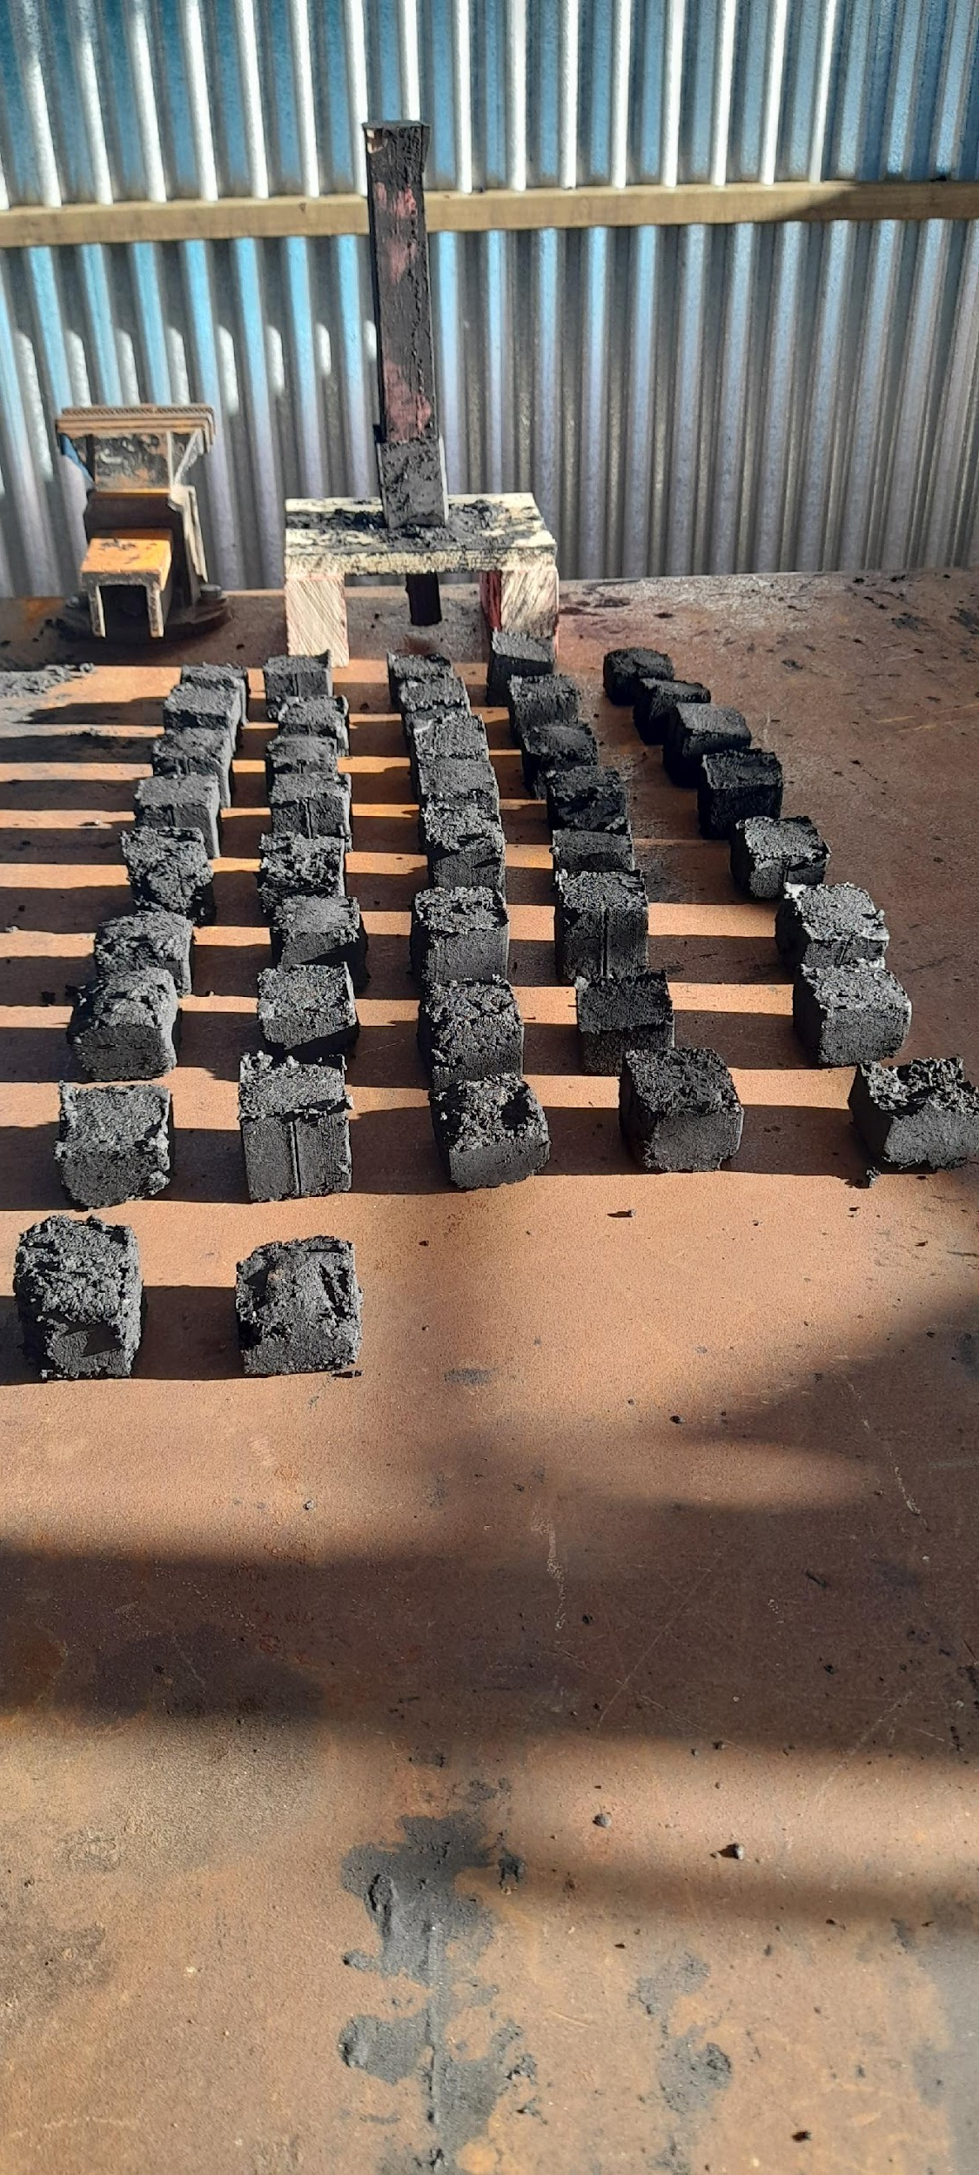
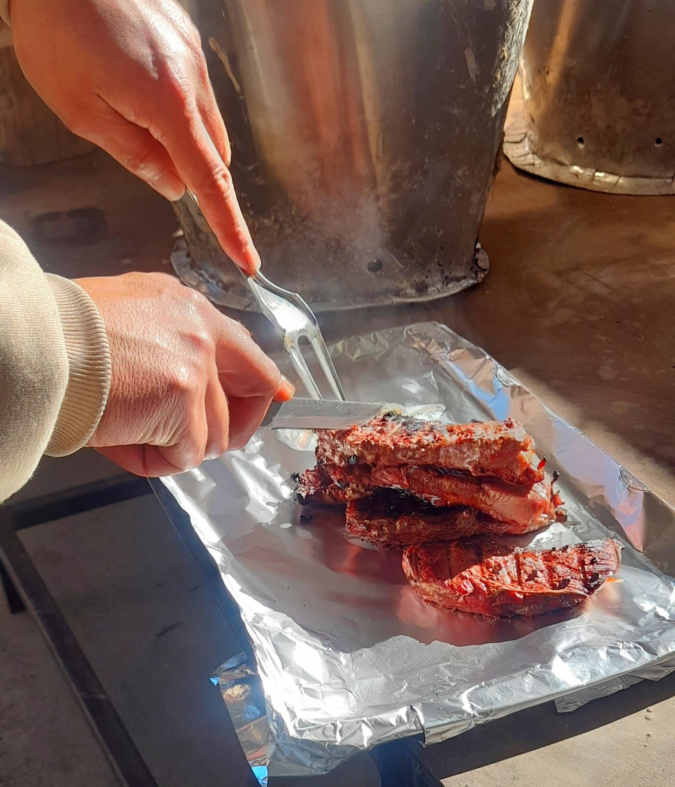
Smokeless Charcoal Briquettes

Slide 9
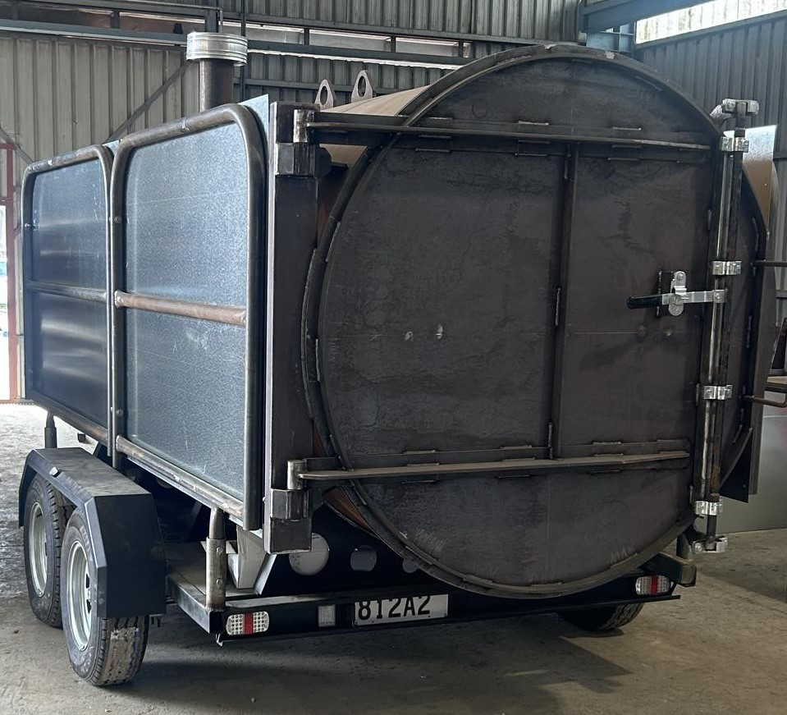
Service offered to the community:
1. Slash Carbonization Only (Incineration/Burning) - 109 NZD per tonne.
2. One Year Job Readiness Training Programme (Fully Subsidized)
Products offered to the community:
1. Organic Biochar Fertilizer (Bulk) - $NZ435 per 5 tonnes.
2. Organic Biochar Fertilizer (Small)- $NZ90 per 20 kg Hessian Bag.
3. Plain Biochar (Small)- $NZ30 per 20 kg Hessian Bag.
4. Smokeless Charcoal Briquettes – $NZ40 per 10 kg Carton Box.

Slide 10
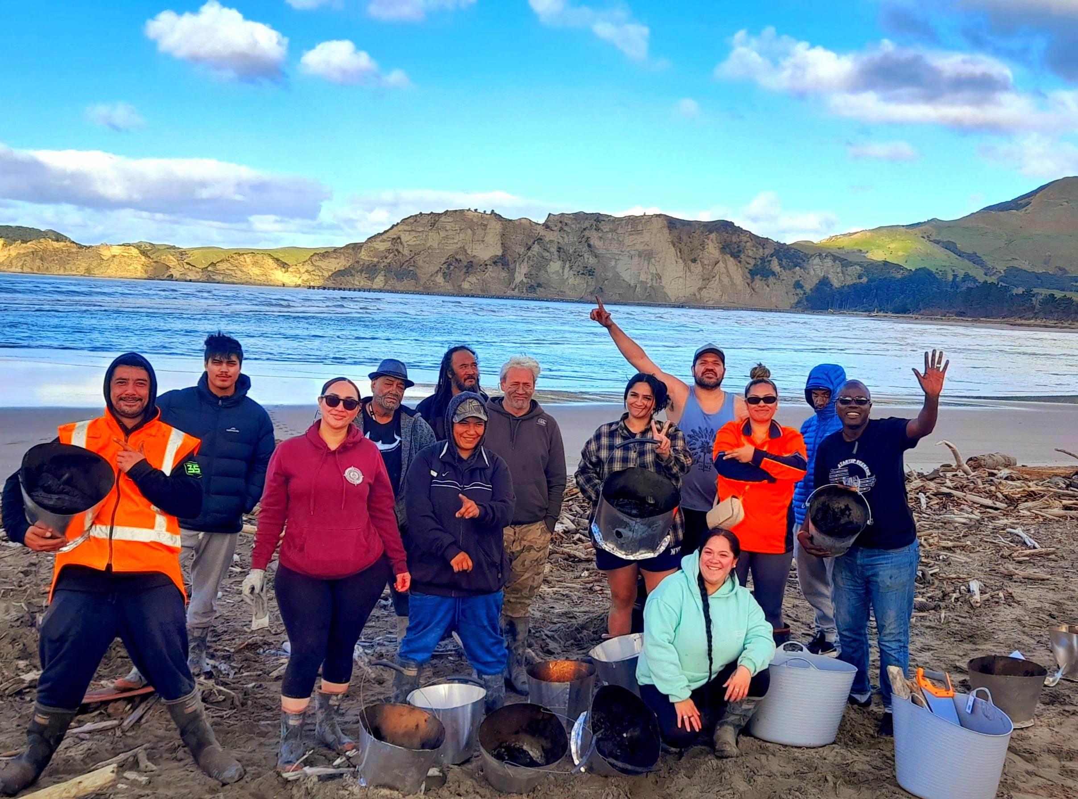
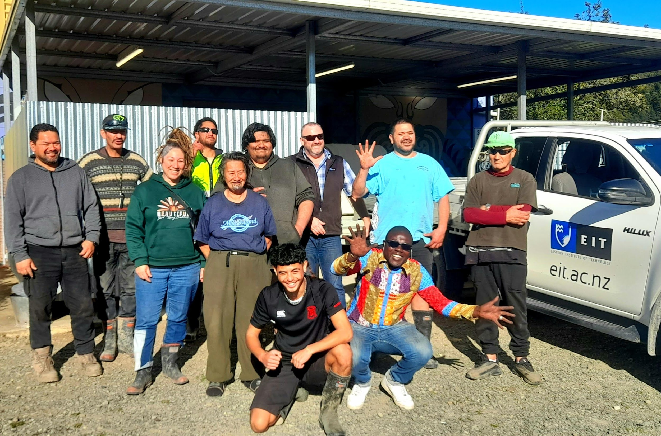
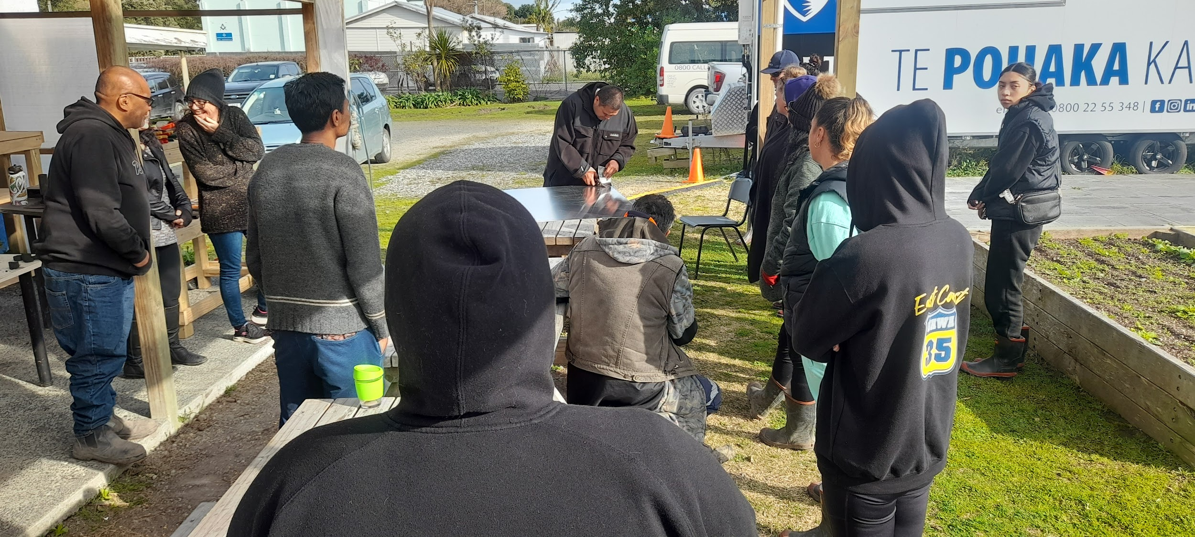
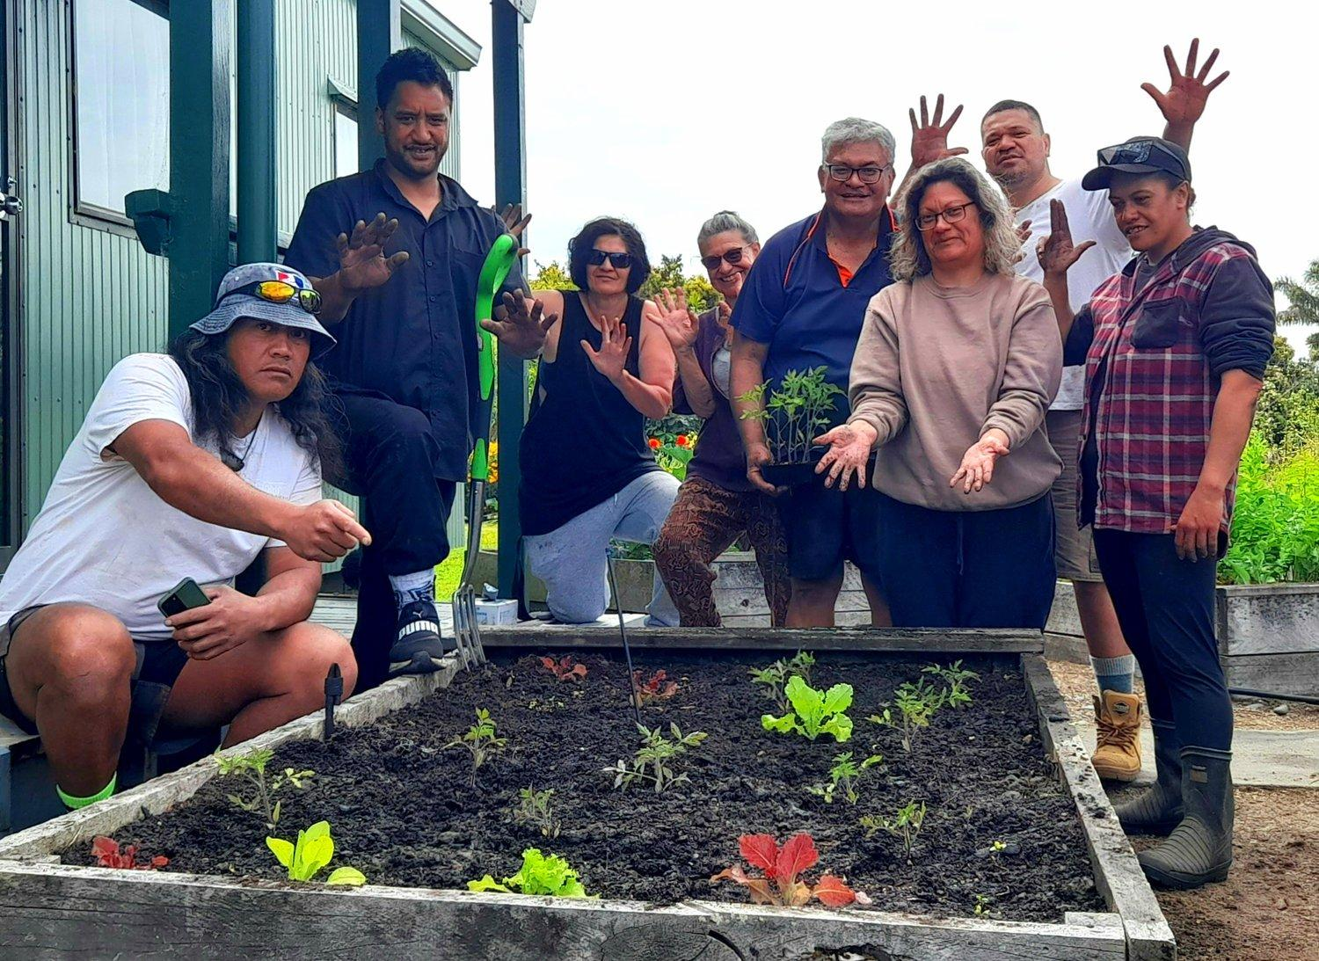
2023 EIT ACE Course
Trainees
Tolaga Bay Community Training
Ruatoria, Tikitiki, Waipiro Bay and Te Aroa Community Training
Wairoa Community Training
Gisborne Community Training

Slide 11
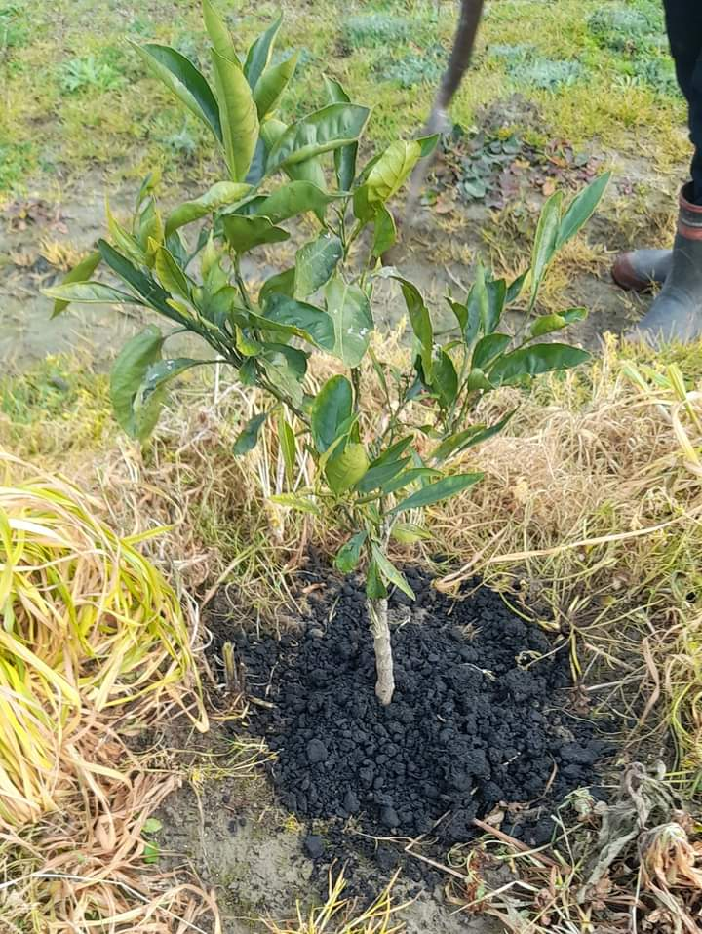
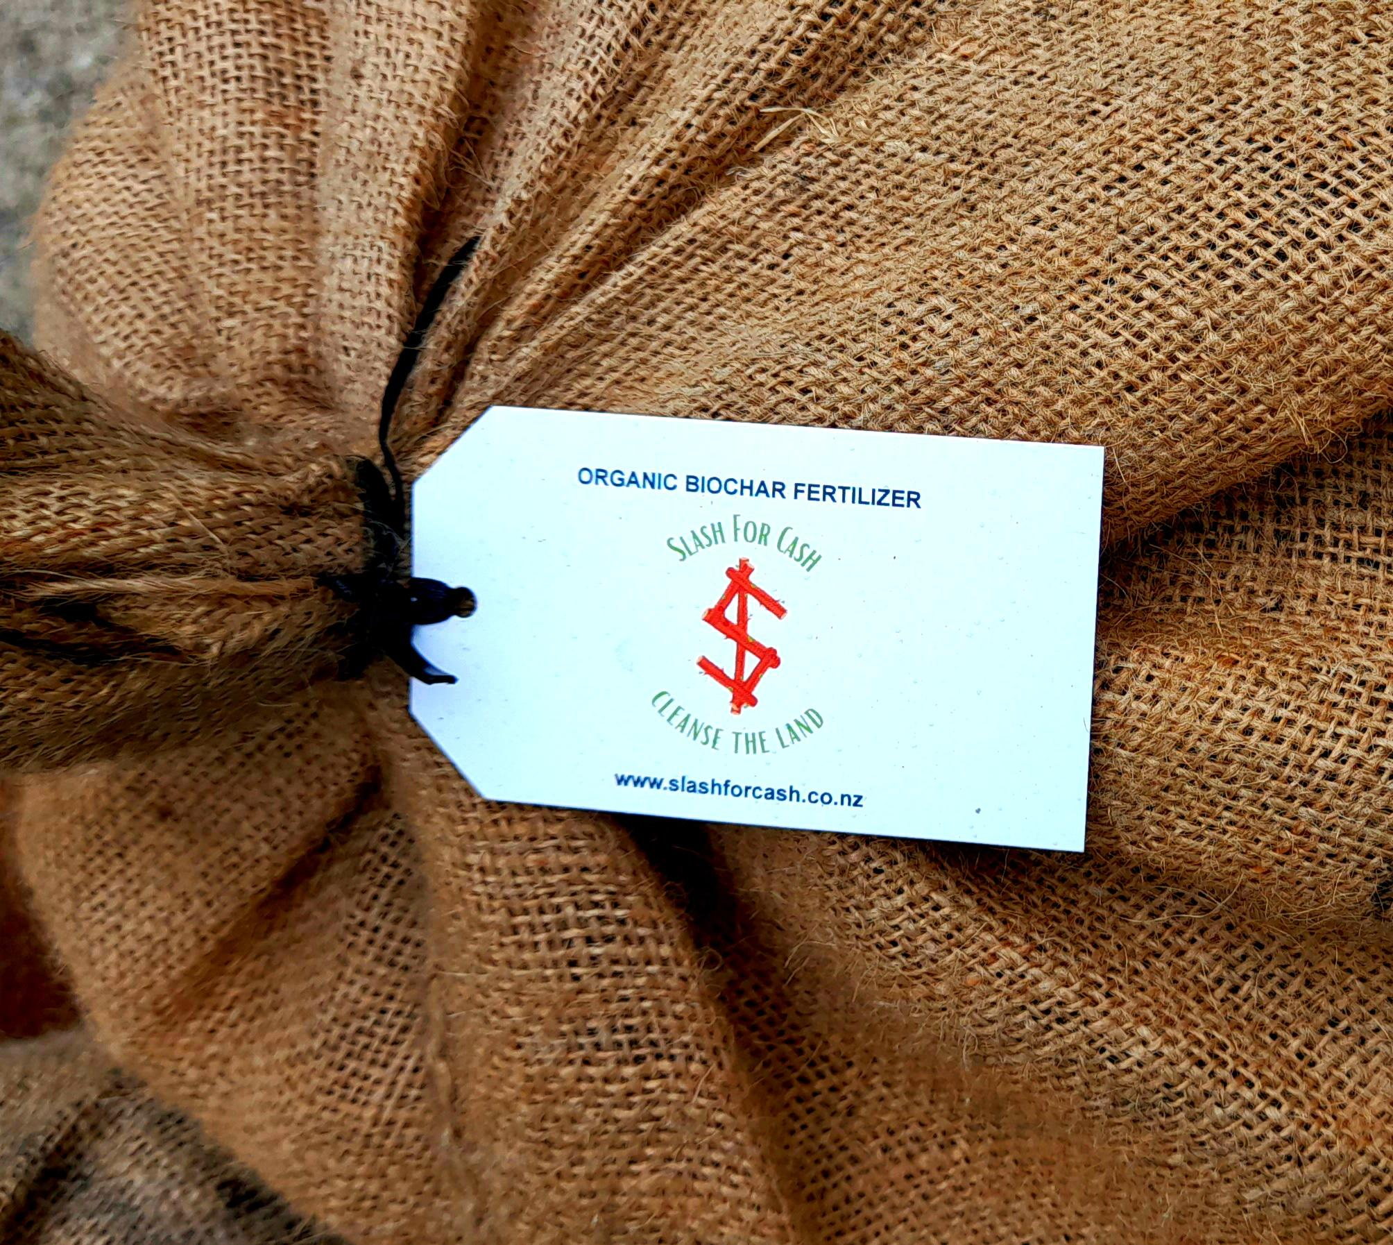
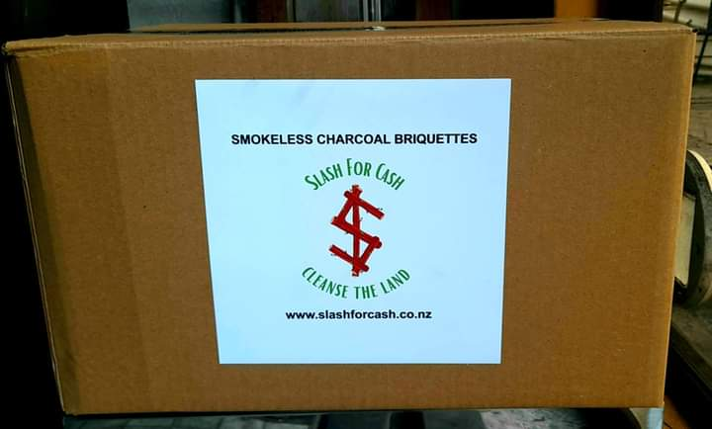
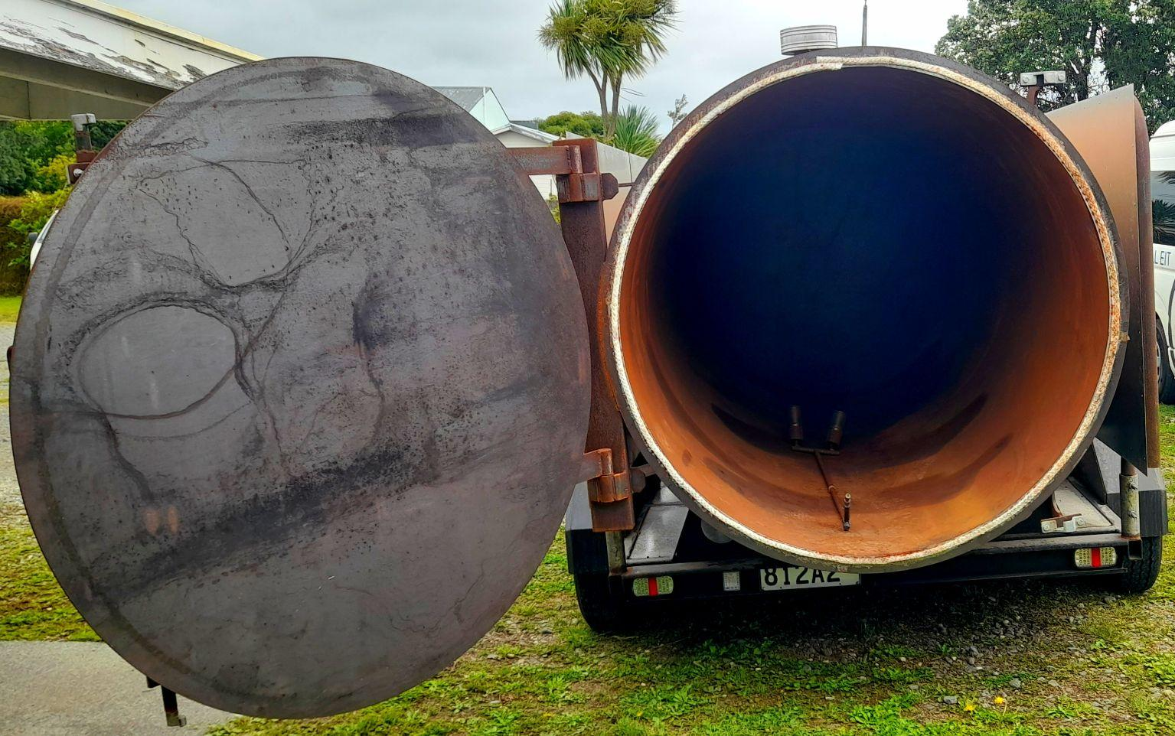
Potential Clients in the Community
1. Whenua Maori Land Blocks / Incorporations /Ahu Whenua Land Blocks / Homesteads
2. Public (councils) and Private landowners
3. Commercial Farm Landowners (commercial farmers, vineyards and orchards)
4. Forestry Woodlot Landowners
5. School Gardens and Community Gardens/Nurseries
6. Individuals and Organisations
7. Retail Outlets

Slide 12





Compliance Checklist
Slash for Cash registered as a social enterprise on the NZBN registry.
Kiln designed and manufactured in line with NZ engineering standards by
Thabiso and Supreme Engineering
Mobile Kiln Intellectual Property protected Supreme Engineering.
Kiln Trailer registered with NZTA
Heavy metals test of our biochar done by SCION Research.
Health and Safety Audit, Policies, Regulations and Tools done by
JPJ & Associates
BS EN 1860-2:2005 International Standards test of our briquettes
done by SGS Wollongong Branch.
Air Quality Assessment and Environmental
Effects Report of our mobile kiln use done by

Slide 13
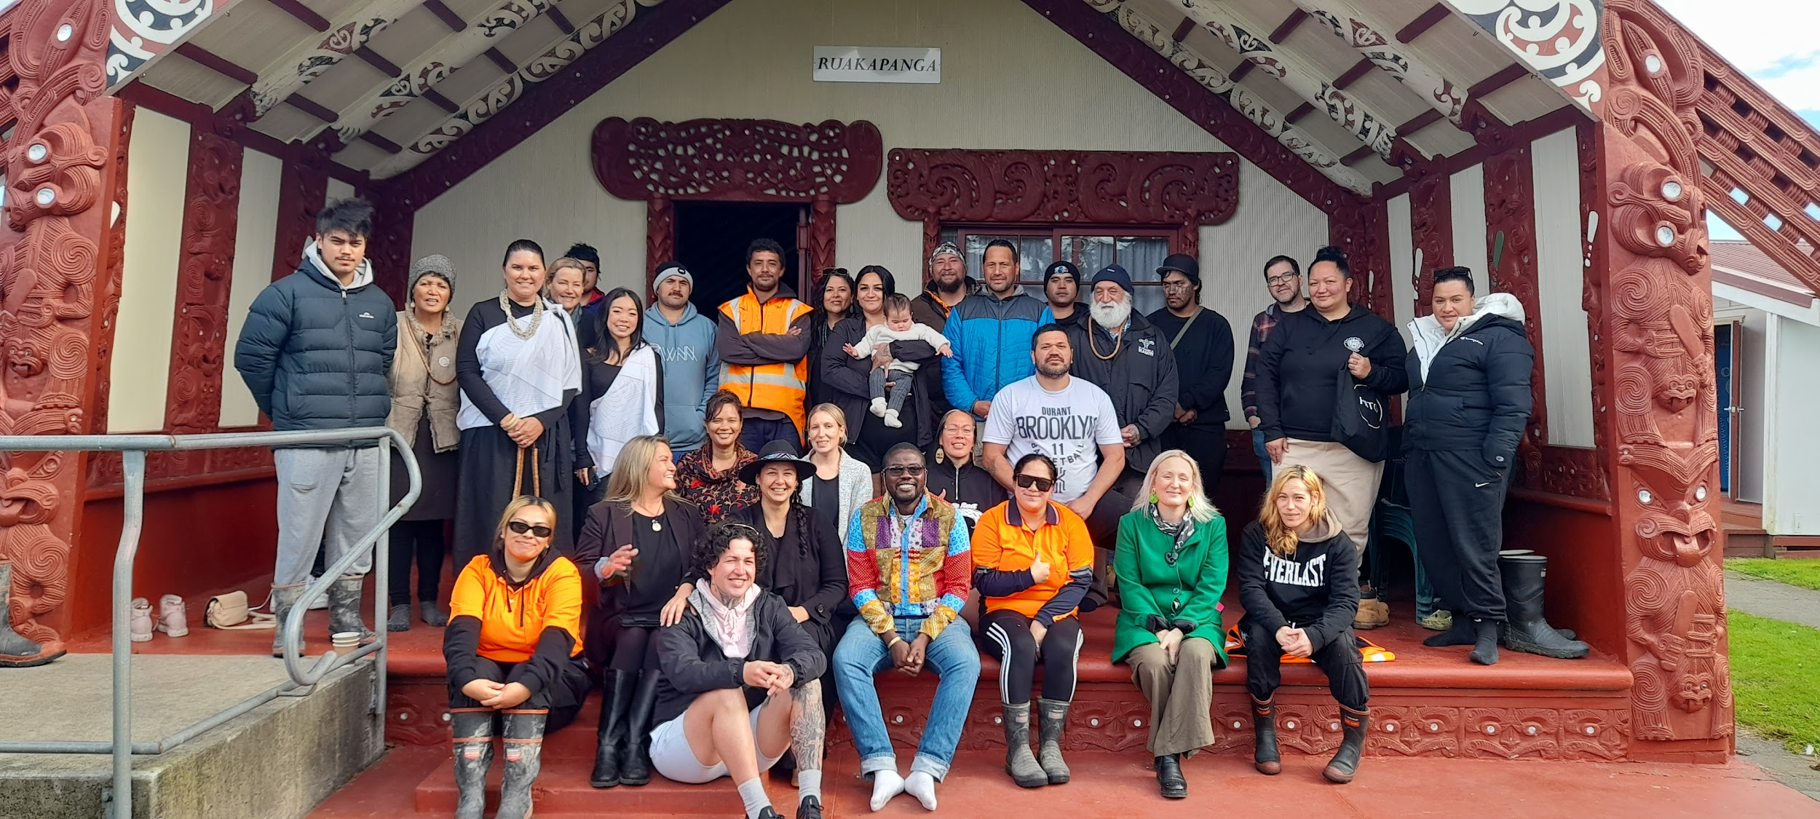







Community Support and Ongoing Work
Full endorsement and support from Te Aitanga a Hauiti Centre of Excellence Trust.
Full endorsement and support from Te Aitanga a Hauiti Iwi, Hauiti Marae and the Tolaga Bay Community.
Support from the Tolaga Bay Heritage Charitable Trust, Taiki E!, Radice Soil Solutions, Supreme Engineering, Eastern institute of Technology, The Good Carbon Farm, Department of Internal Affairs and The Eastern and Central Community Trust.
Consulting and getting support from other Iwi and Hapu in the Tairawhiti and Wairoa Region to process resource consent application for discretionary air discharge permit.
Working with Gisborne District Council and Hawkes Bay Regional Council to process resource consent application and get discretionary air discharge permit.
Currently running the 2025 One Year Job Readiness Training for 7 Tolaga Bay trainees, 6 Ruatoria trainees, 9 Wairoa trainees and building Kilns number 2 and 3.

Slide 14
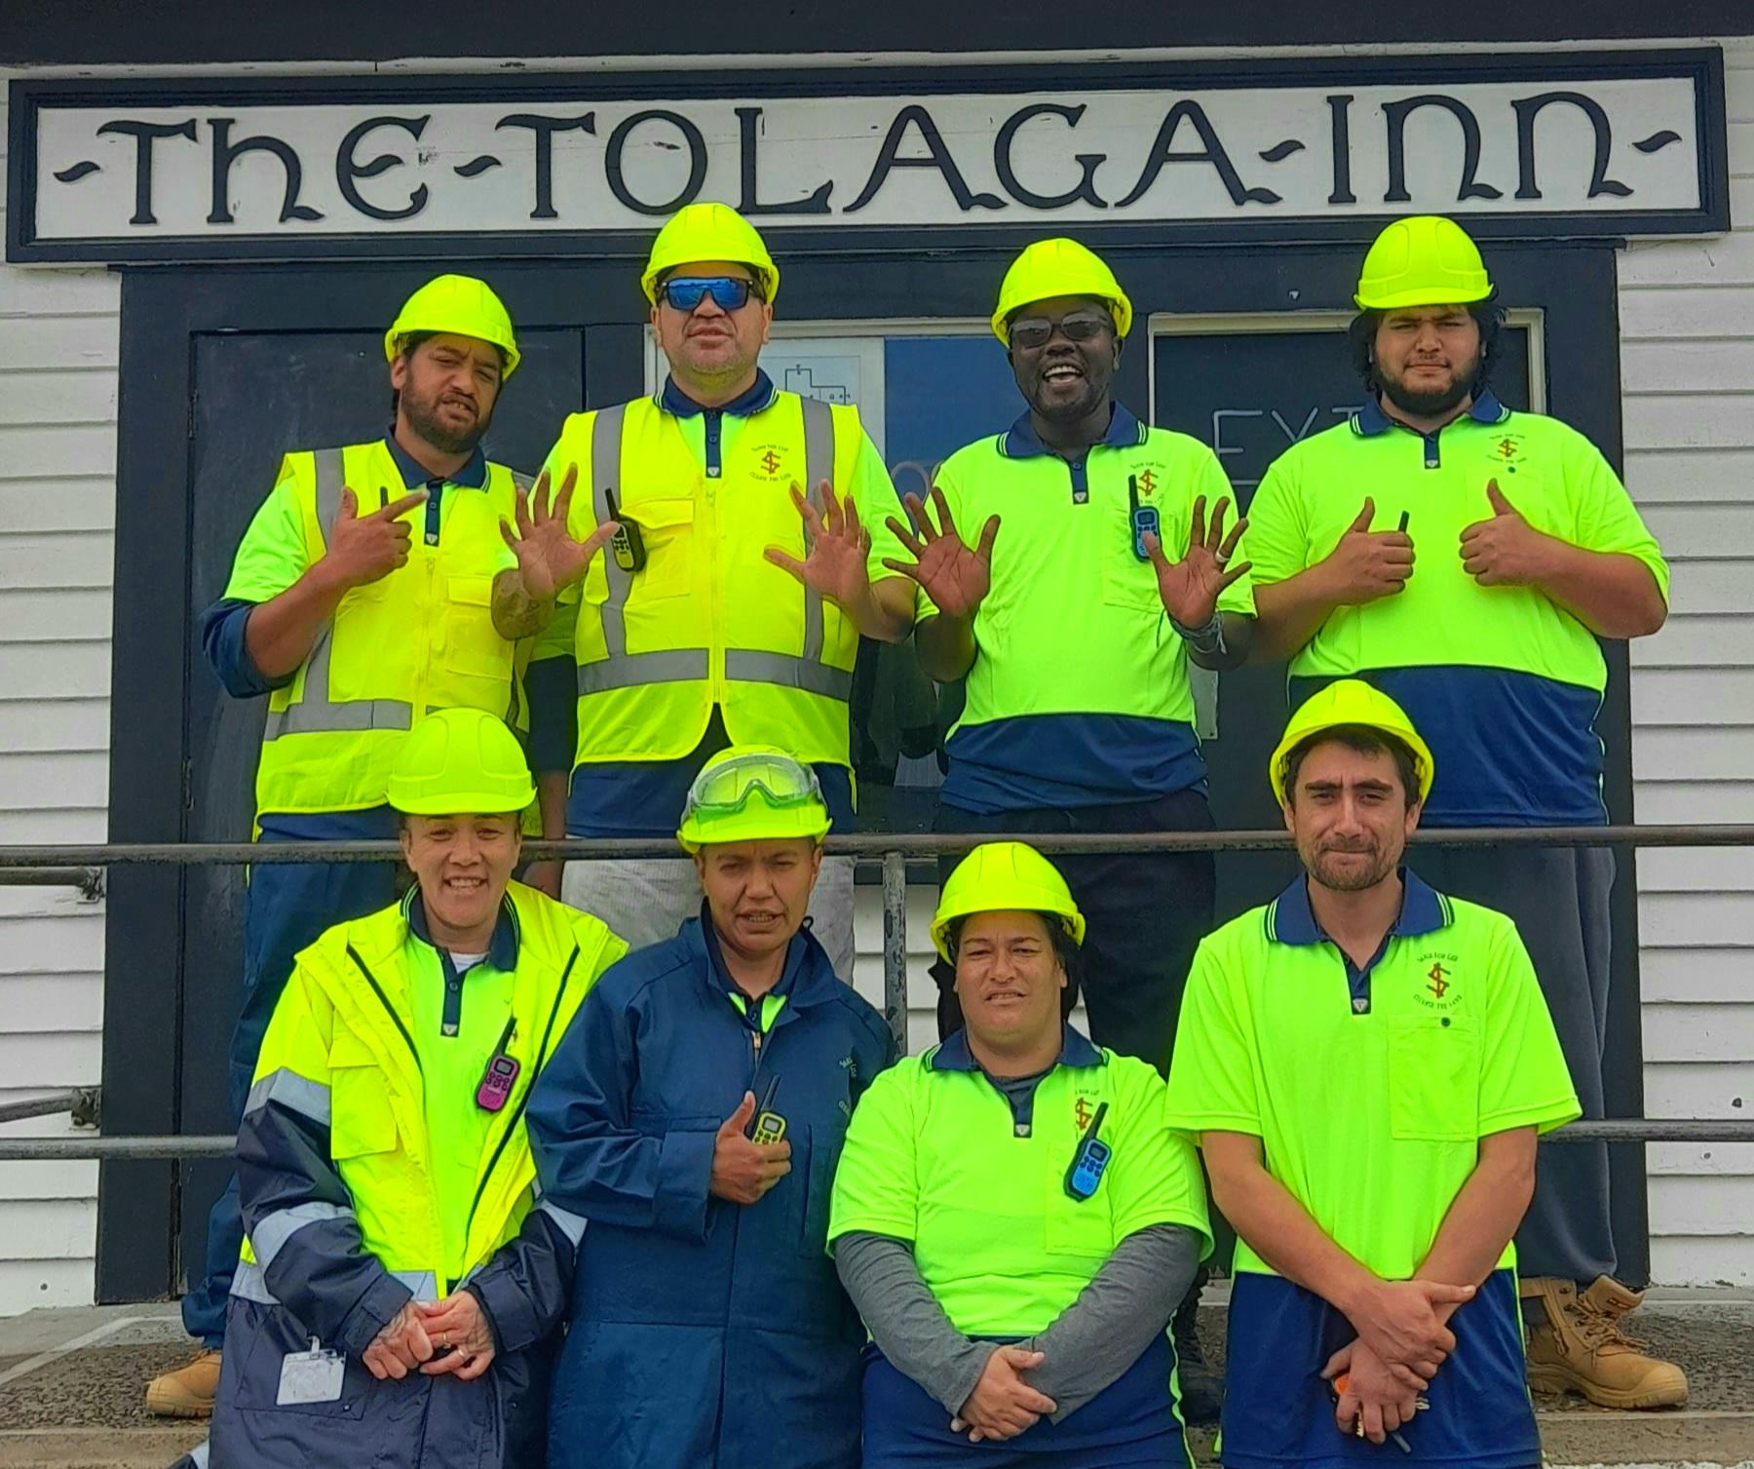
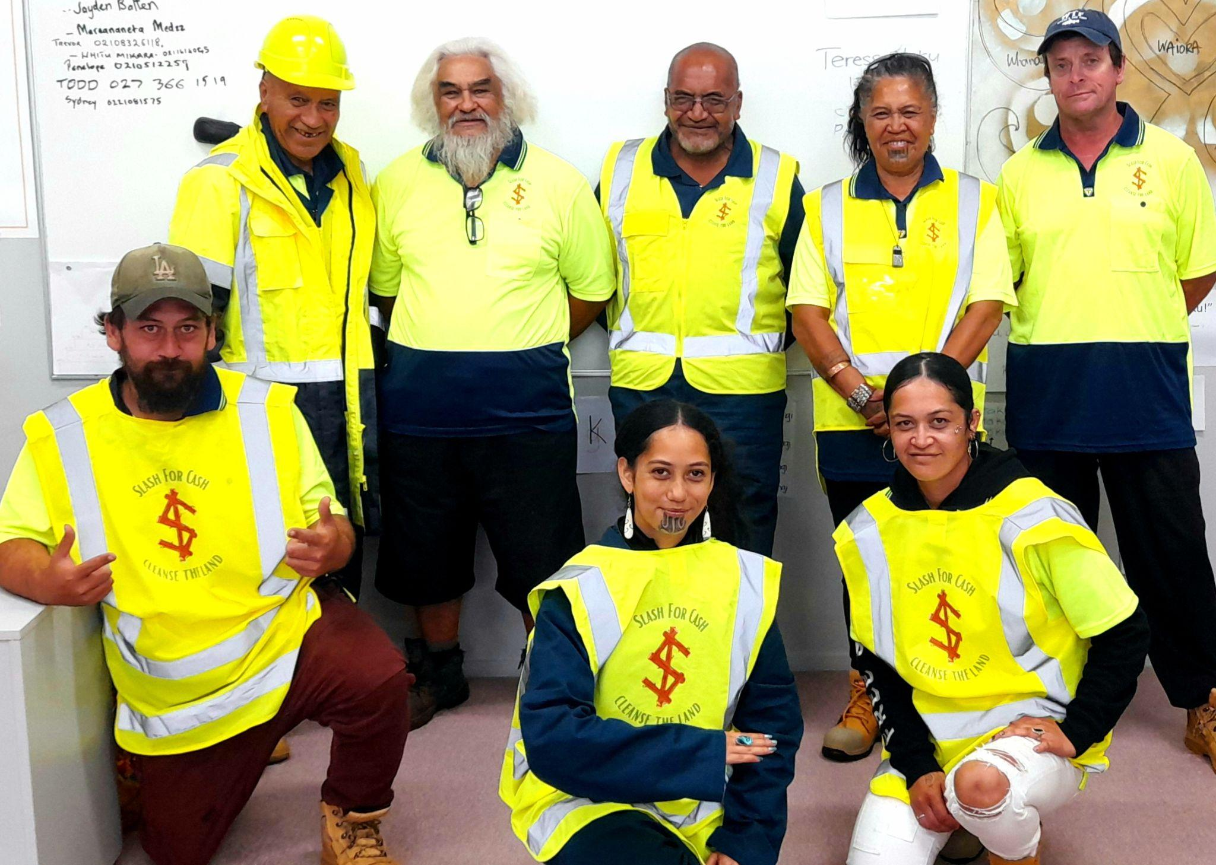
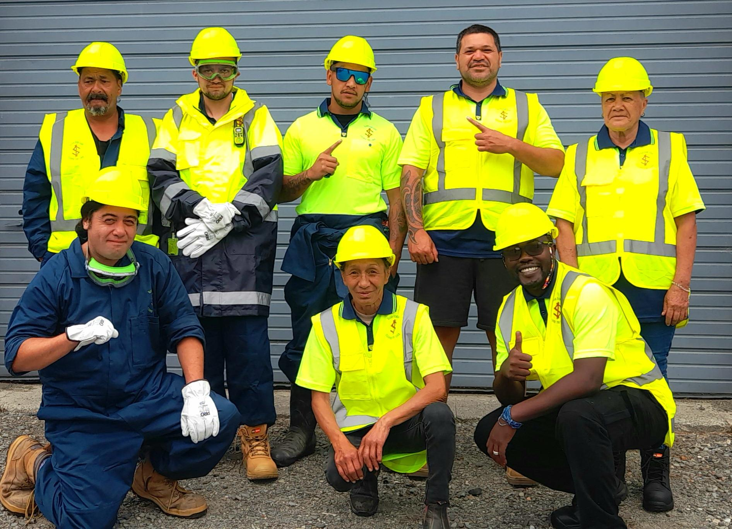
2025 One Year Job Readiness Training
Digital Literacy and Public Speaking Skills
Health & Safety Training
First Aid Training
Wairoa Trainees
Uawa Trainees
Community Development Tools, Skills and Network
Traditional Marketing, Digital Marketing and Sales Skills
Administration and Report Writing Skills
Financial Literacy, Business Thinking & Networking Skills
Solar Technologies
Biochar for Commercial Production Techniques and Skills
Commercial Production Skills
Ruatoria Trainees

Slide 15
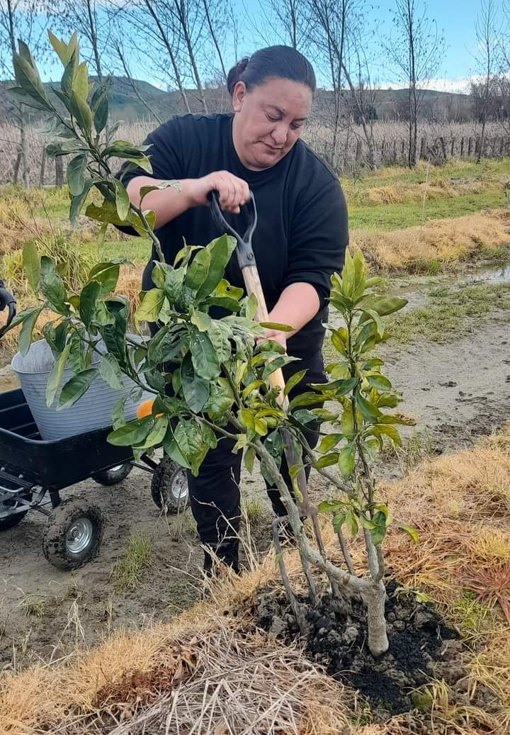
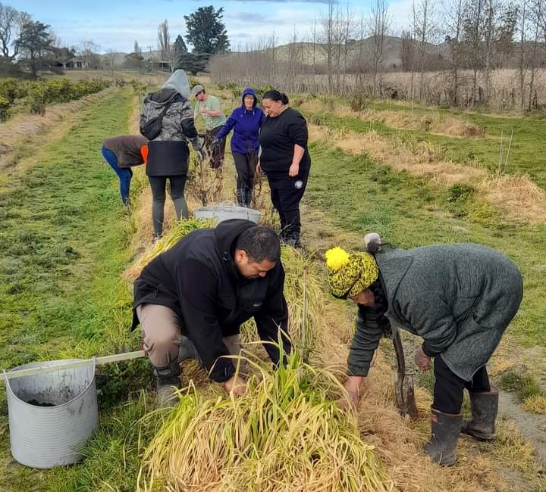
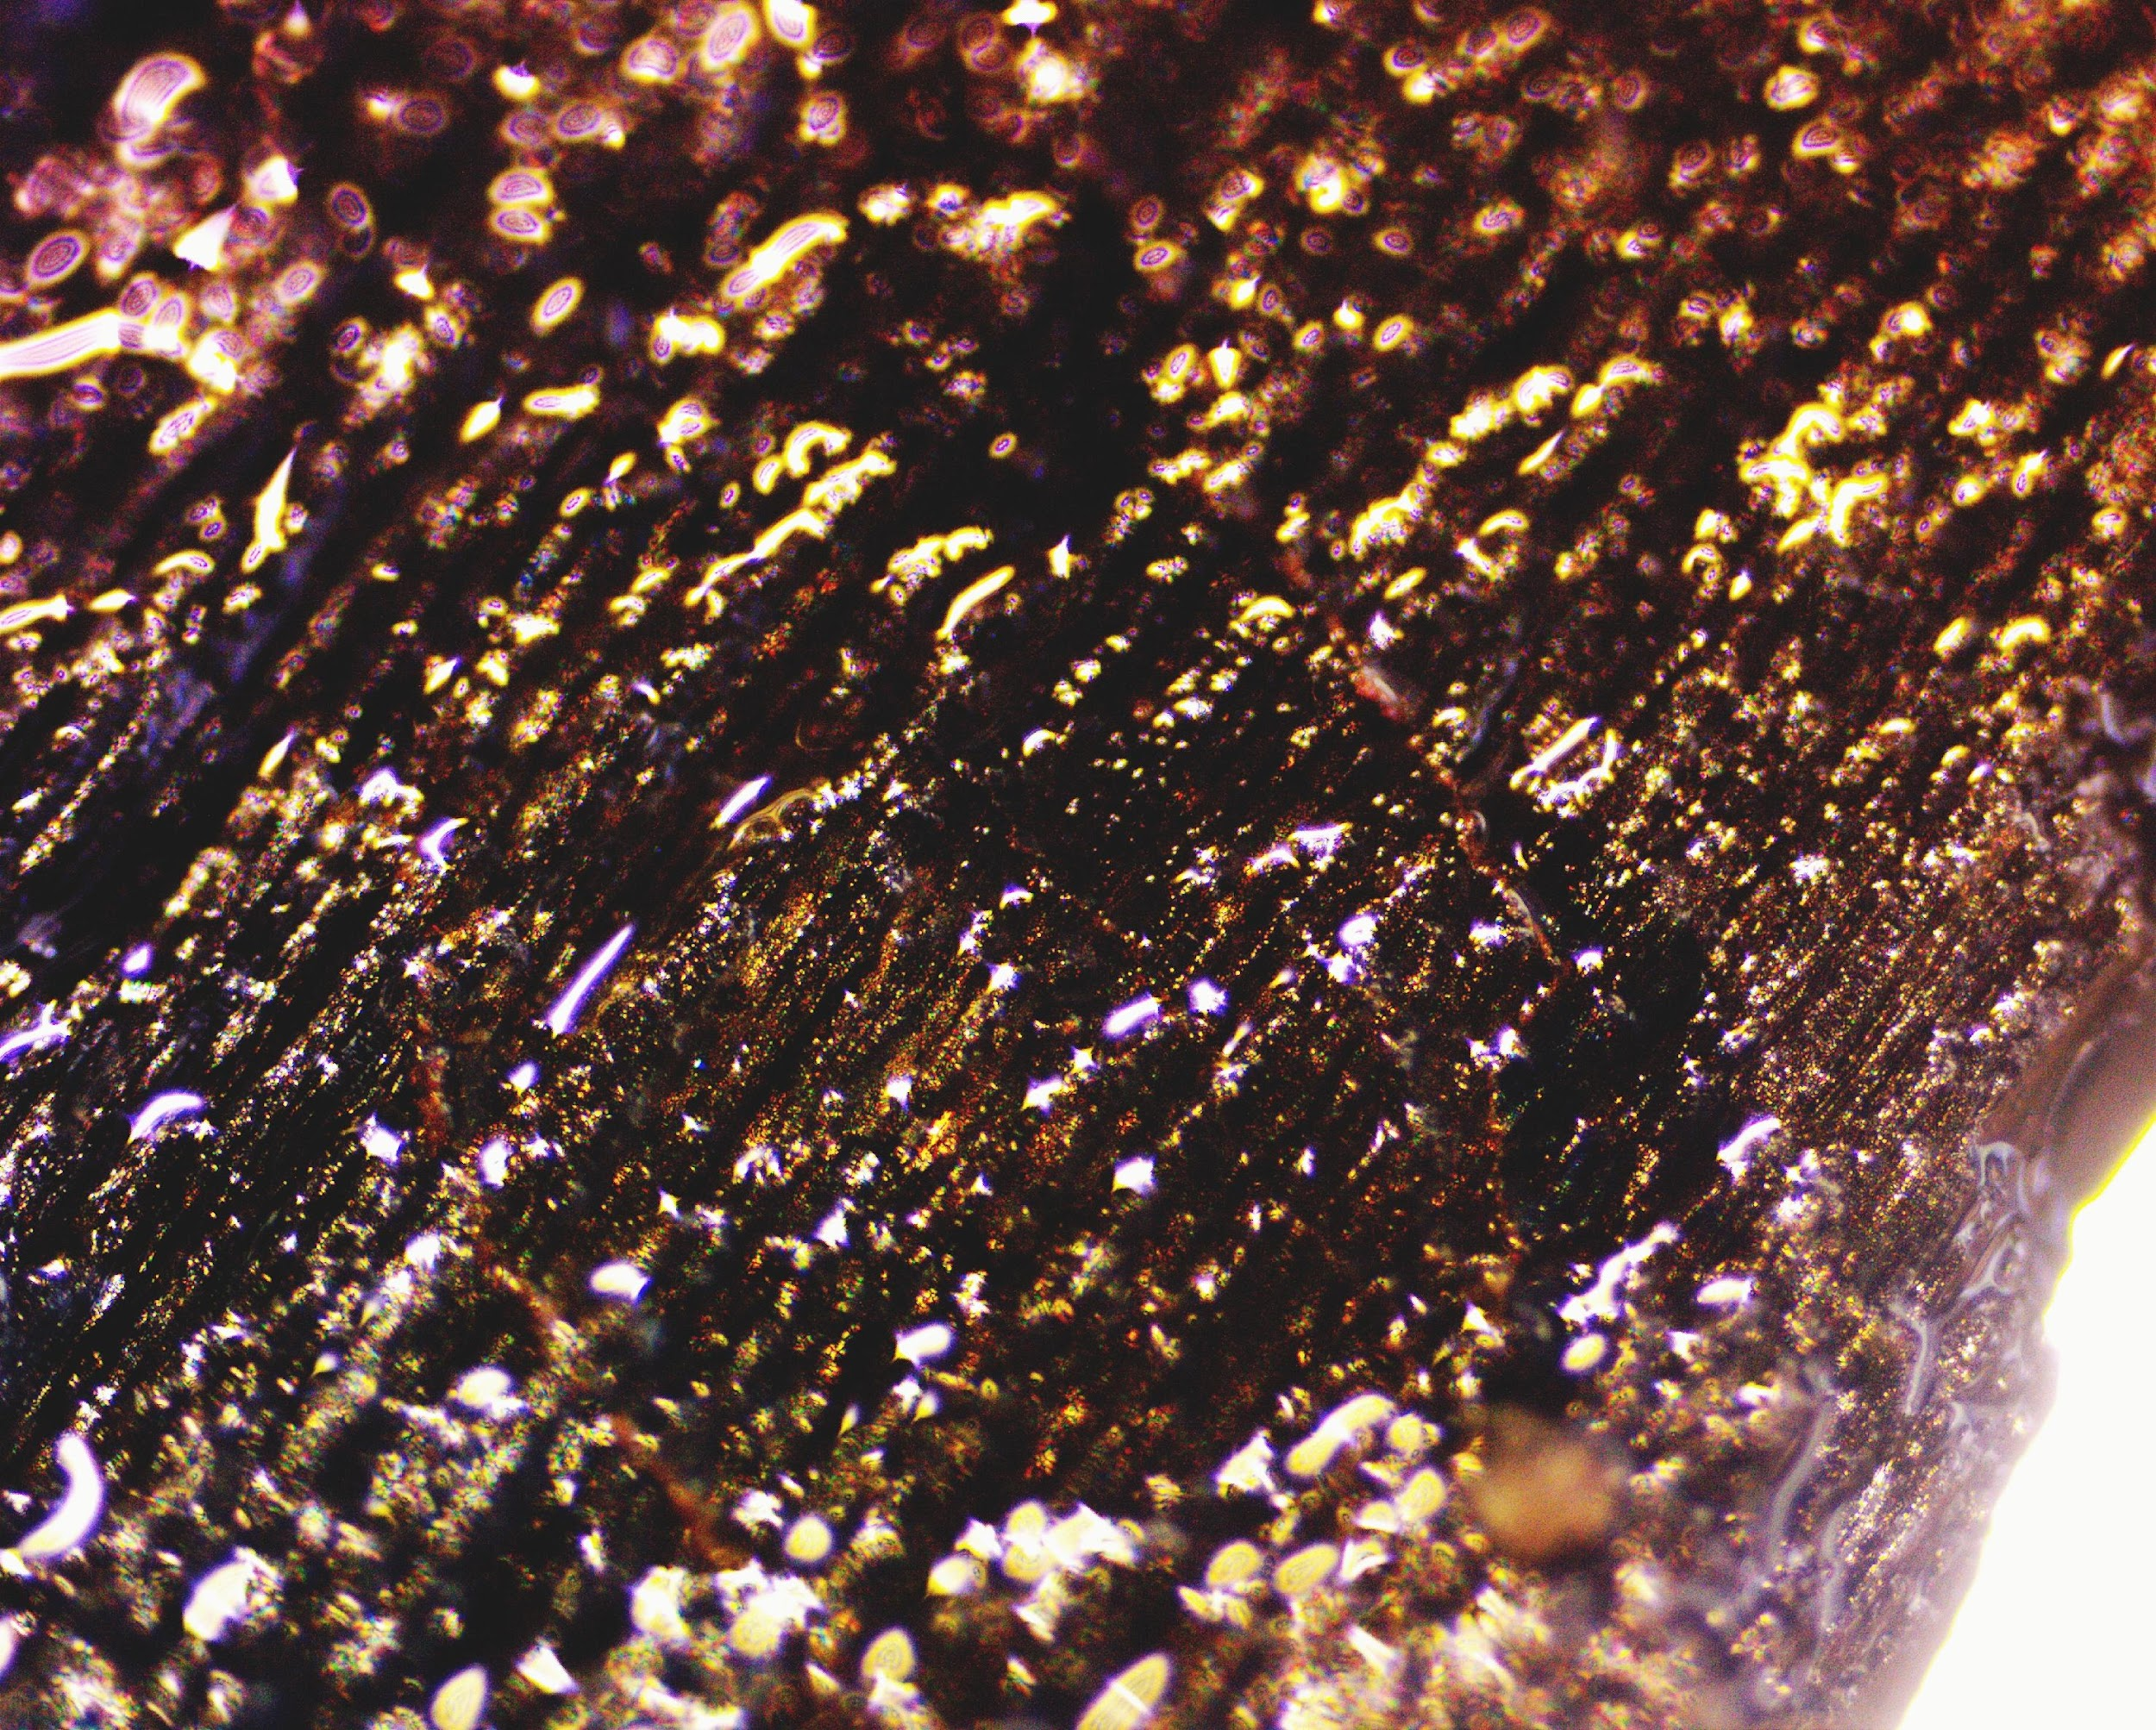
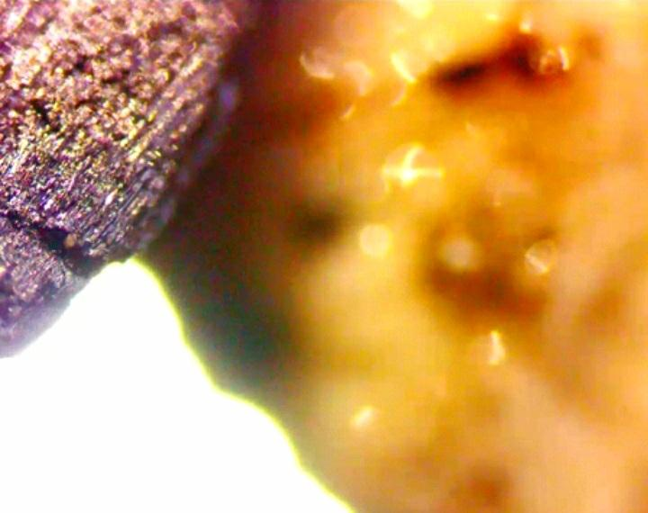
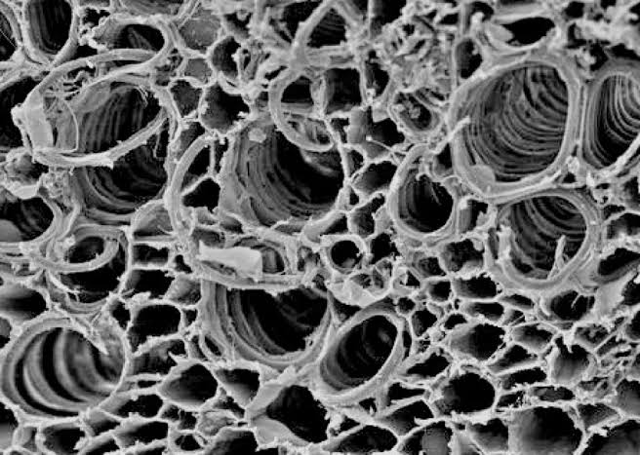
Our Potential Impact and Ask
● Potential to clean up a total of 360 tonnes of the available Slash between April and May
2025, producing a total 60 tonnes of biochar at each of our 3 sites being Tolaga Bay, Ruatoria,and Wairoa.
● Potential to clean up a total of 360 tonnes of the available Slash between May and June 2025, producing a total 60 tonnes of biochar at each of our 3 sites being Tolaga Bay, Ruatoria,and Wairoa.
● Potential to clean up a total of 1440 tonnes of the available Slash the 4 months of July, August, October and November 2025 , producing a total of 240 tonnes of biochar at each of our 3 sites being Tolaga Bay, Ruatoria,and Wairoa.
● Potential to create 23 Full Time Employment Opportunities in Tolaga Bay (8), Ruatoria (6),and Wairoa (9) from 2026.
● Potential to clean up a total of 4320 tonnes of the available Slash in 2026, producing a total 720 tonnes of biochar at each of our 3 sites being Tolaga Bay, Ruatoria,and Wairoa.
● Potential clients in Tairawhiti and Wairoa regions to pilot our services and products with in April, May, June, July, August, October and November 2025.
● Potential clients to engage us for our services and buy our products from 2026.

Slide 16
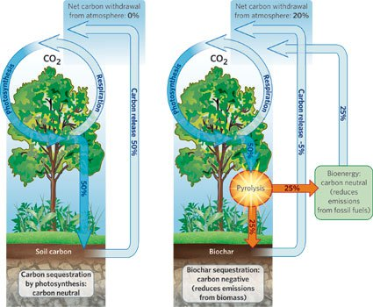
Alignment with SDGs
● Climate Action (SDG 13)
● No Poverty (SDG 1)
● Decent Work and Economic Growth (SDG 8)
● Reduced Inequalities (SDG 10).
Scalability and Replicability
● Services are designed to be replicated and sold across Tairawhiti region, Wairoa region, other parts of New Zealand and globally where there is a demand for our training and our innovative and intellectually protected mobile kiln to clean up slash or any other
carbon matter.
● Products are designed to be sold across Tairawhiti region, Wairoa region, other parts of New Zealand and globally where there is a need to heal and protect the land using our organic biochar fertilizer or a demand for our smokeless charcoal briquettes as an
alternative clean cooking fuel.

Slide 17
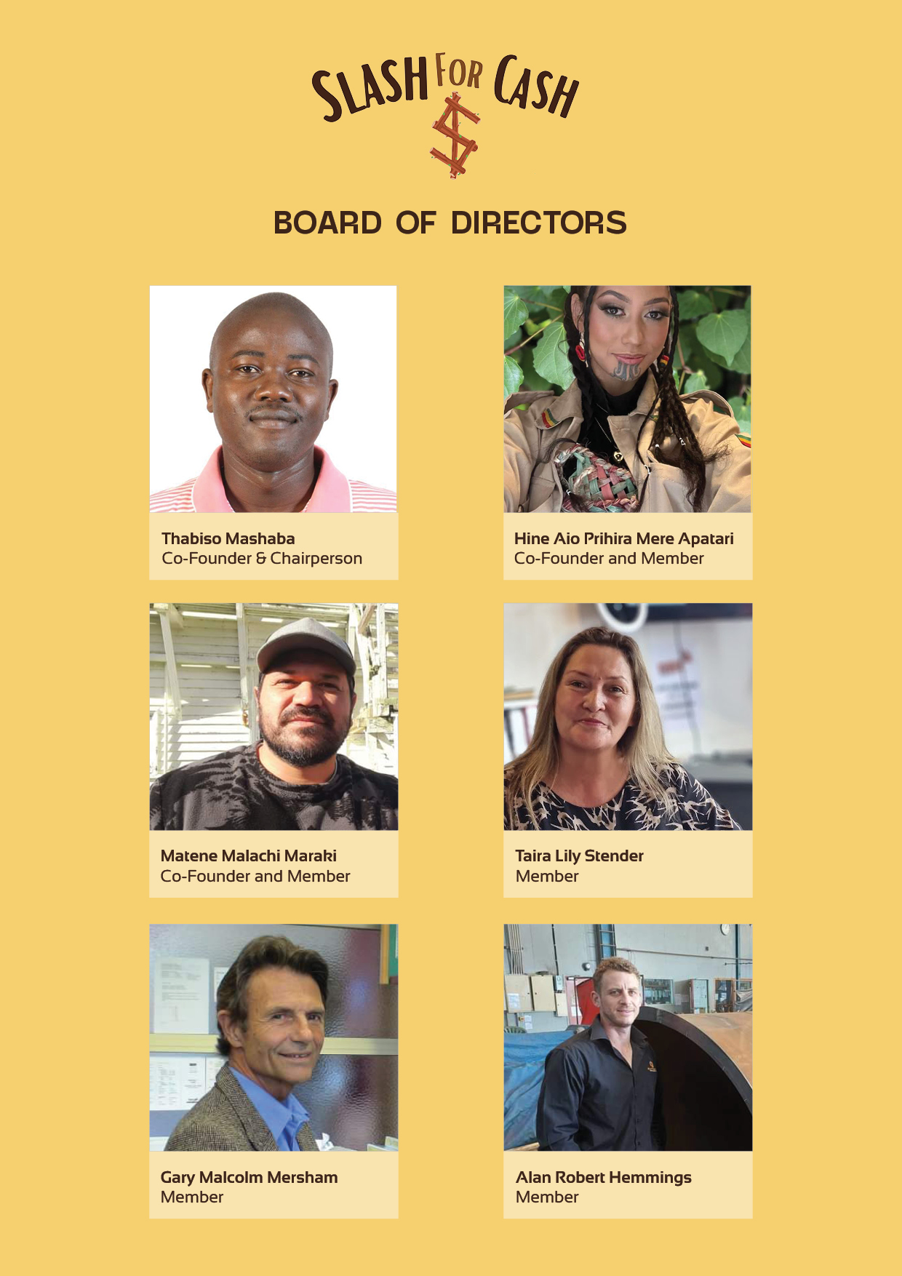
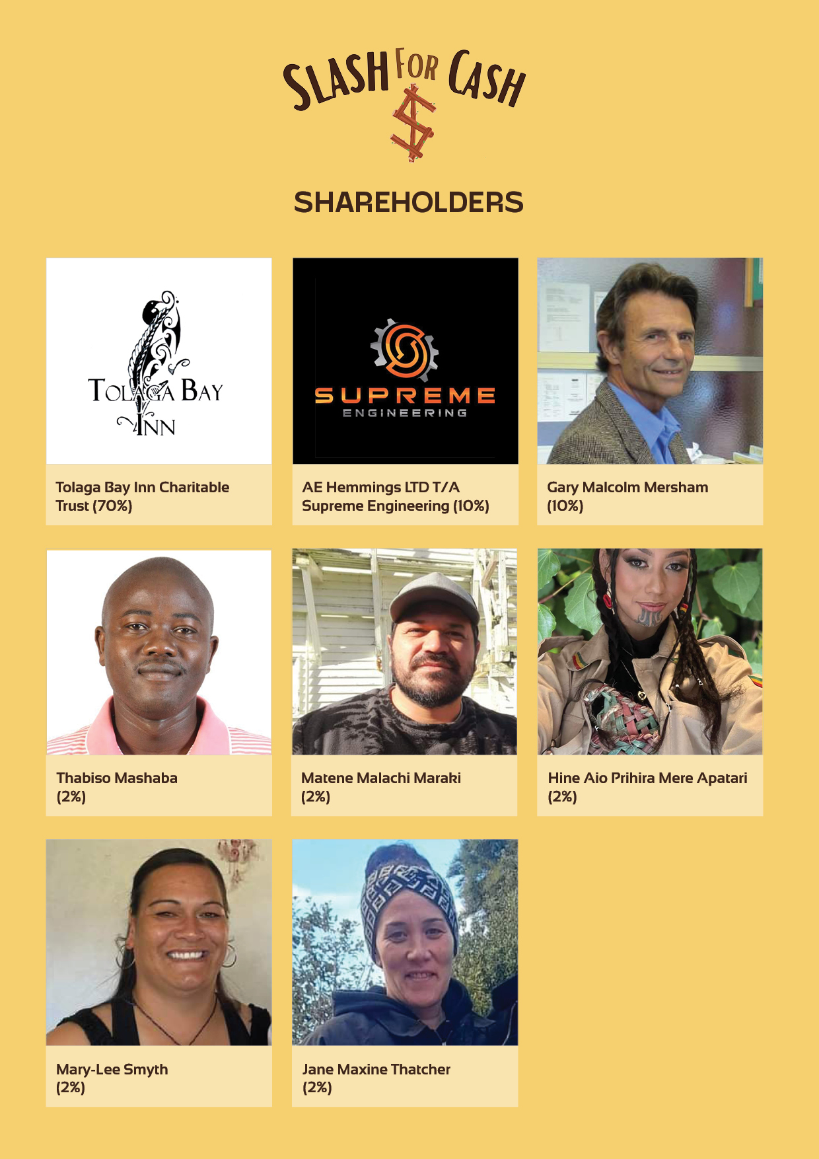

Slide 18
NGA MIHI
Thabiso Mashaba
Project Coordinator
Tel: +642108564647
Email: Kiaora@slashforcash.co.nz
Website: www.slashforcash.co.nz

