Slide 1
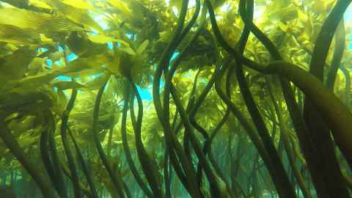
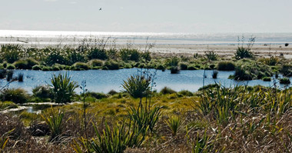
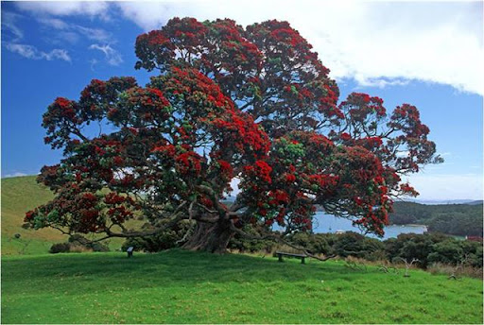
Bioshields and Tsunamis
Investigating the use of different ecosystems
to help mitigate the effects of tsunamis
Laura Hughes*, Jean Roger, Xiaoming Wang,
Aditya Gusman, Vinod Sadashiva, Uma Ashok, Annet Forkink
*l.hughes@gns.cri.nz

Slide 2
Outline
Outline:
What are Bioshields?
Vegetation and Ecosystems Investigated;
Case Study Location;
Earthquakes Investigated;
Simulation Set-up;
Preliminary Simulation Results;
Limitations;
Next Steps.

Slide 3
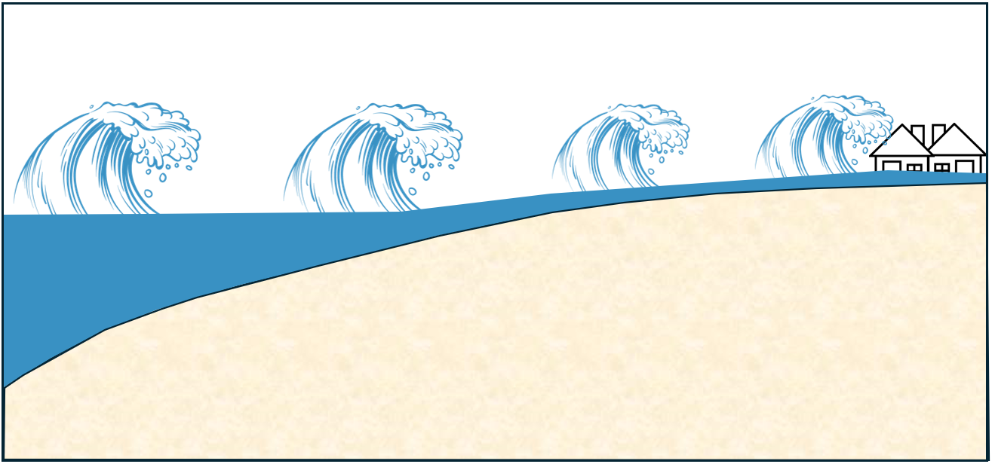
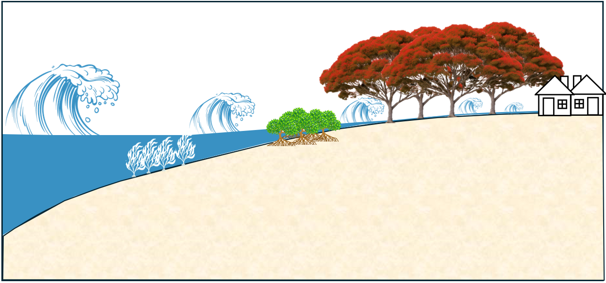
What are Bioshields?
Bioshields:
Pohutukawa Trees
Mangroves
Kelp
Forest

Slide 4
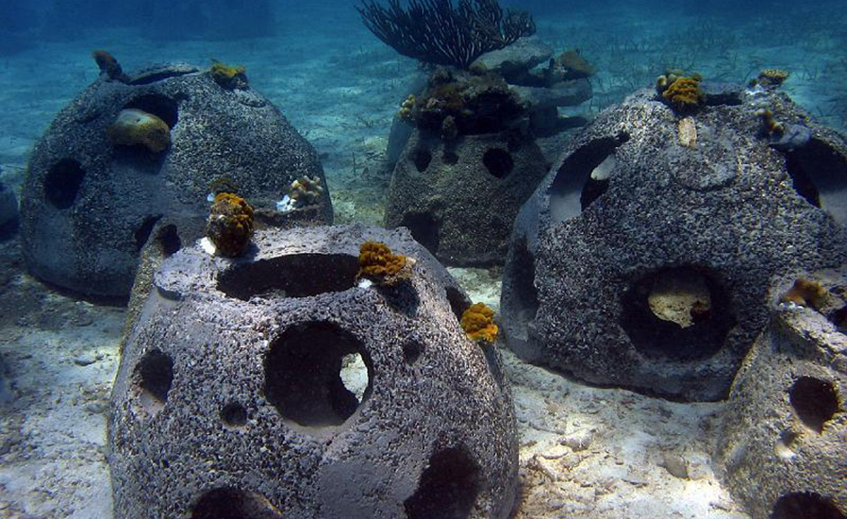
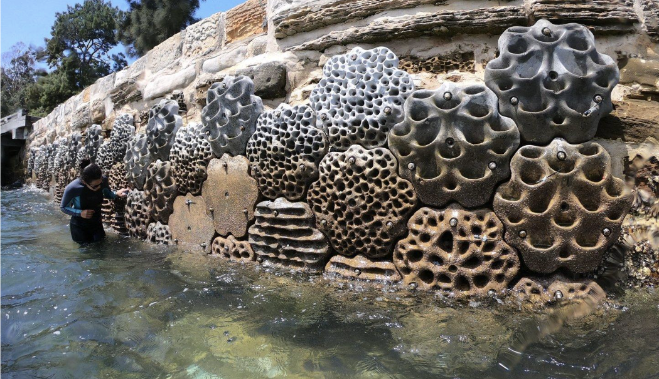
Vegetation and Ecosystems Investigated
Vegetation and Ecosystems:
Kelp Forests
Restored Estuary
Pohutukawa Trees
Artificial Reef
Sea Wall

Slide 5
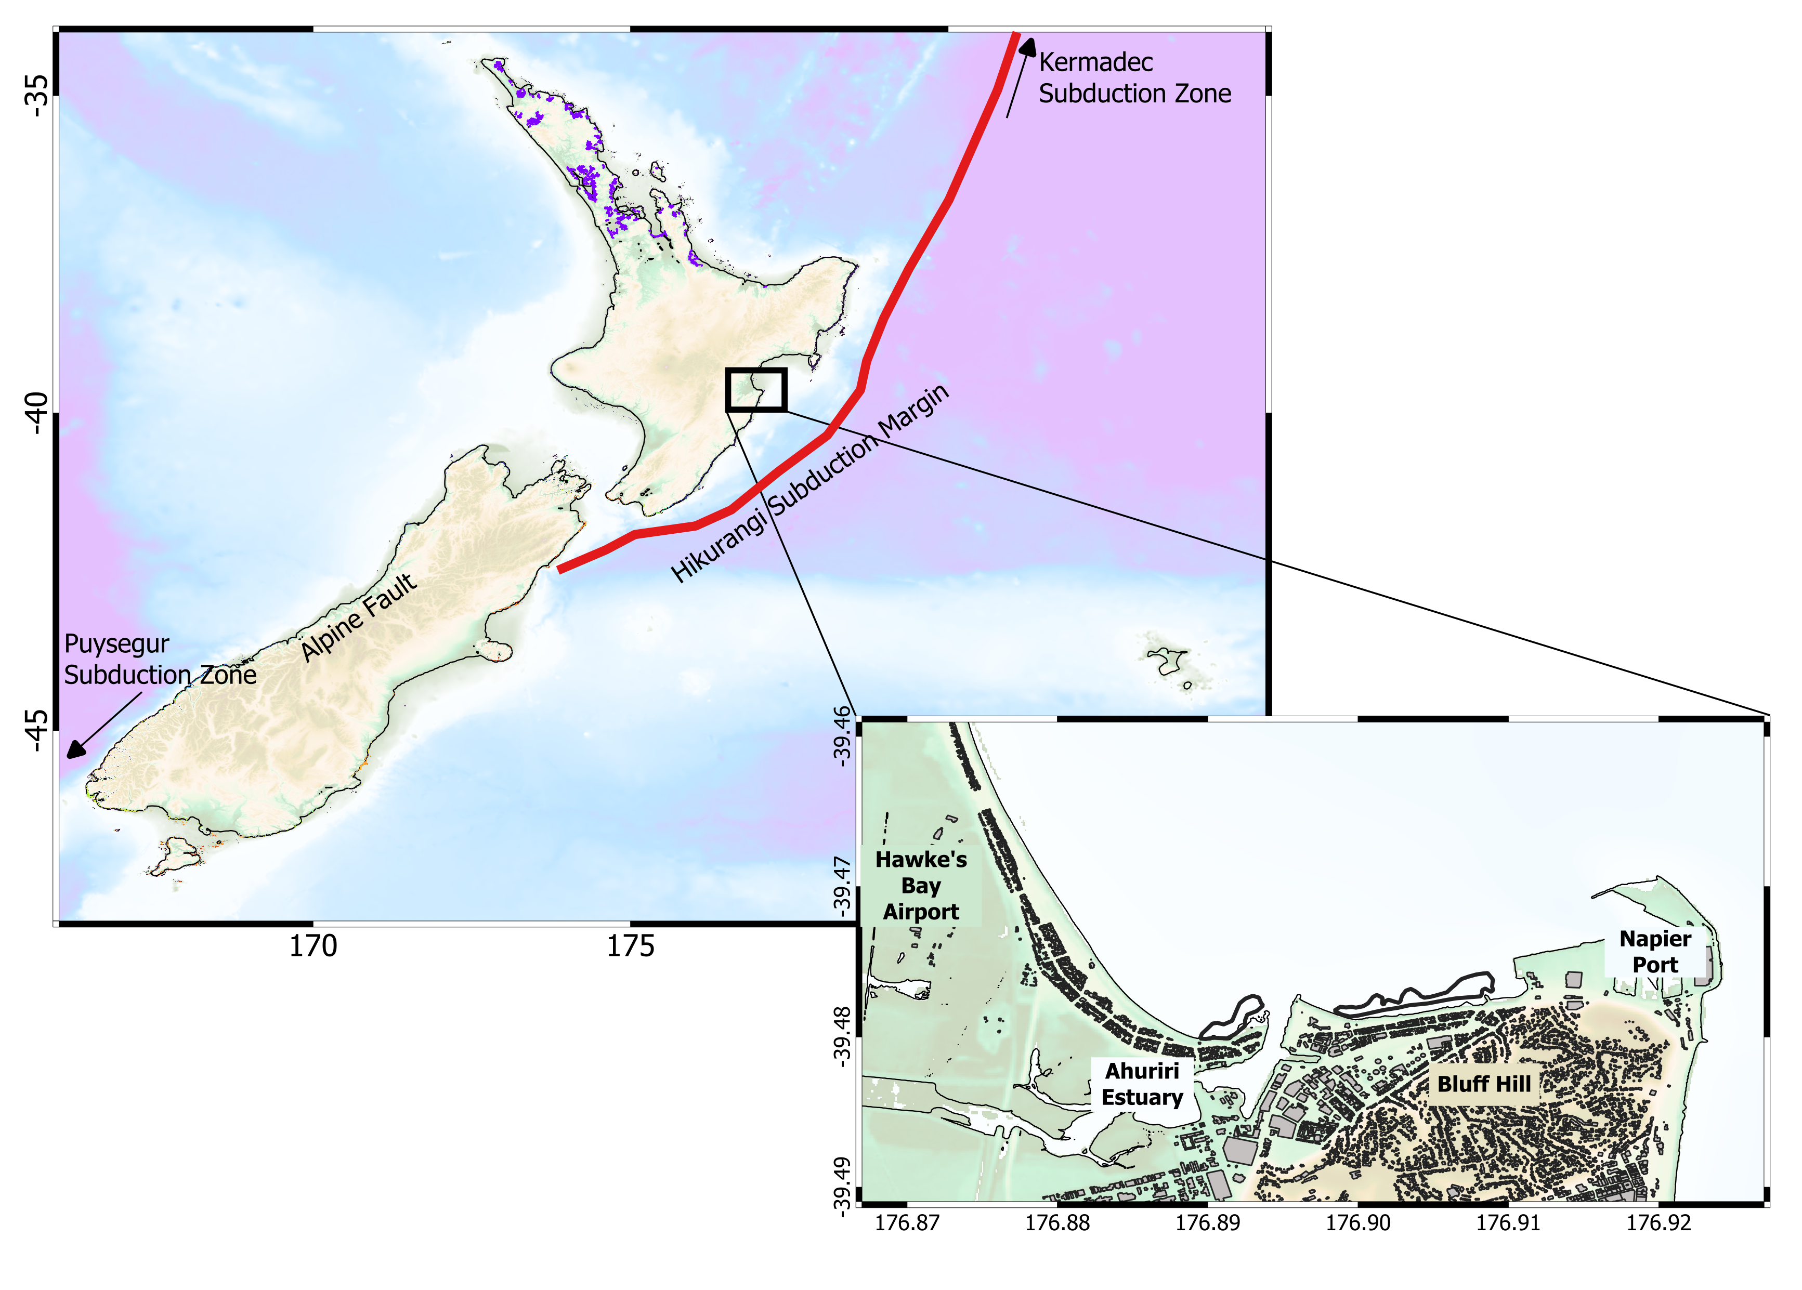
Case study Location
Case Study Location:

Slide 6
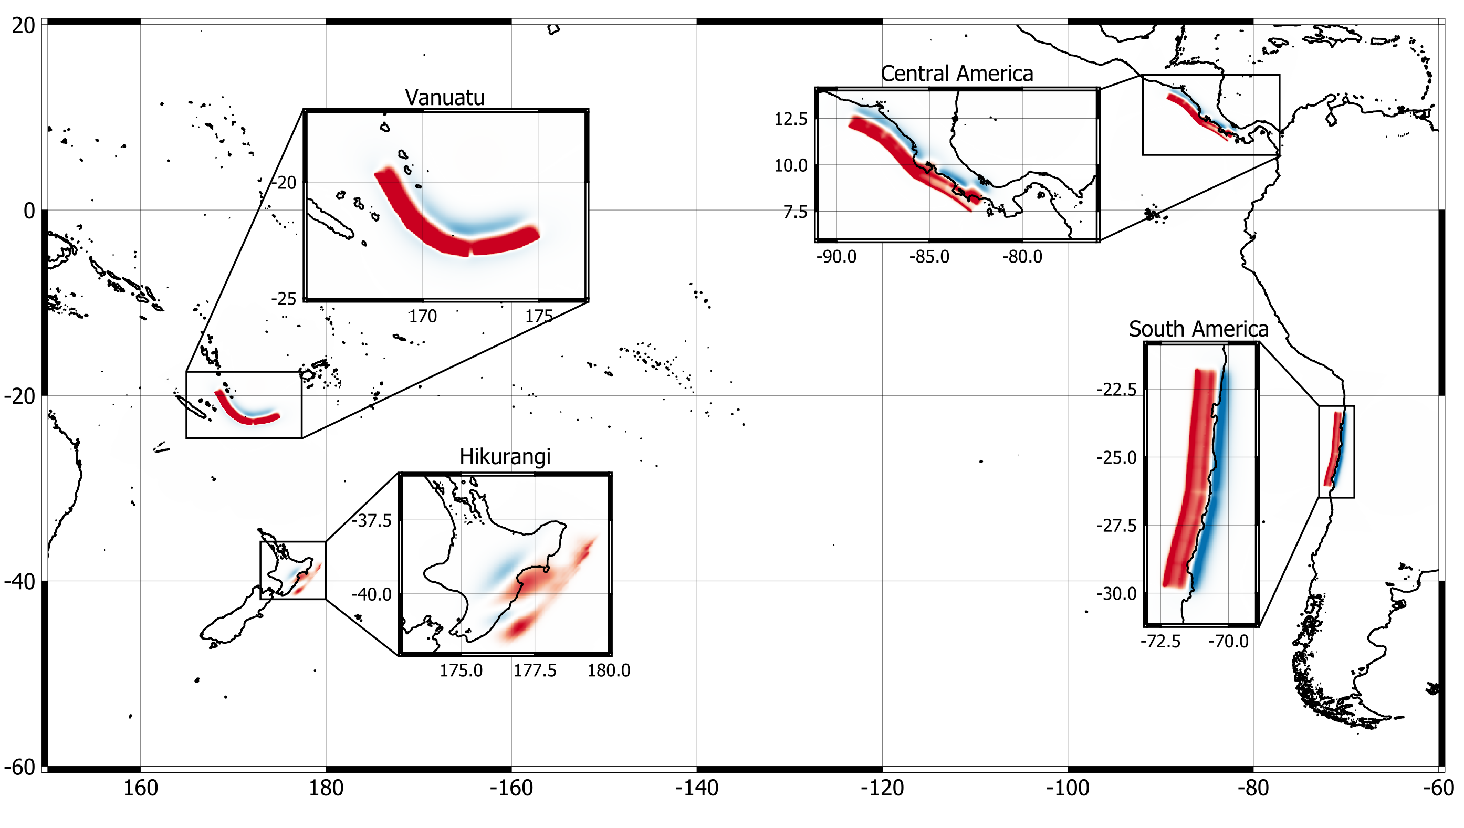
Earthquake sources
Earthquake Sources:

Slide 7
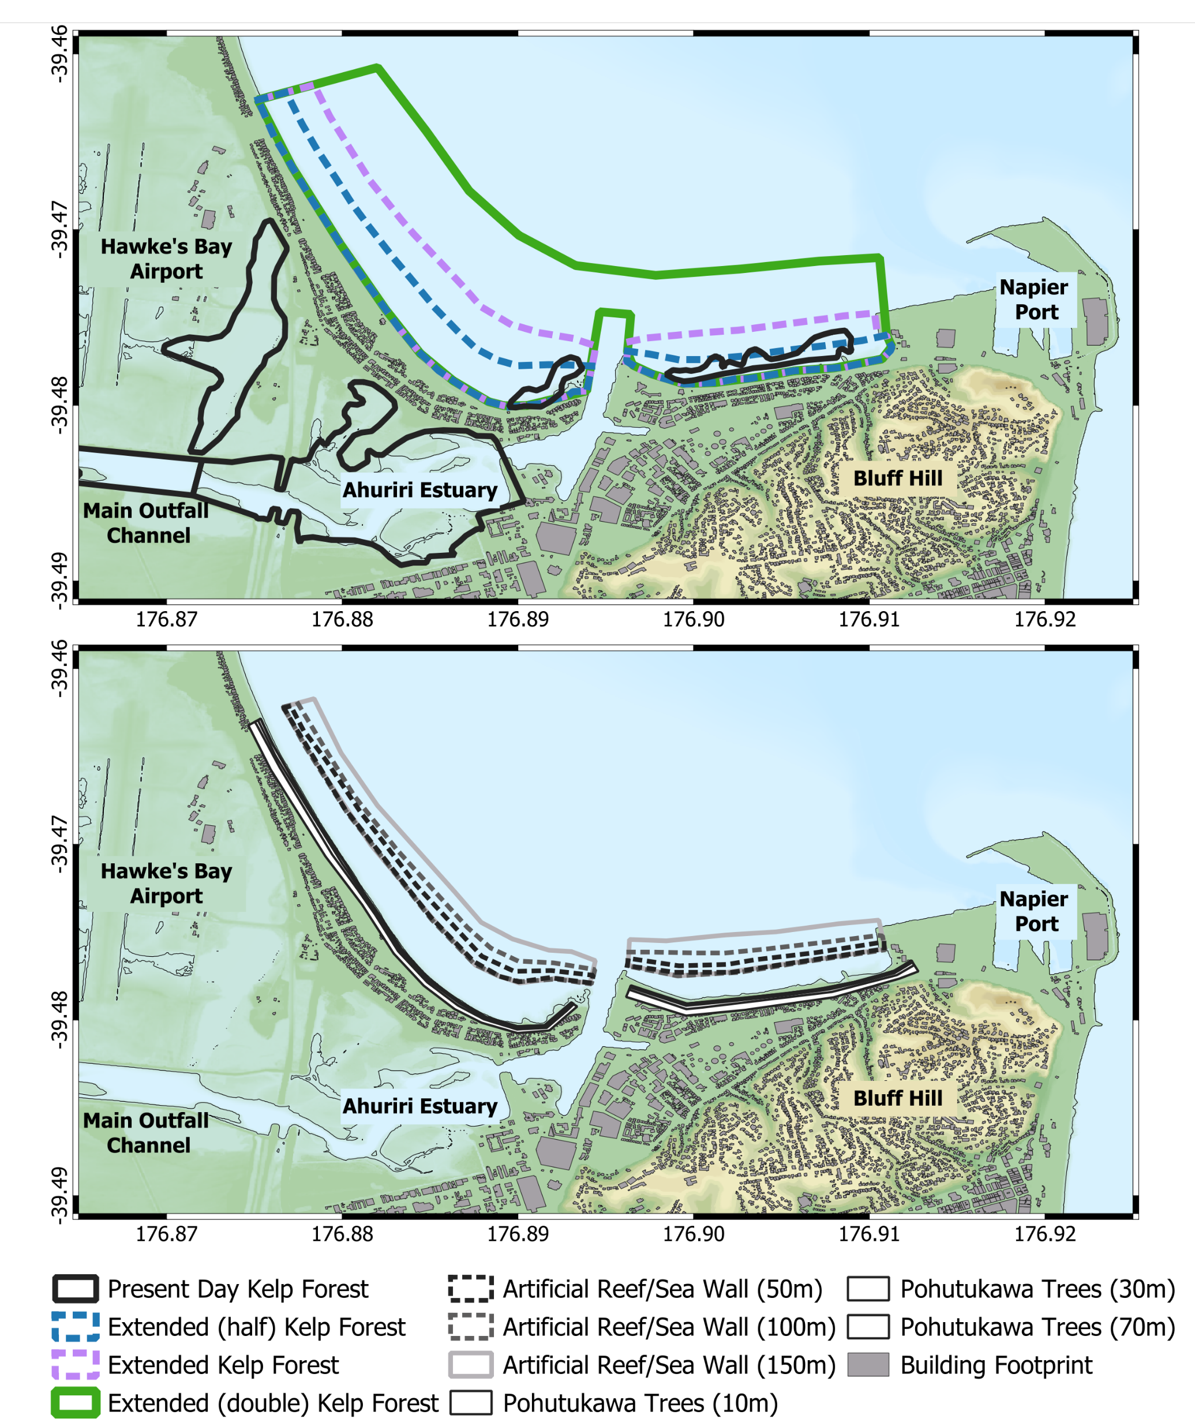
Simulation set-up
Modelling the Different Ecosystems/Structures:

Slide 8
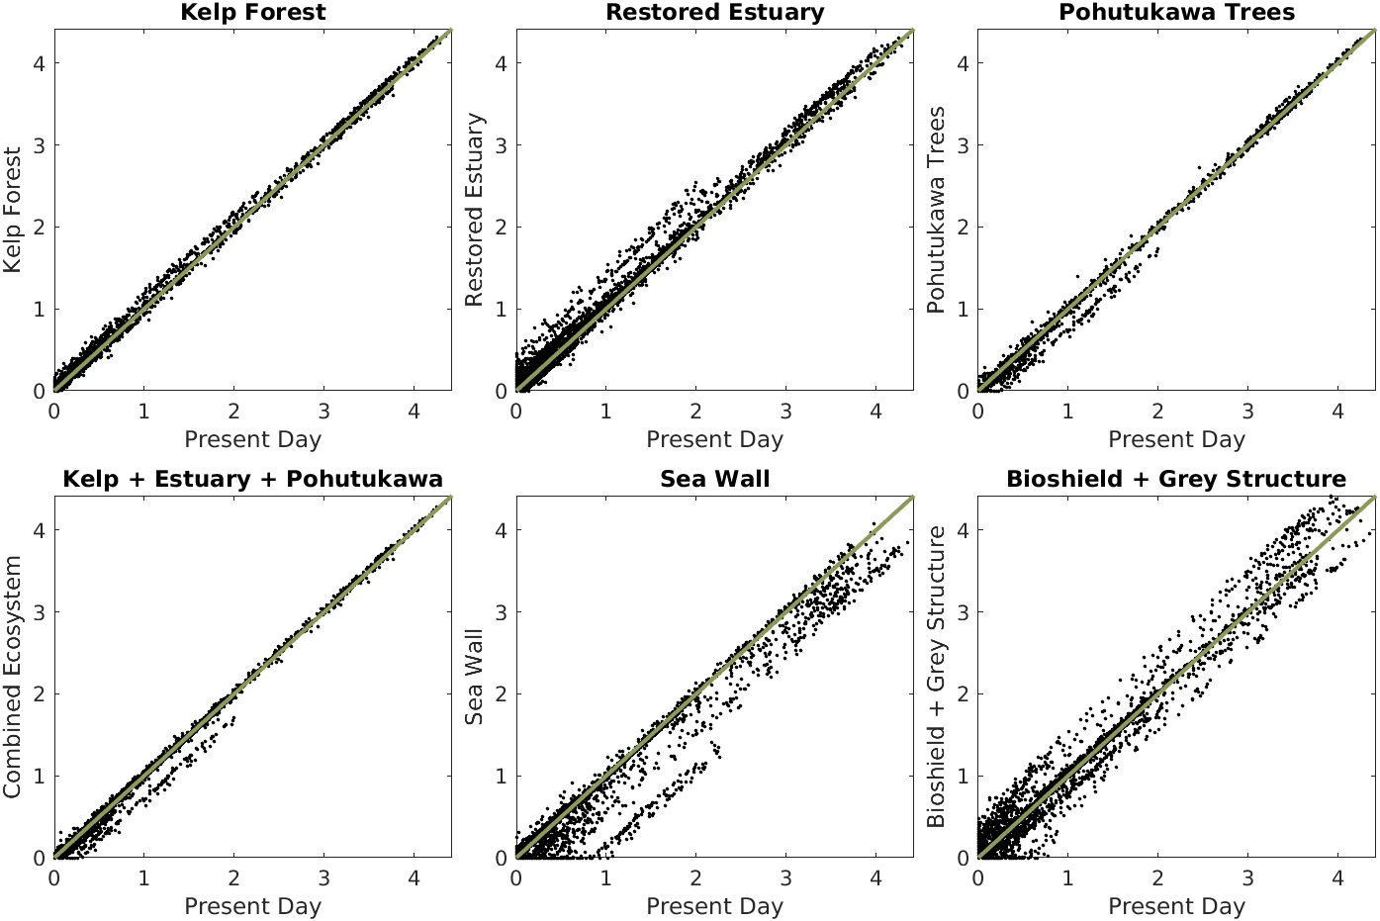
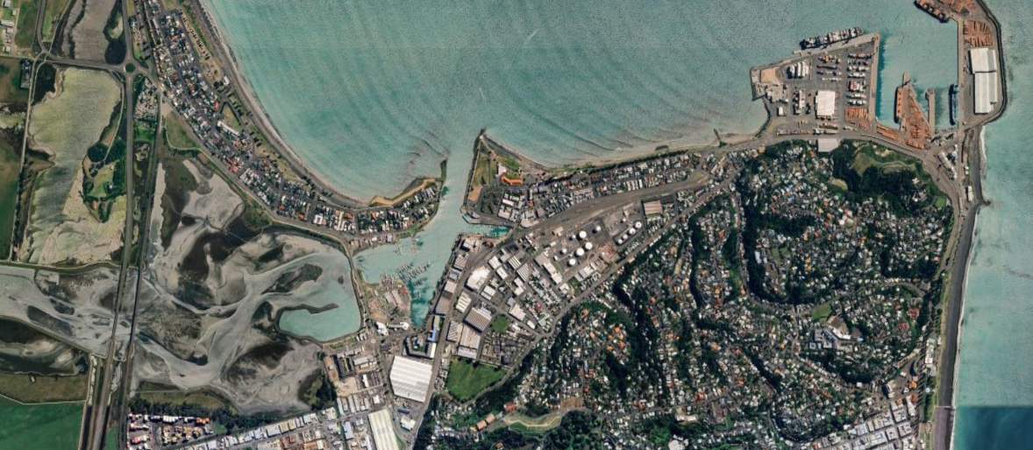
Preliminary simulation results
Preliminary Results: Hikurangi

Slide 9
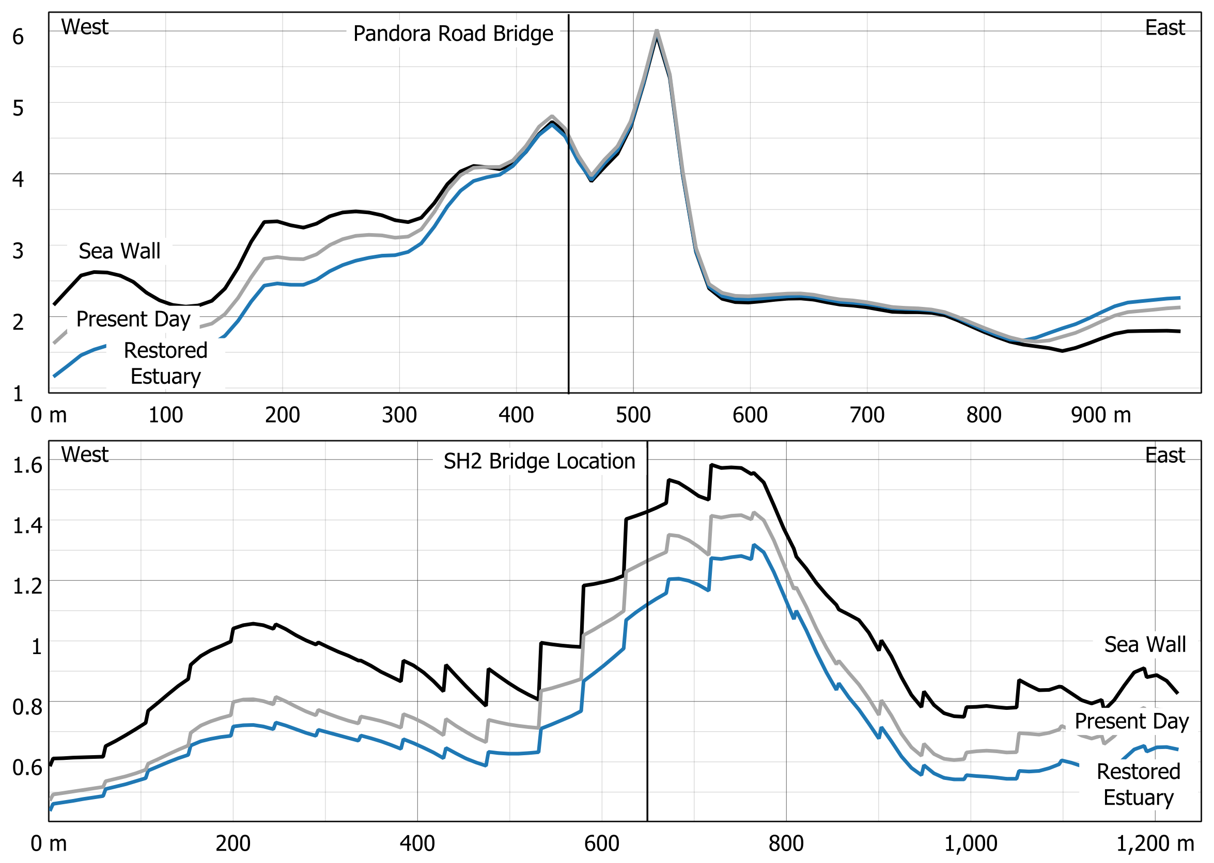
Preliminary simulation results
Preliminary Results: Hikurangi

Slide 10
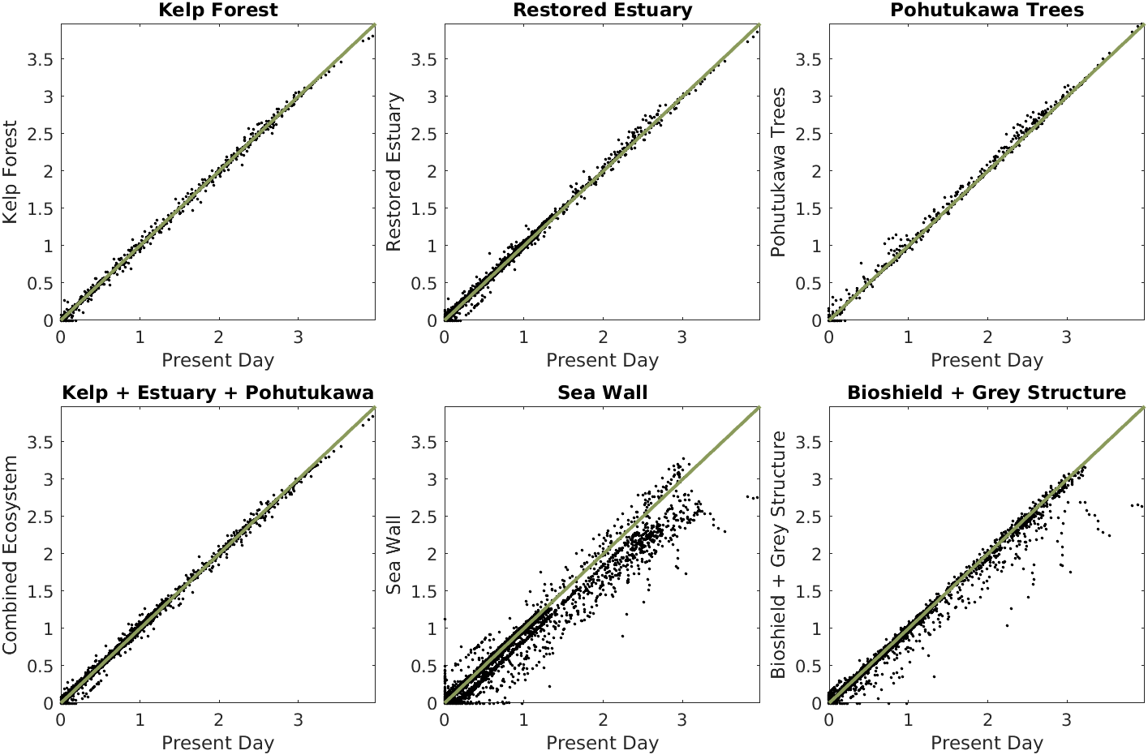
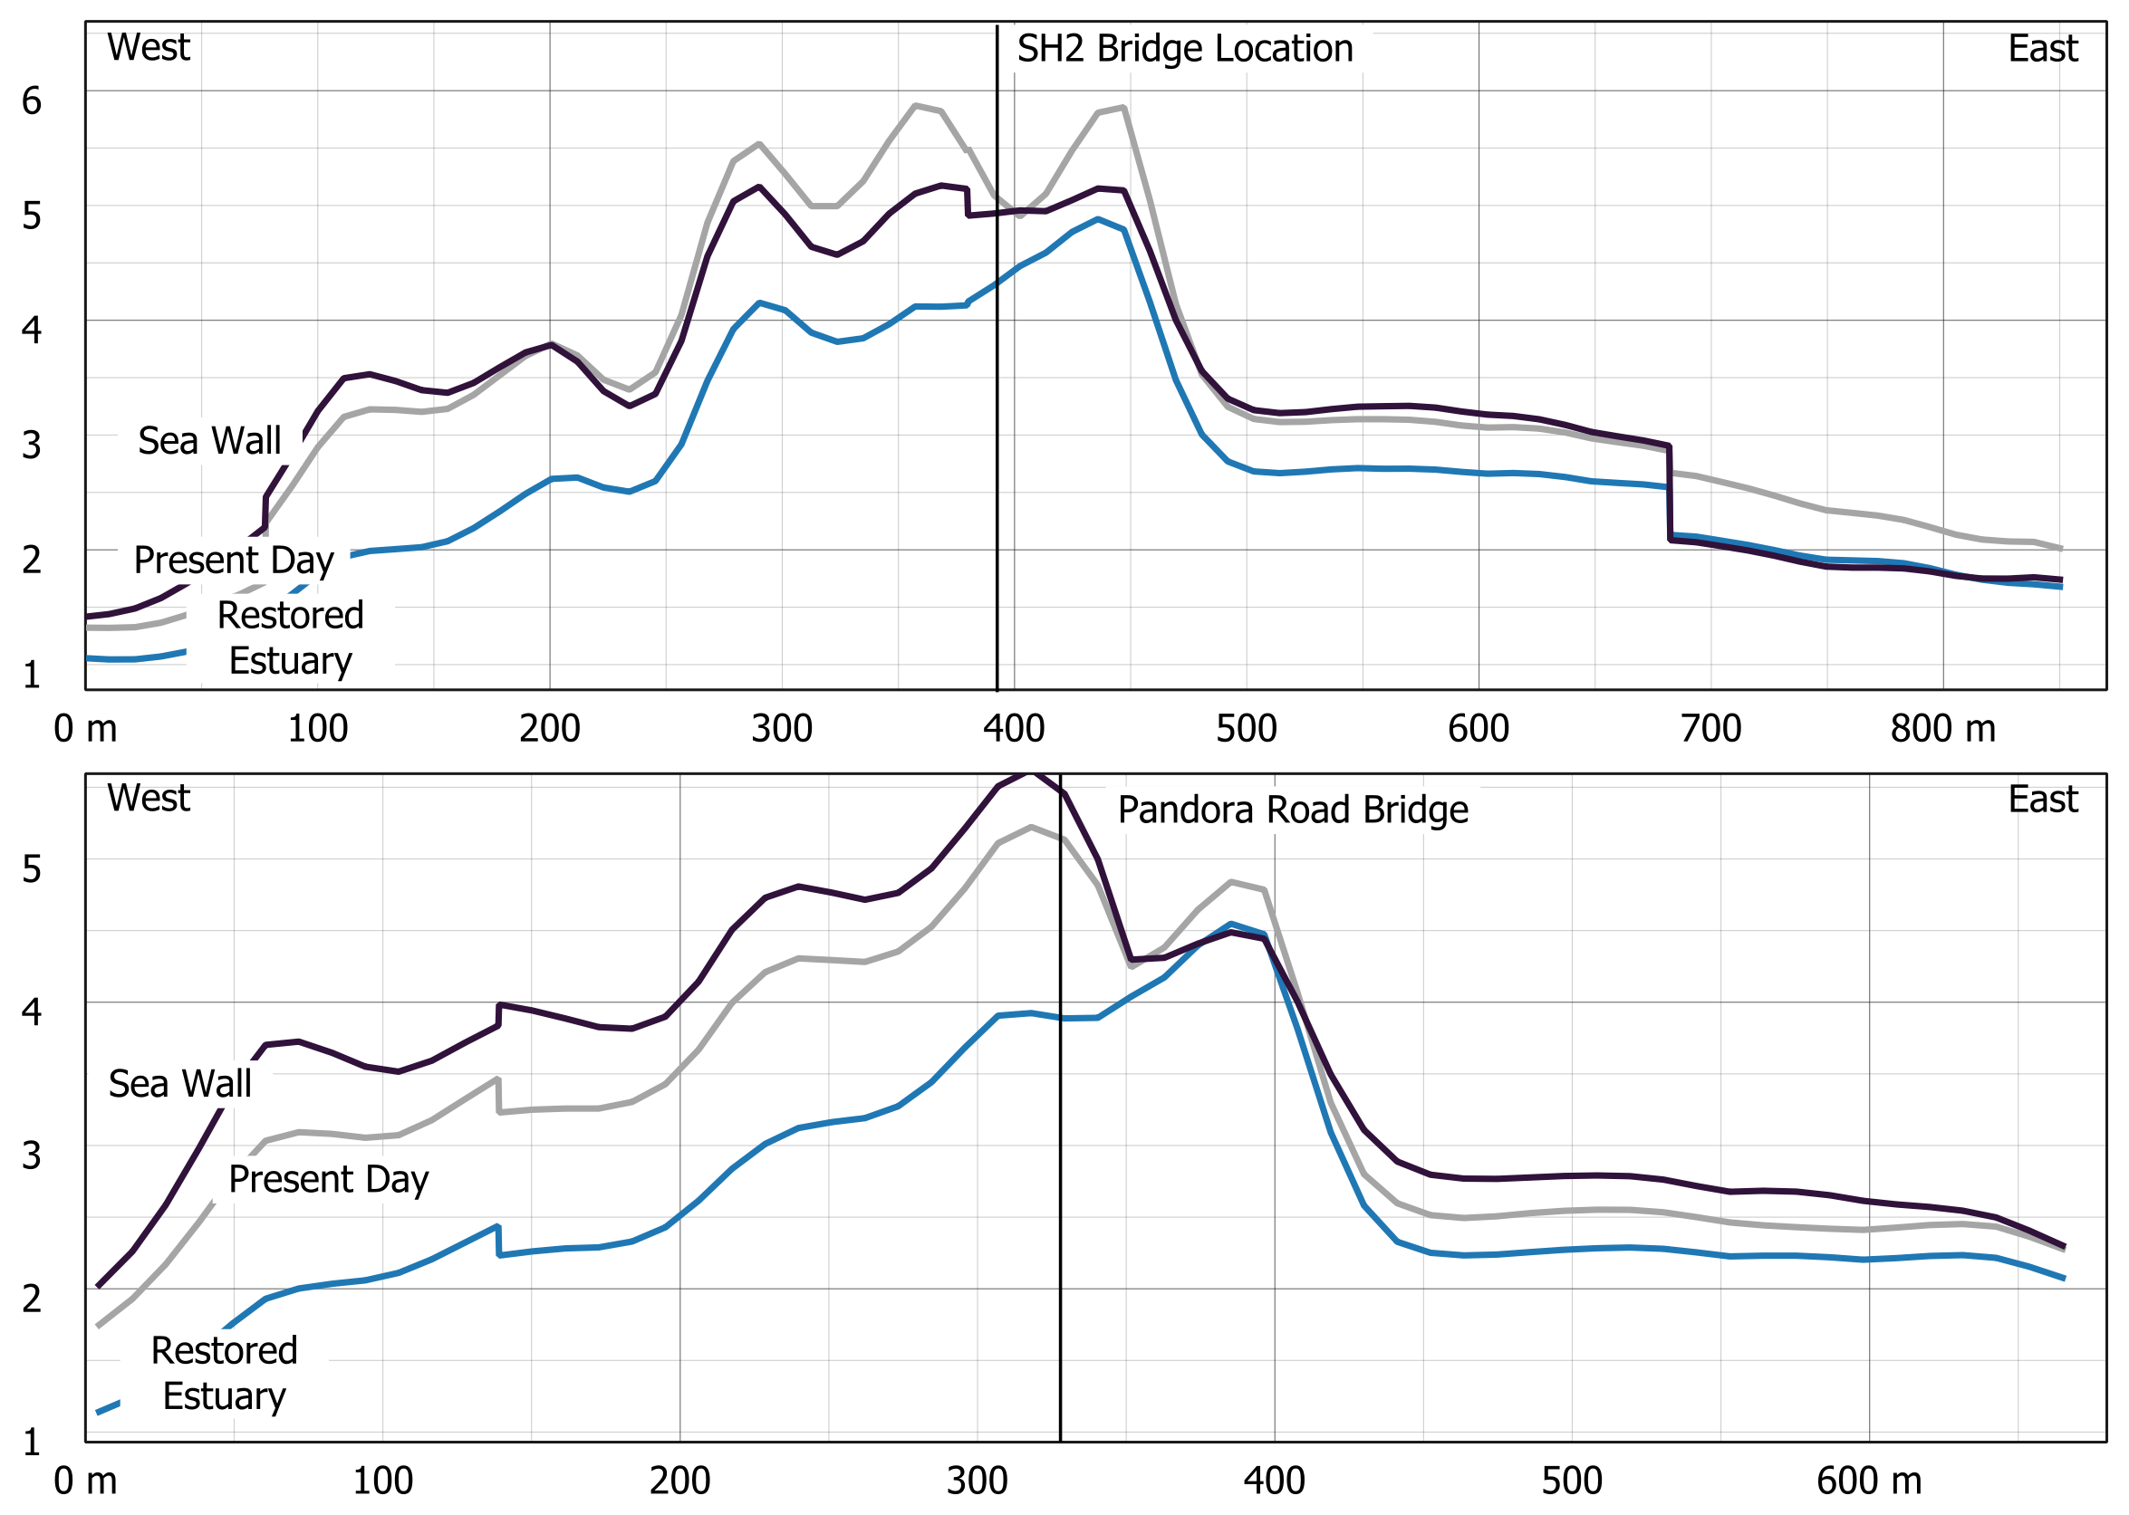
Preliminary simulation results
Preliminary Results: Vanuatu

Slide 11
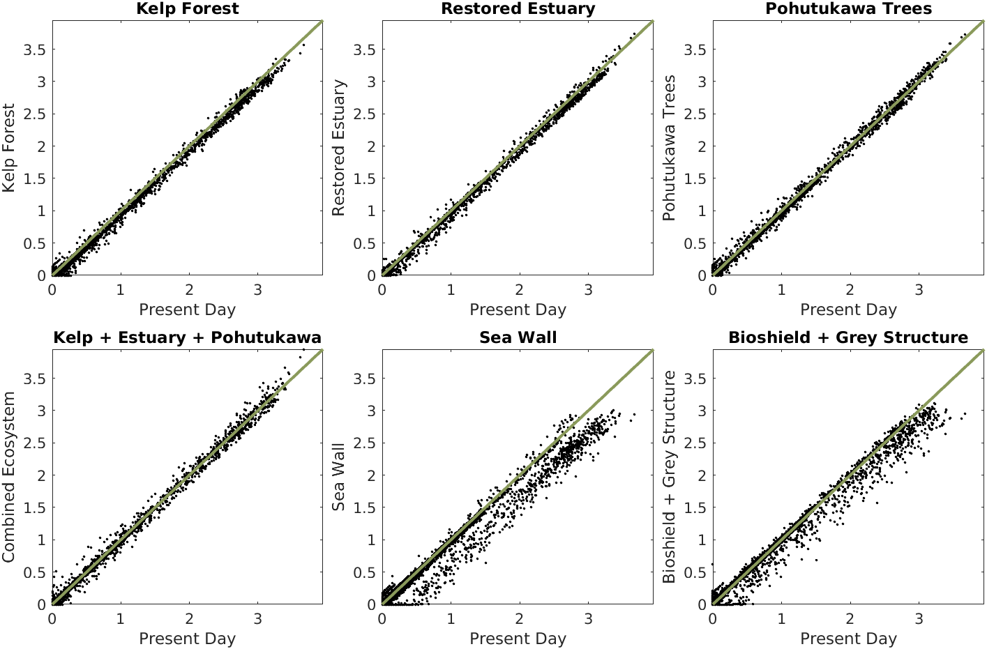
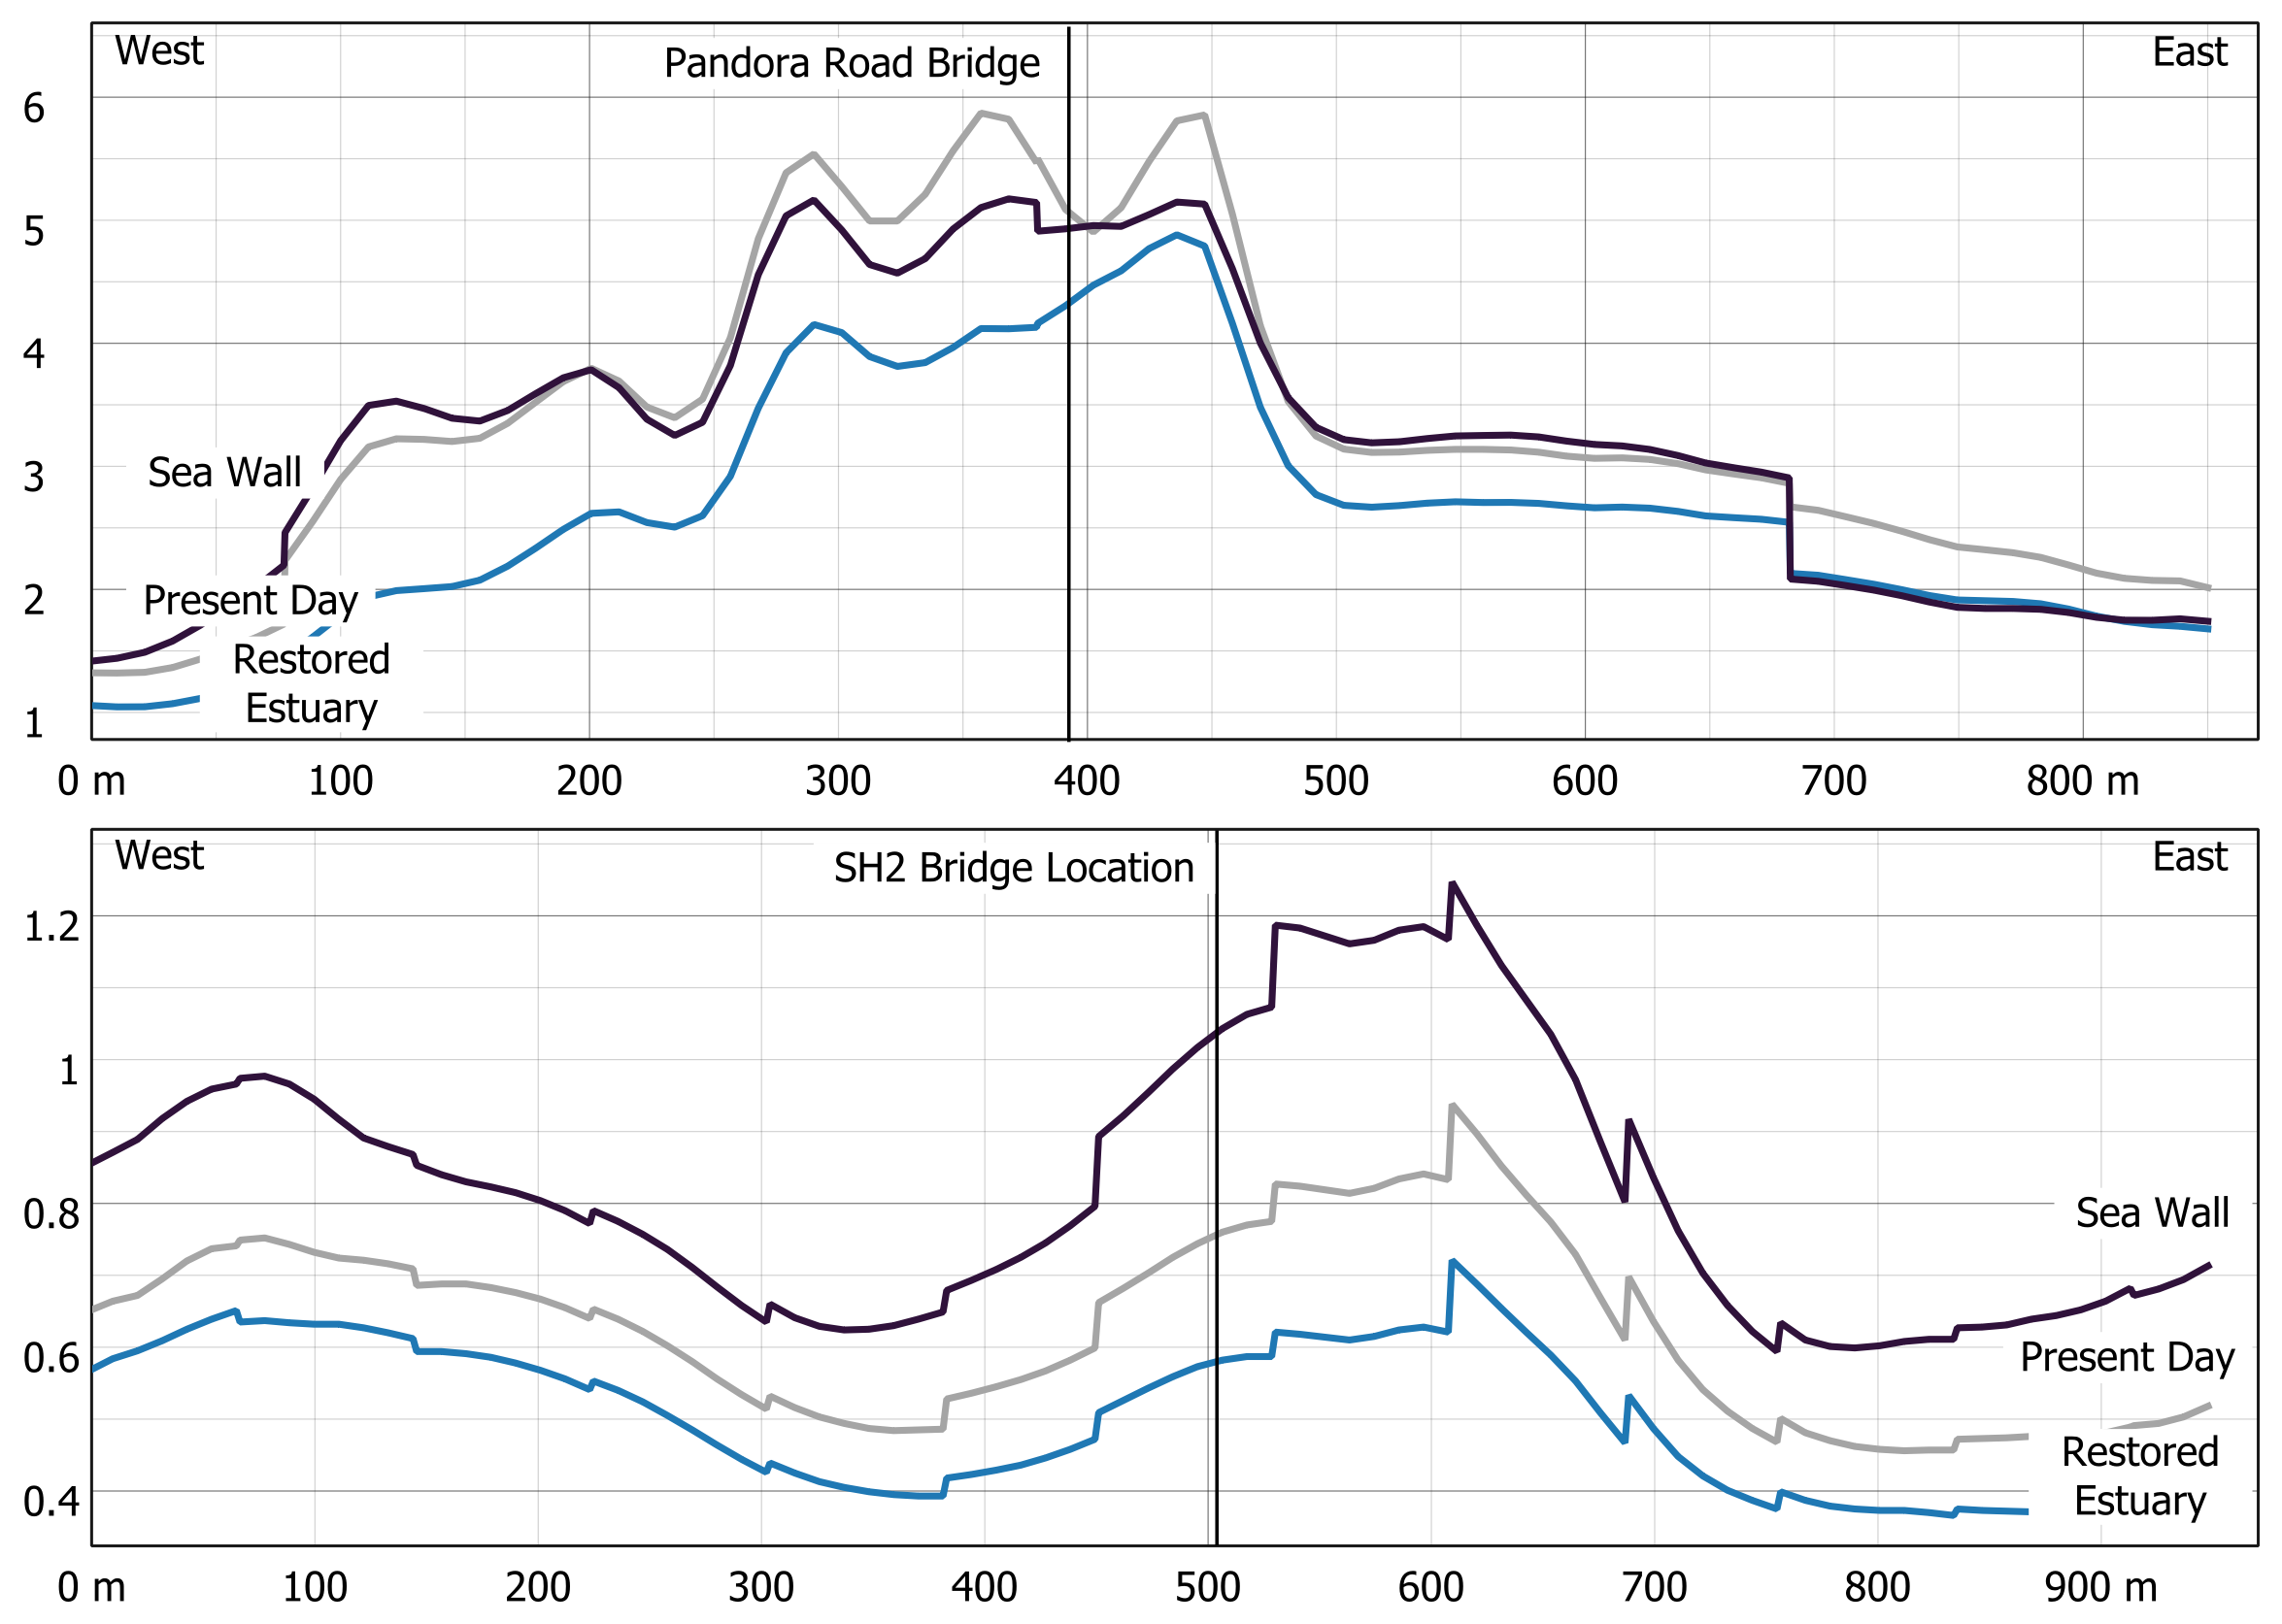
Preliminary simulation results
Preliminary Results: Central America

Slide 12
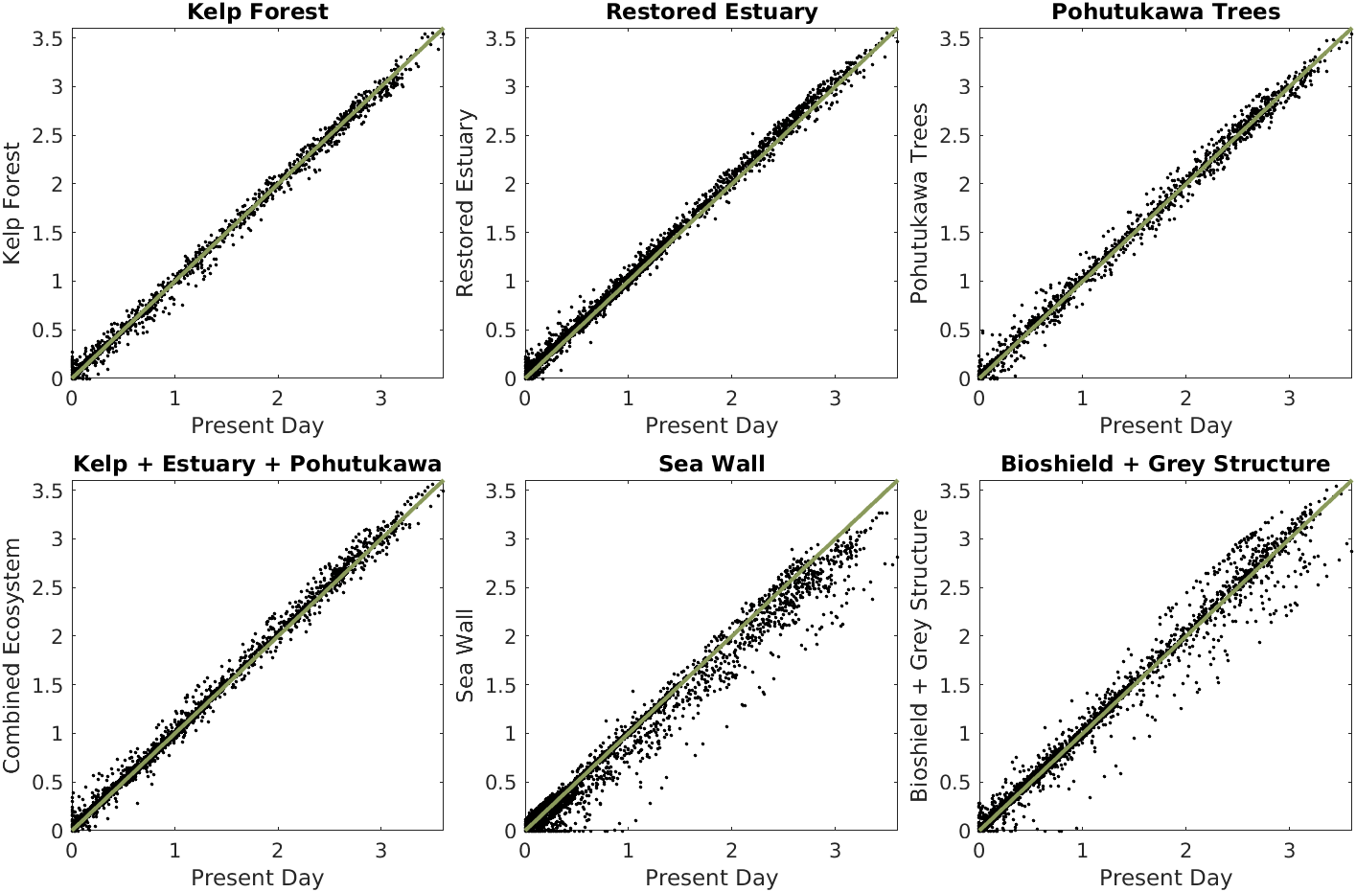
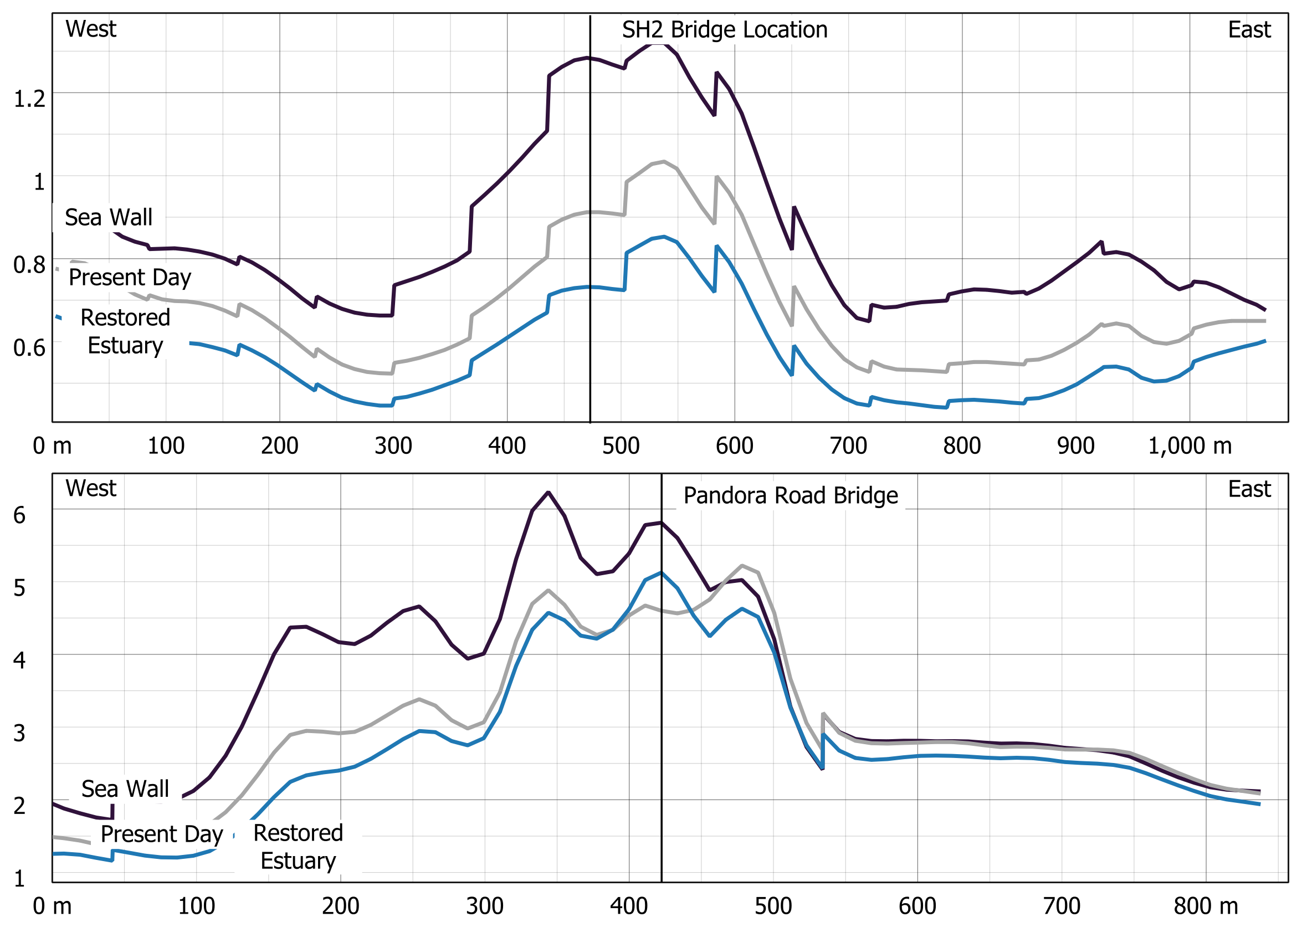
Preliminary simulation results
Preliminary Results: South America

Slide 13
limitations
Limitations
We do not know what the exact friction value of the ecosystems;
We do not know how large tsunami waves disturb the ecosystems;
We have to approximate the ecosystems with polygons.

Slide 14
Next steps
Next Steps
Undertake modelling to investigate how the ecosystems influence the transport of sediment;
Further investigate how the ecosystems respond to large waves;
Run experiments to determine a more accurate friction value for alternative ecosystems;
Run simulations with alternative earthquake scenarios (e.g. smaller earthquake which generate smaller tsunamis as these events occur more frequently);
Test modelling in alternative location around New Zealand.

Slide 15
Thank you
Laura Hughes*, Jean Roger, Xiaoming Wang,
Aditya Gusman, Vinod Sadashiva, Uma Ashok, Annet Forkink
*l.hughes@gns.cri.nz

