Slide 1
Coastal Restoration Trust of New Zealand Conference
Ūawa Tolaga Bay, March 2025
PROJECT UPDATES & PROPOSALS
David Bergin and Michael Bergin
Current projects
Restoration of a native forest coastal sequence – Tuhaitara Coastal Park, North Canterbury
Videos
  Form and function of coasts, impacts of climate change, etc (14 videos completed)
  Kapiti Coast coastcare video (current)
  Northland coastcare video (recently contracted)
TTC/TTT seed islands – demonstrating concept on coastal sites
New proposals
Other projects and funding opportunities
Request your input into priorities for CRT projects, funding options…

Slide 2
Coastal Restoration Trust of New Zealand
Project funding and support partners
Funders
Department of Conservation’s Community Fund
Research partners of the Coastal Restoration Trust
Trees That Count/Project Crimson Trust project funding
Ministry for the Environment, Ministry for Primary Industries
Tāne’s Tree Trust research fund
Project partners
Our research partners - Department of Conservation, regional councils
Other local authorities
Coast care groups, iwi, trusts, coastal landowners and managers
The Coastal Restoration Trust is grateful for ongoing support

Slide 3
Restoration of a native forest coastal sequence, Tuhaitara Coastal Park, North Canterbury
Objective
Set up a demonstration site of a restored native coastal forest sequence typical of north Canterbury
Method
Establish 50m wide transect within logged pine area as a coastal sequence linking foredunes, lagoons, wetlands, inland coastal forest
Focus on restoring native dominant coastal habitats
Progress
Delays due to COVID, flooding and major fire November 2022 – 160 ha of pine with native plantings and trials burnt
Planting coastal podocarp forest groves underway on inland dunes
Final report and recommendations
To be completed mid-2025

Slide 4
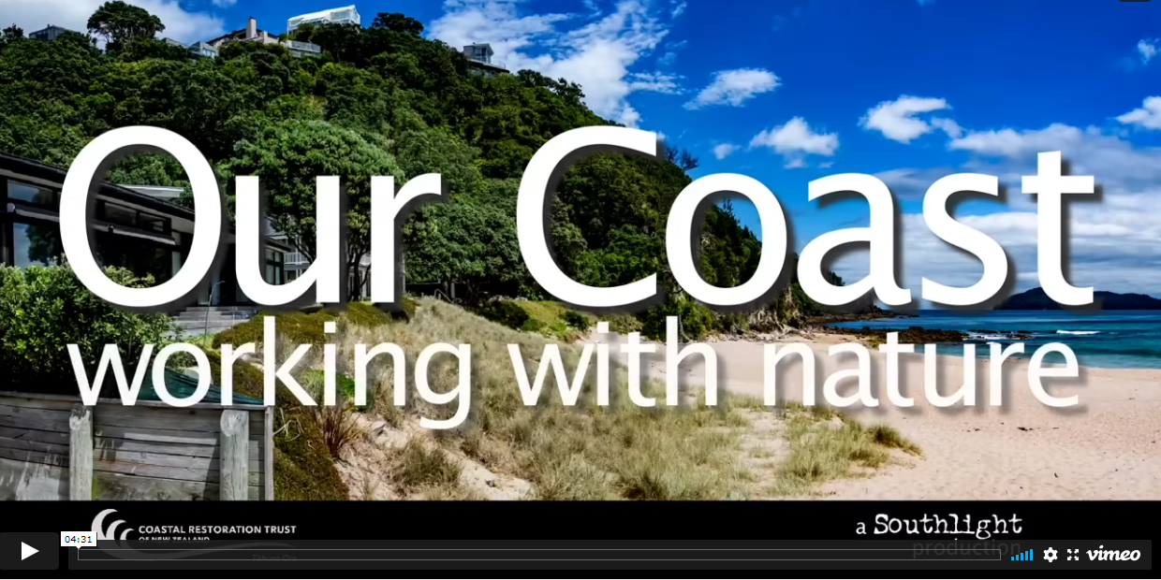
Videos – building resilient natural coasts in the face of climate change
Working with nature videos
14 videos now available on the CRT website focused on:
  form and function of our coasts
  impacts of human use and climate change
  adaptive management, managed retreat
  community restoration…
Regional ‘how to’ videos
Providing practical demonstrations of restoration at local levels – assessing issues, weed control, pest animal control, planting, maintenance, beach user management…
First of these underway for Kapiti Coast and Northland
Other regional videos
Production by Southlight Studios

Slide 5
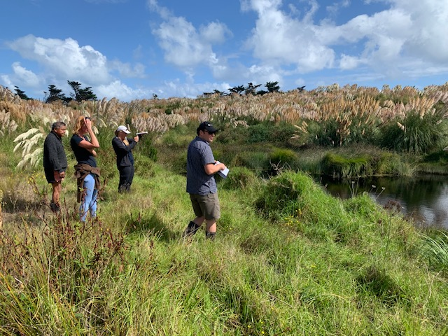
Seed island concept for coastal sites
Objective
To accelerate landscape scale restoration of native vegetation on coastal sites
Rationale
Cost for blanket planting natives is $20,000+ per hectare
Plant small groves (seed islands) of natives on best micro-sites across a landscape as long-term seed sources
Seed islands become ‘stepping stones’ for birds to disperse seed along with wind dispersal hastening natural regeneration at scale
Progress to date
Two coastal sites established as part of 13 demonstration sites set up by Tane’s Tree Trust and Trees That Count from Northland to Southland:
  Kawhia – mixed species groups planted on backdunes
  Canterbury – coastal podocarp forest groves – totara , matai, kahikatea
Working with nature – what can we do to help?

Slide 6
Project proposals and ideas
We need to know your ideas for new CRT projects
Priority areas – what are the priority areas on our coasts
Potential collaboration – scope to work with other research providers, councils, Coastcare, iwi…
Funding opportunities – new projects require funding
Proposals
Regional workshops, videos, technical advice…
  Does your region want a ‘how to’ video?
  CRT can contribute to local workshops, seminars, field demonstrations
Blue carbon and restoration of estuaries
  Quantifying biodiversity benefits and blue carbon in coastal restoration particularly estuaries
  Links with wider catchment restoration initiatives to reduce sedimentation
  Provide tools to quantify biodiversity gains, carbon sequestration, climate change mitigation
Regional demonstration areas
  Set up regional restoration sites as exemplars of best practice coastal restoration
  A network for field days, workshops, etc
Marae-based coastal and lowland restoration – exploring options…

Slide 7
Project proposal
Restoration of culturally significant coastal ecosystems for marae and Maori land
Rationale
Vulnerability of coastal marae, cultural sites and Maori land from an iwi perspective
Address climate change and biodiversity loss to increase resilience of our coasts
Focus on marae, culturally significant sites, Maori land
Marae ‘gardens’, education, resources
Establish culturally significant species as resources– weaving, Rongoa Maori, food and herbal, building and carving materials
Educational opportunities, refugia for sustainable management of resources, landscaping marae grounds…
Sustainable management of wider landscape
Restoration of culturally significant habitats on surrounding Maori land – coastal, riparian, lowlands, hill country
Includes endangered species within these habitats
Planting & managing totara (and other natives) on Maori land as a future resource for carving, etc...
Next steps
Needs to be iwi led, marae based…
Nationwide network of best-practice demonstration sites with interested marae/iwi
What are your ideas? Funding?

