Slide 1

Biodiversity, Cats, Councils and Parliament
Coastal Restoration 2025
Celia Wade-Brown QSO MP
Green Party of Aotearoa New Zealand
Authorised by Celia Wade-Brown MP, Parliament Buildings, Wellington

Slide 2
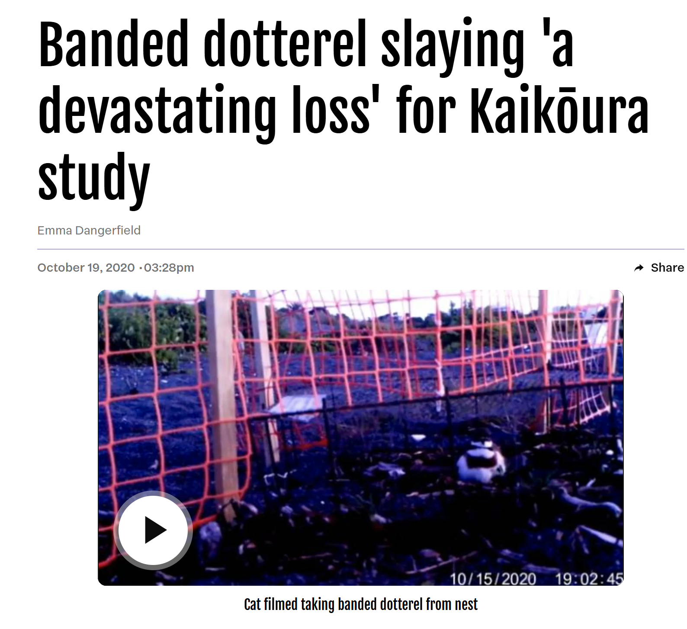
Biodiversity and Predation by cats
Sanctuaries
PCL
Urban and peri-urban
Lizards
Bats
Birds
Invertebrates
Notes:
The resurgence of wildlife in our towns and cities is something to celebrate, thanks to so many volunteers, DOC and Councils BUT

Slide 3
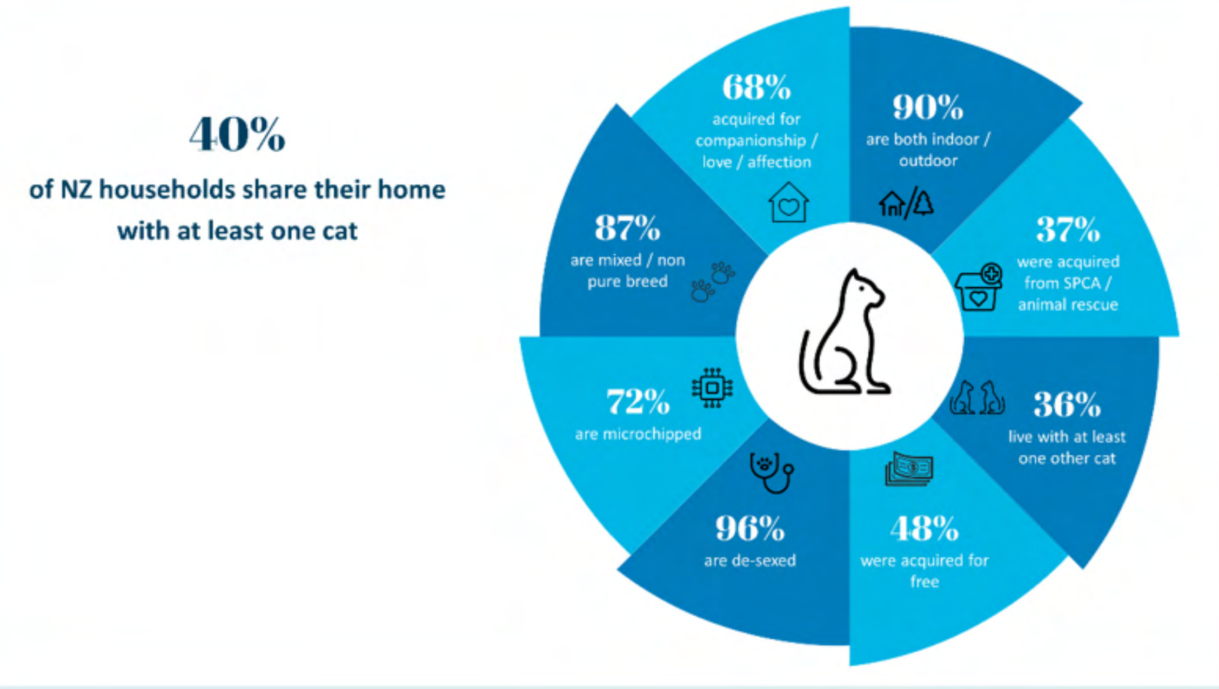
Latest pet data – CANZ survey
Notes:
Members bill re cats compulsory mmicrochipping and registering
Cat welfare – reunification, owned/unowned means PF2050 could incl ctas. Local bylaws remain but Councils can use fines not have to invoke breach of bylaw process.

Slide 4
Possibilities for Legislation
Microchipping
Registering
Desexing
Containment
Limits
Breeds

Slide 5
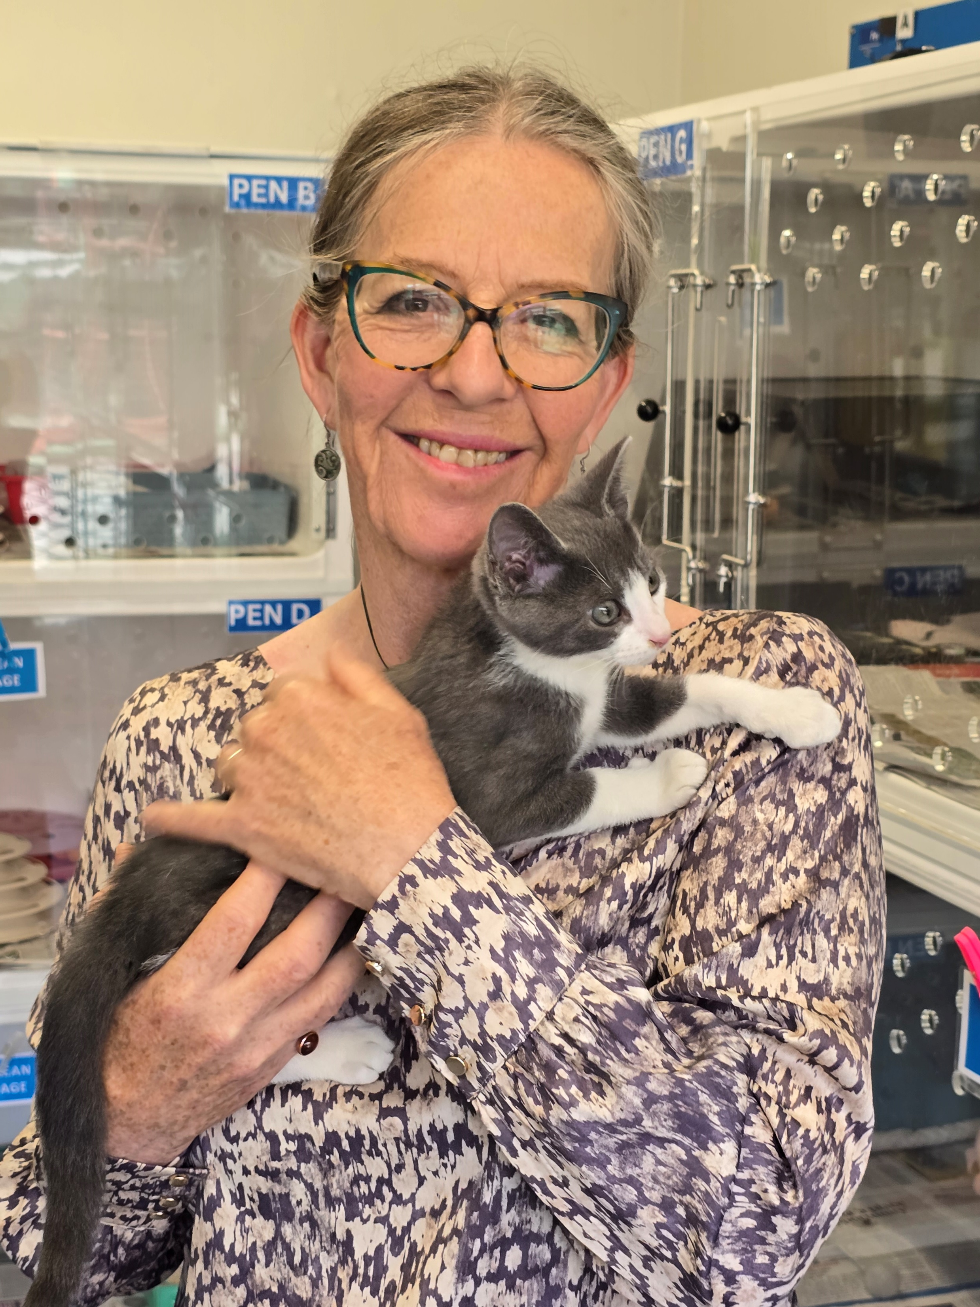
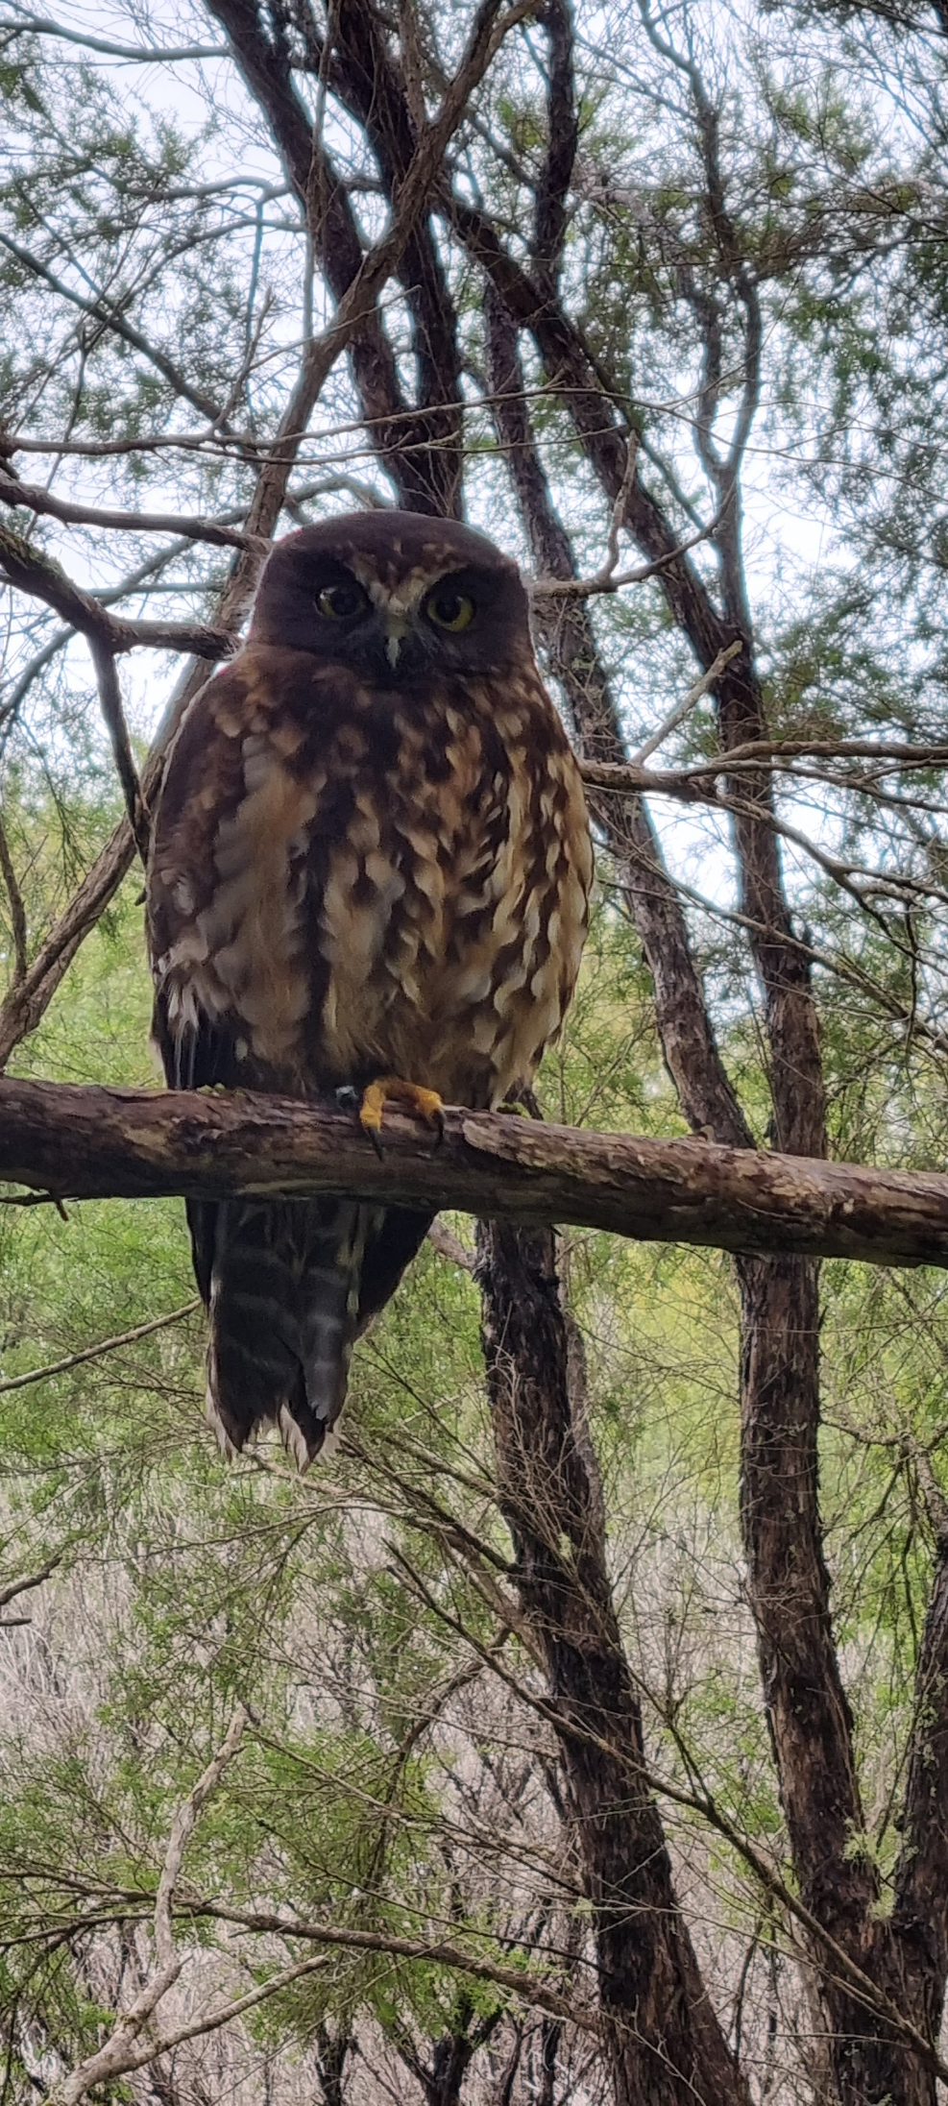
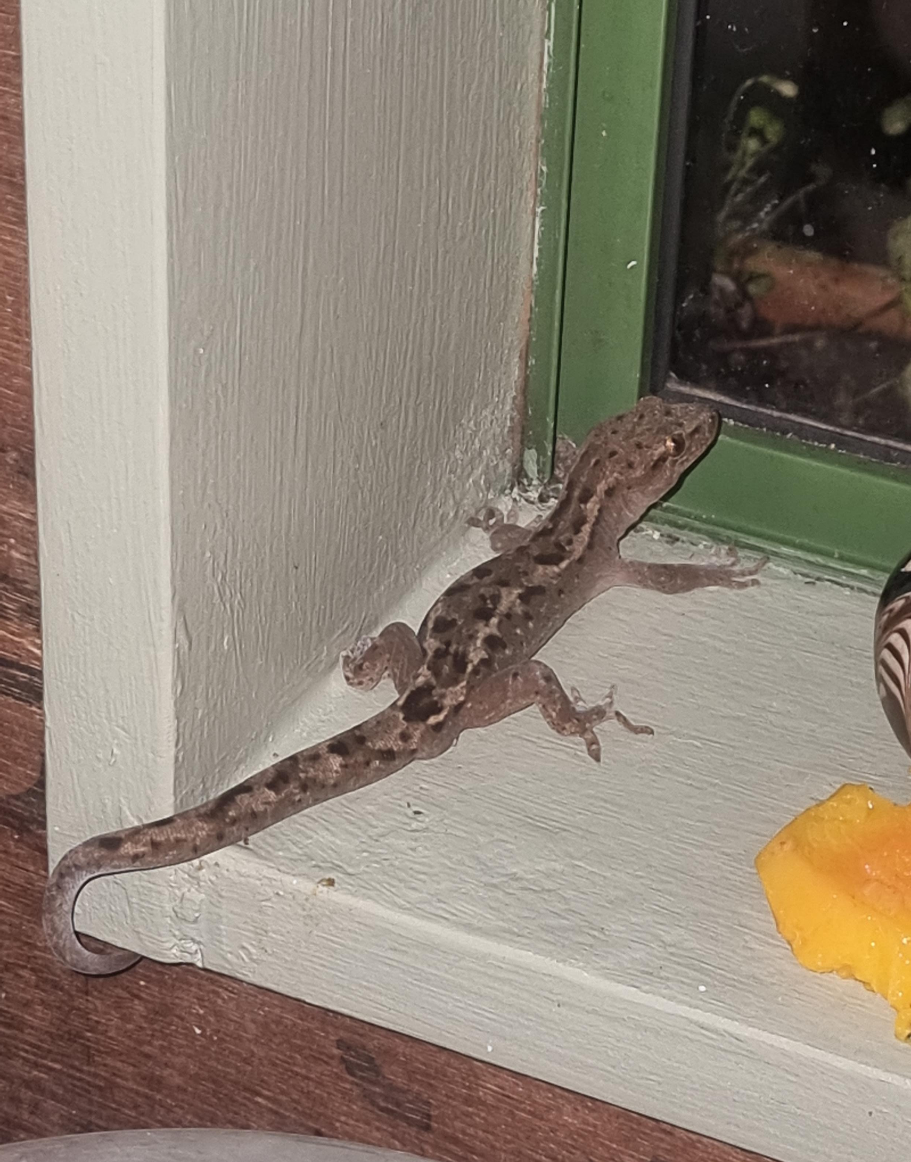
Domestic Cat Microchipping Member’s Bill
Notes:
Members bill re cats compulsory mmicrochipping and registering
Cat welfare – reunification, owned/unowned means PF2050 could incl ctas. Local bylaws remain but Councils can use fines not have to invoke breach of bylaw process.

Slide 6
Councils and Covenants
Most Regional and unitary Councils mention feral cats in their RPMP
Some territorial Councils have bylaws
  Varied
  Difficult to enforce
LGNZ and Taituarā want legislation
QE2 Covenants
Subdivision covenants
Notes:
NB Bill explicit about

Slide 7
What you can do today!
Support any Council consultation
Email MPs, urge to support Bill out of ballot
  Use PFNZ site www.predatorfreenz.org/cats
Covenant any property you own/influence
Keep your cat inside
Encourage PF Strategy to include feral/unowned cats
Be ready for National Cat Management Strategy

Slide 8
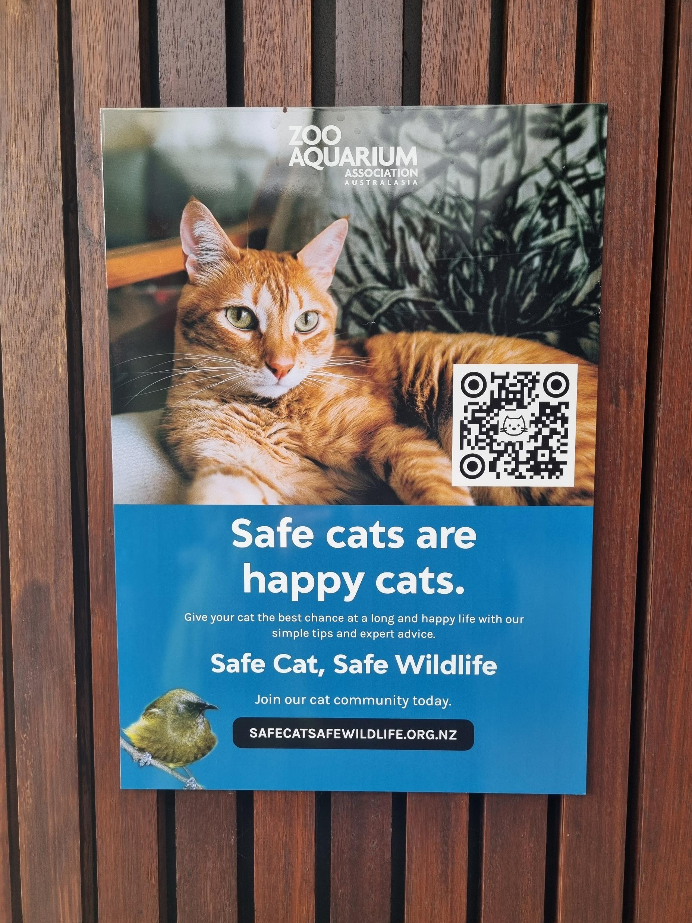
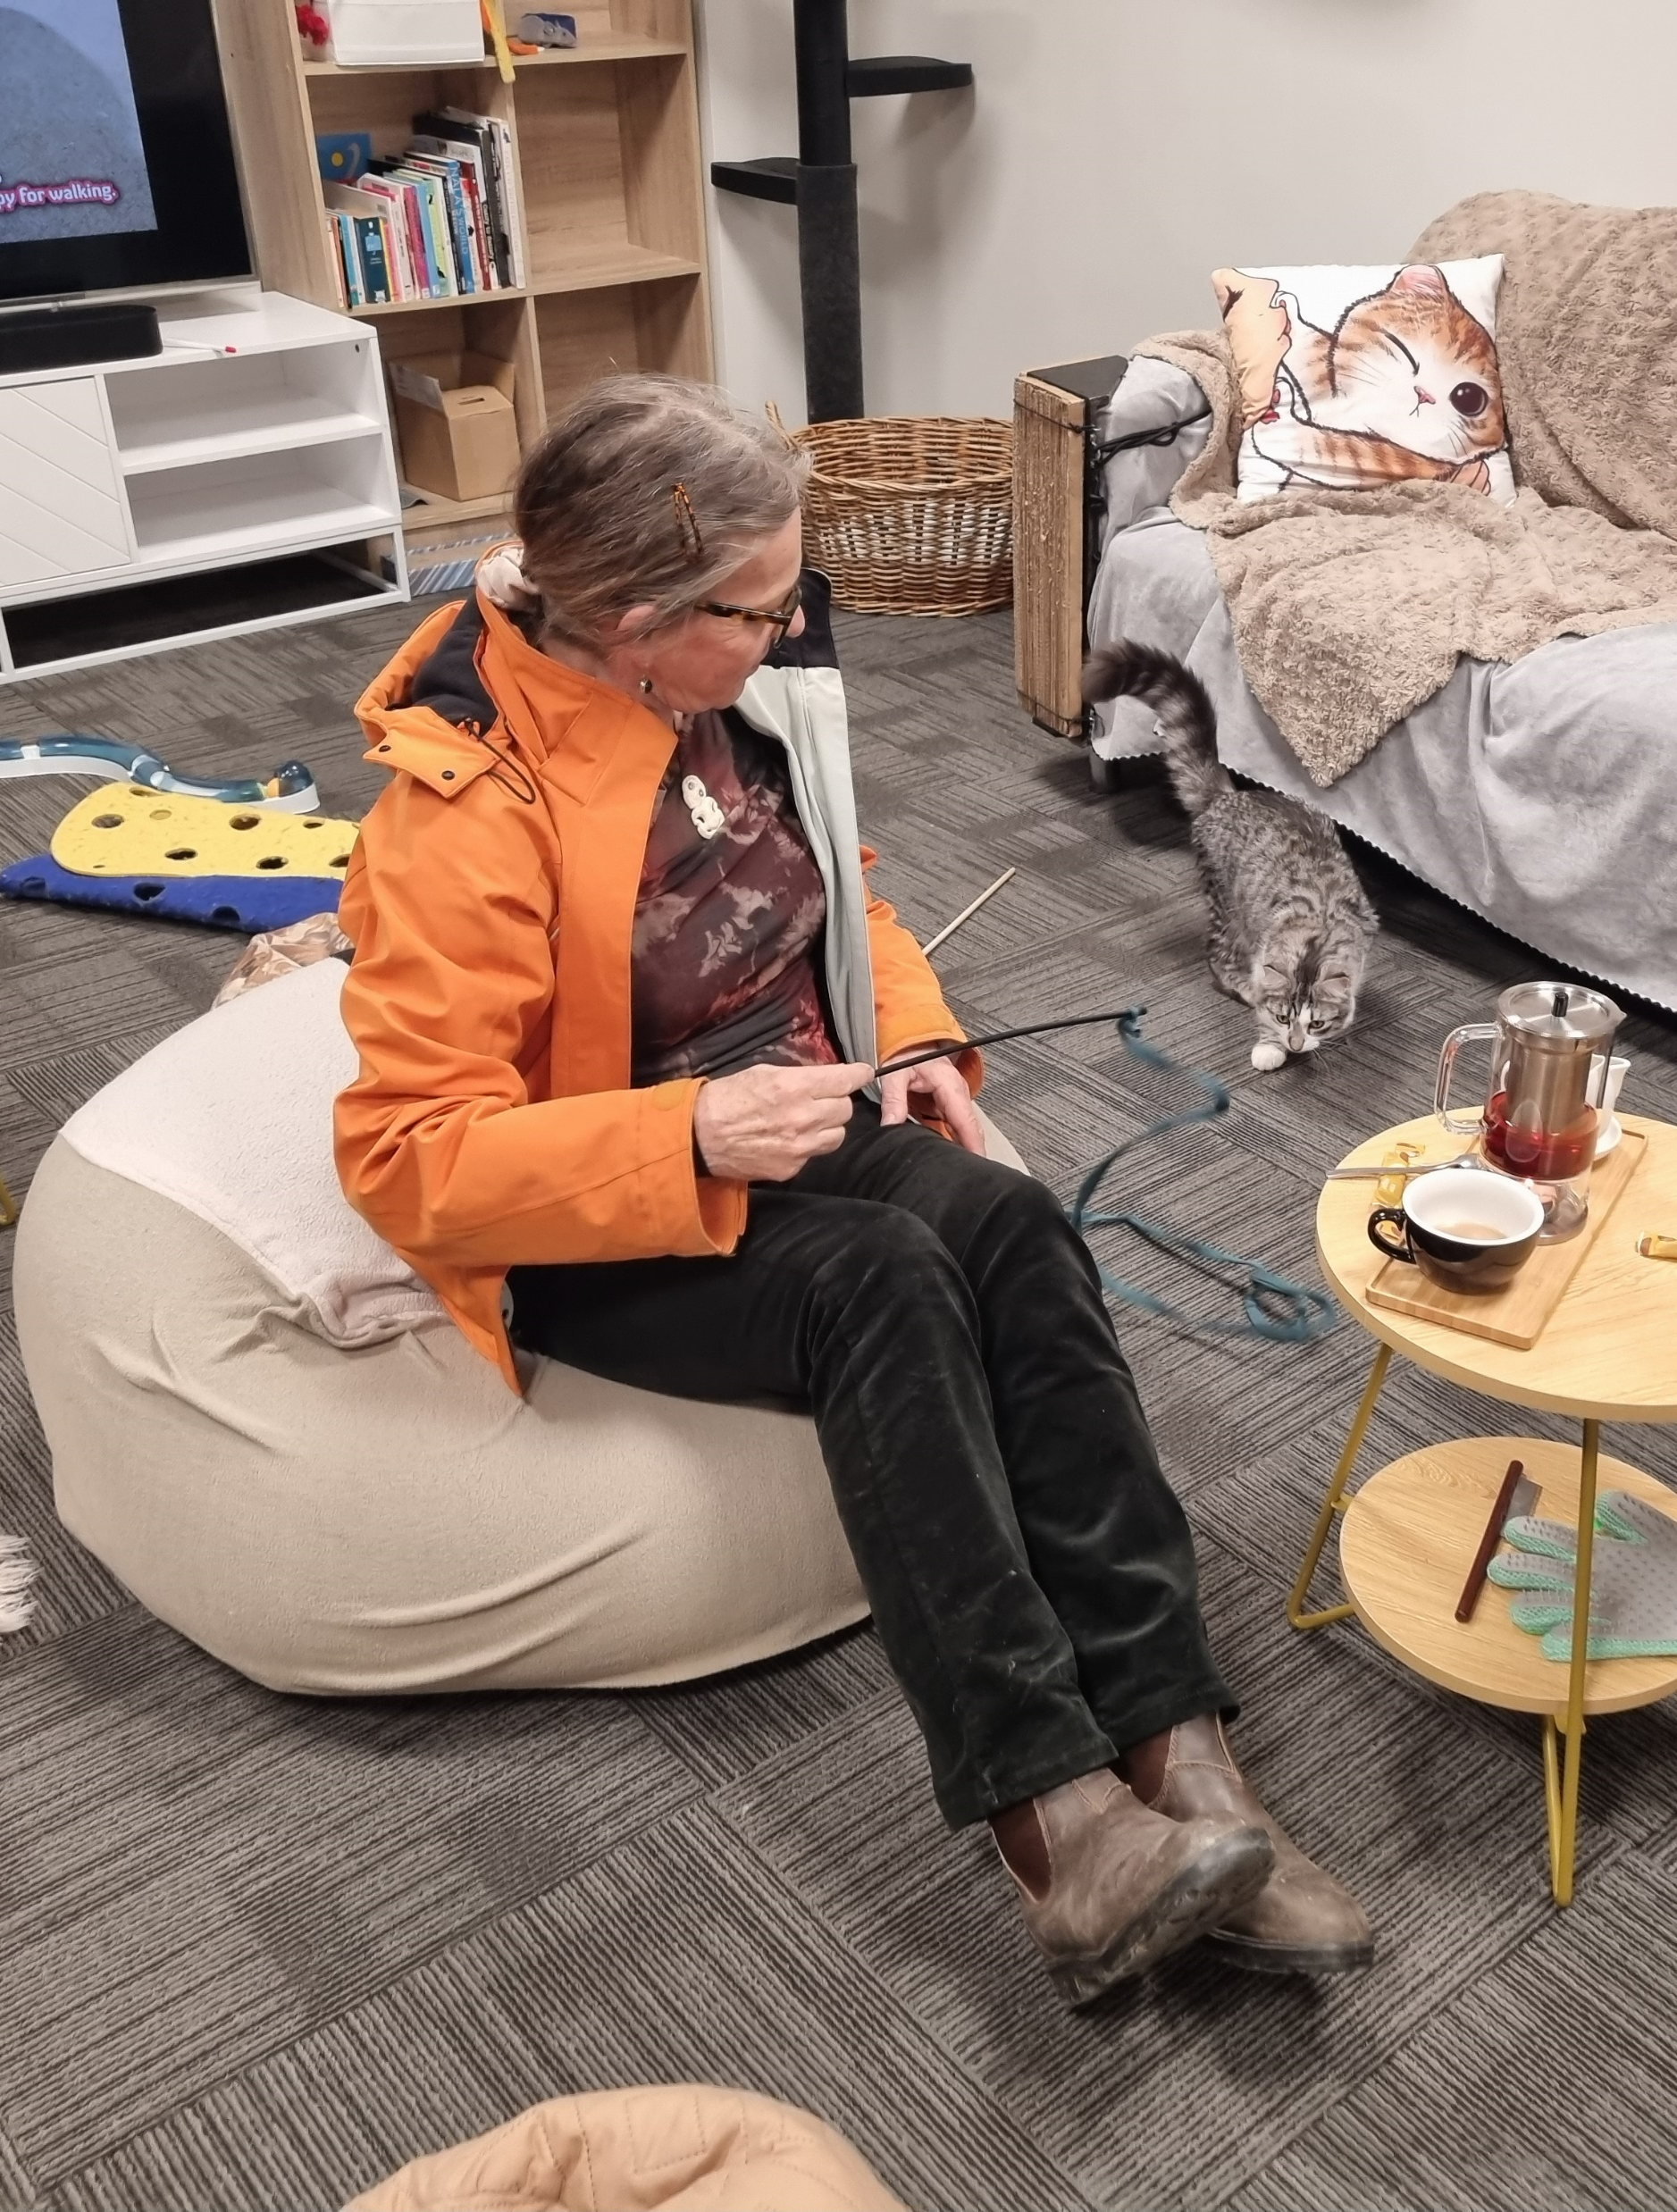
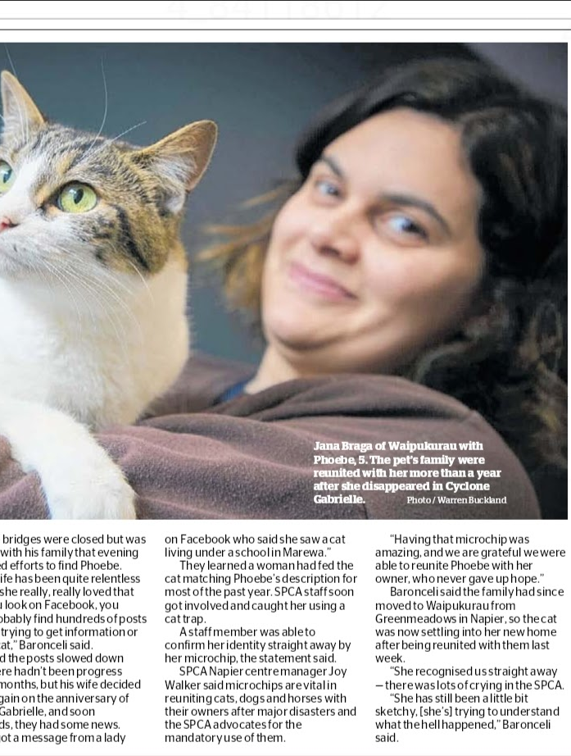
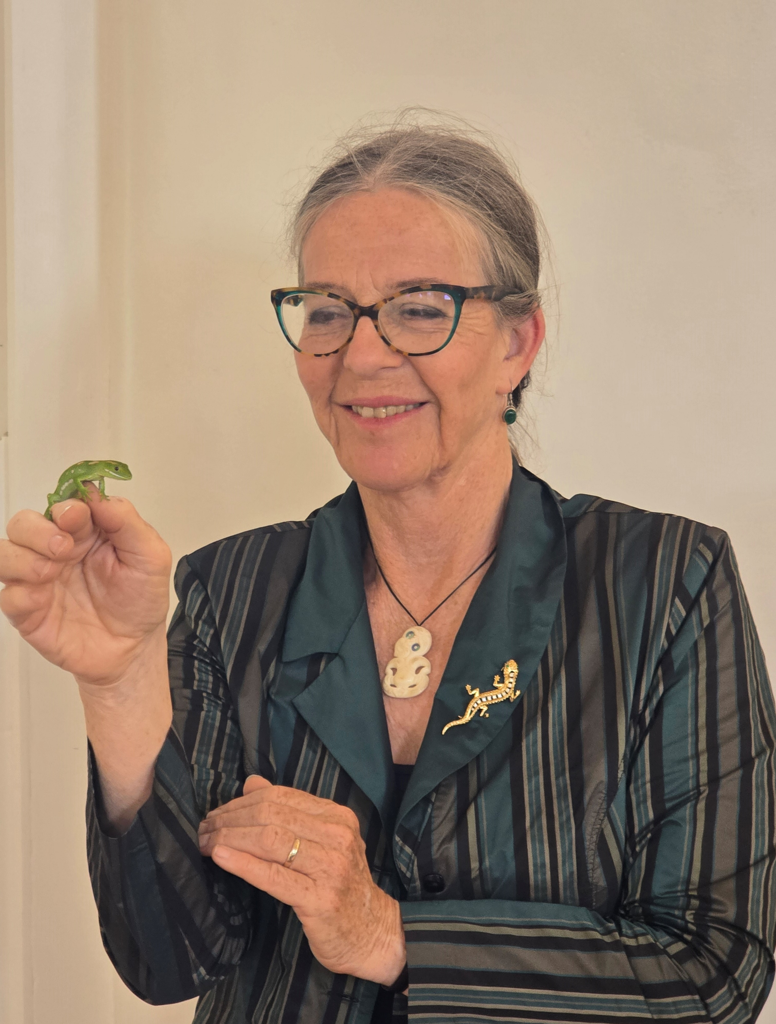
Questions?
Authorised by Celia Wade-Brown MP, Parliament Buildings, Wellington

