Slide 1

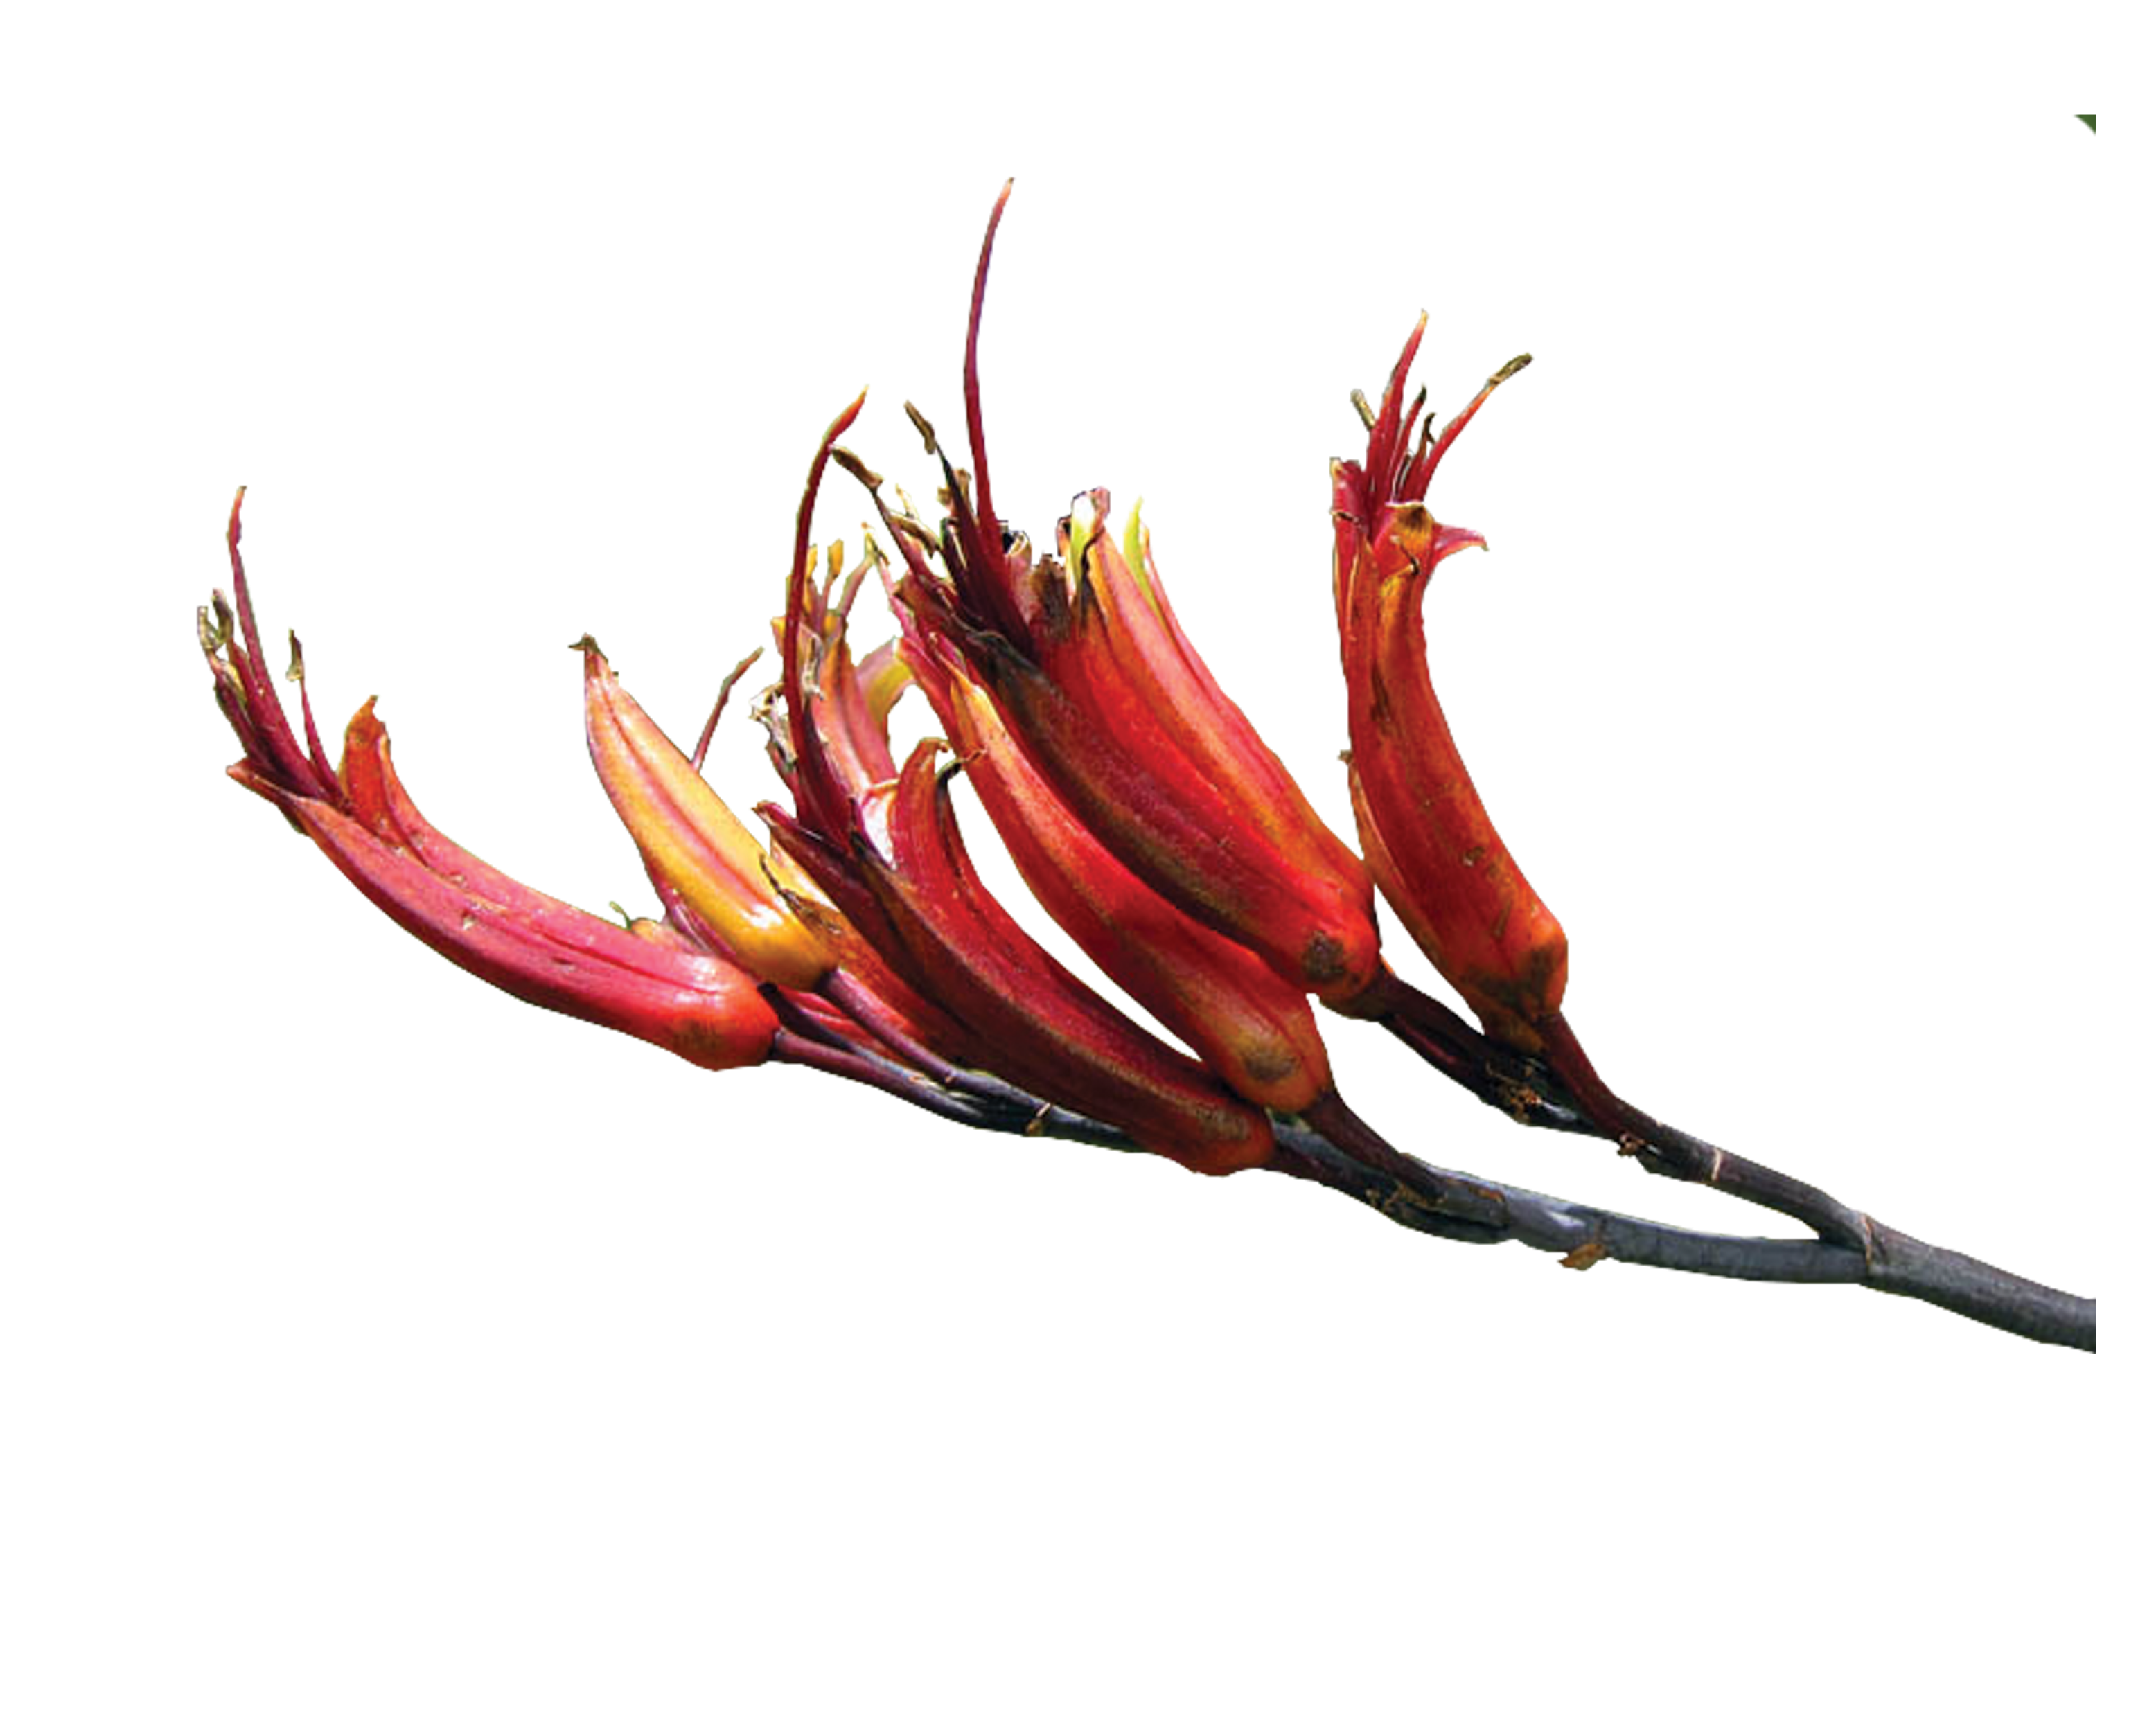
Weed species Control for Tairāwhiti Dune Restoration
BIODIVERSITY INCREASE

Slide 2
PURPOSE
How to identify, prioritise and control specific noxious weed species found in dunes and other coastal environments before, during and after plant restoration.

Slide 3
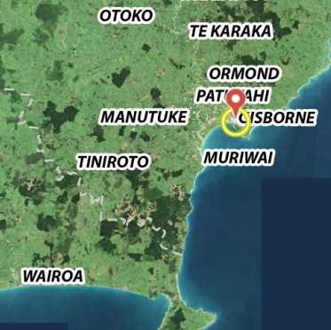
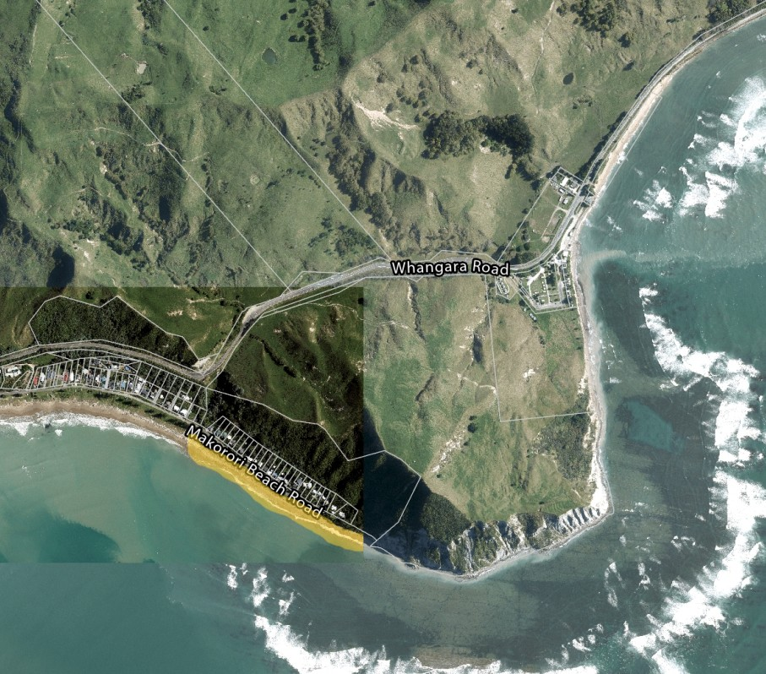
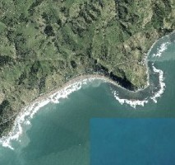
RESTORATION EXAMPLE
MAKARORI BEACH GISBORNE
Notes:
Add information around Biosecurity advising volunteers and other Departments around control, plus worked with other Staff in identifying. Many weed species are listed under the Council’s Regional Pest Management Plan and are put into categories. No Eradication level were present, meaning that the control comes under other groups and Biosecurity play an advisory role. Many weed species such as cape Ivy were well established on residential properties.

Slide 4




4
Continued control
1
Identifying
WEED
SPECIES
CONTROL
3
Methodology
2
Prioritizing

Slide 5
4
Continued control
1
Identifying
WEED
SPECIES
CONTROL
3
Methodology
2
Prioritizing

Slide 6
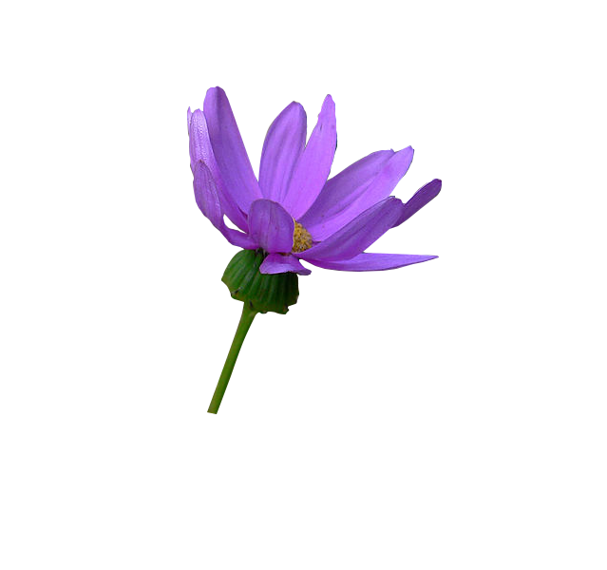
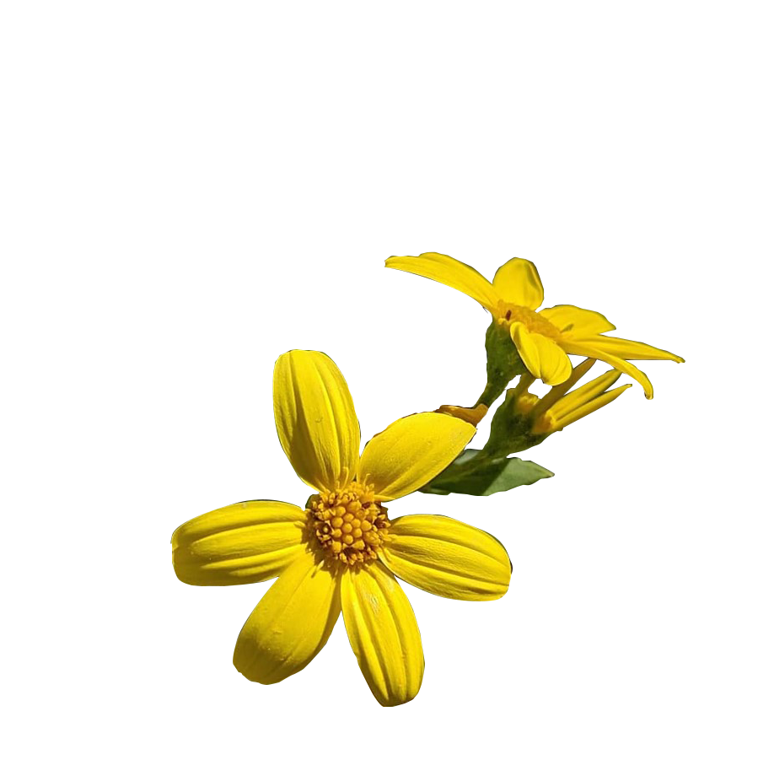
1
Identifying
4
Continued control
Based off observations exotic invasive species within dune areas are the result of:
Green waste being dumped from local households. Example Cape Ivy.
Transported by wind, birds etc.
Examples Boneseed & ragwort.
3
Methodology
Notes:
What can be a containable household decorative plant can become highly invasive in another environment.

Slide 7
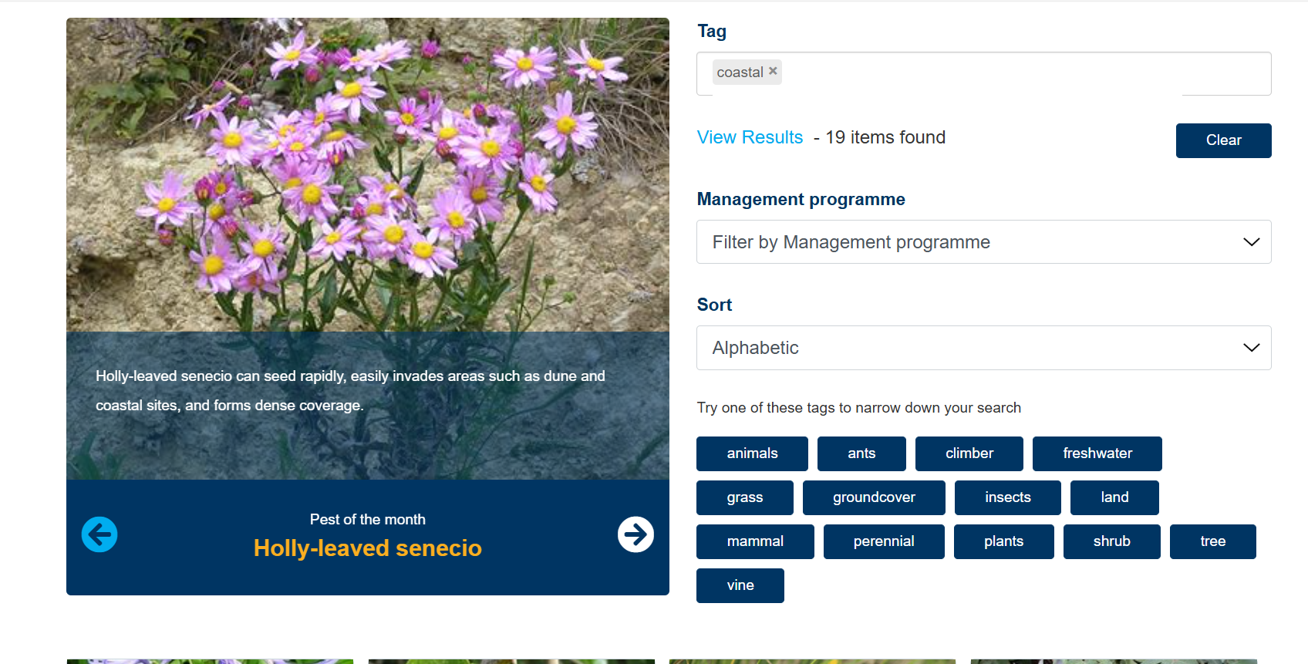
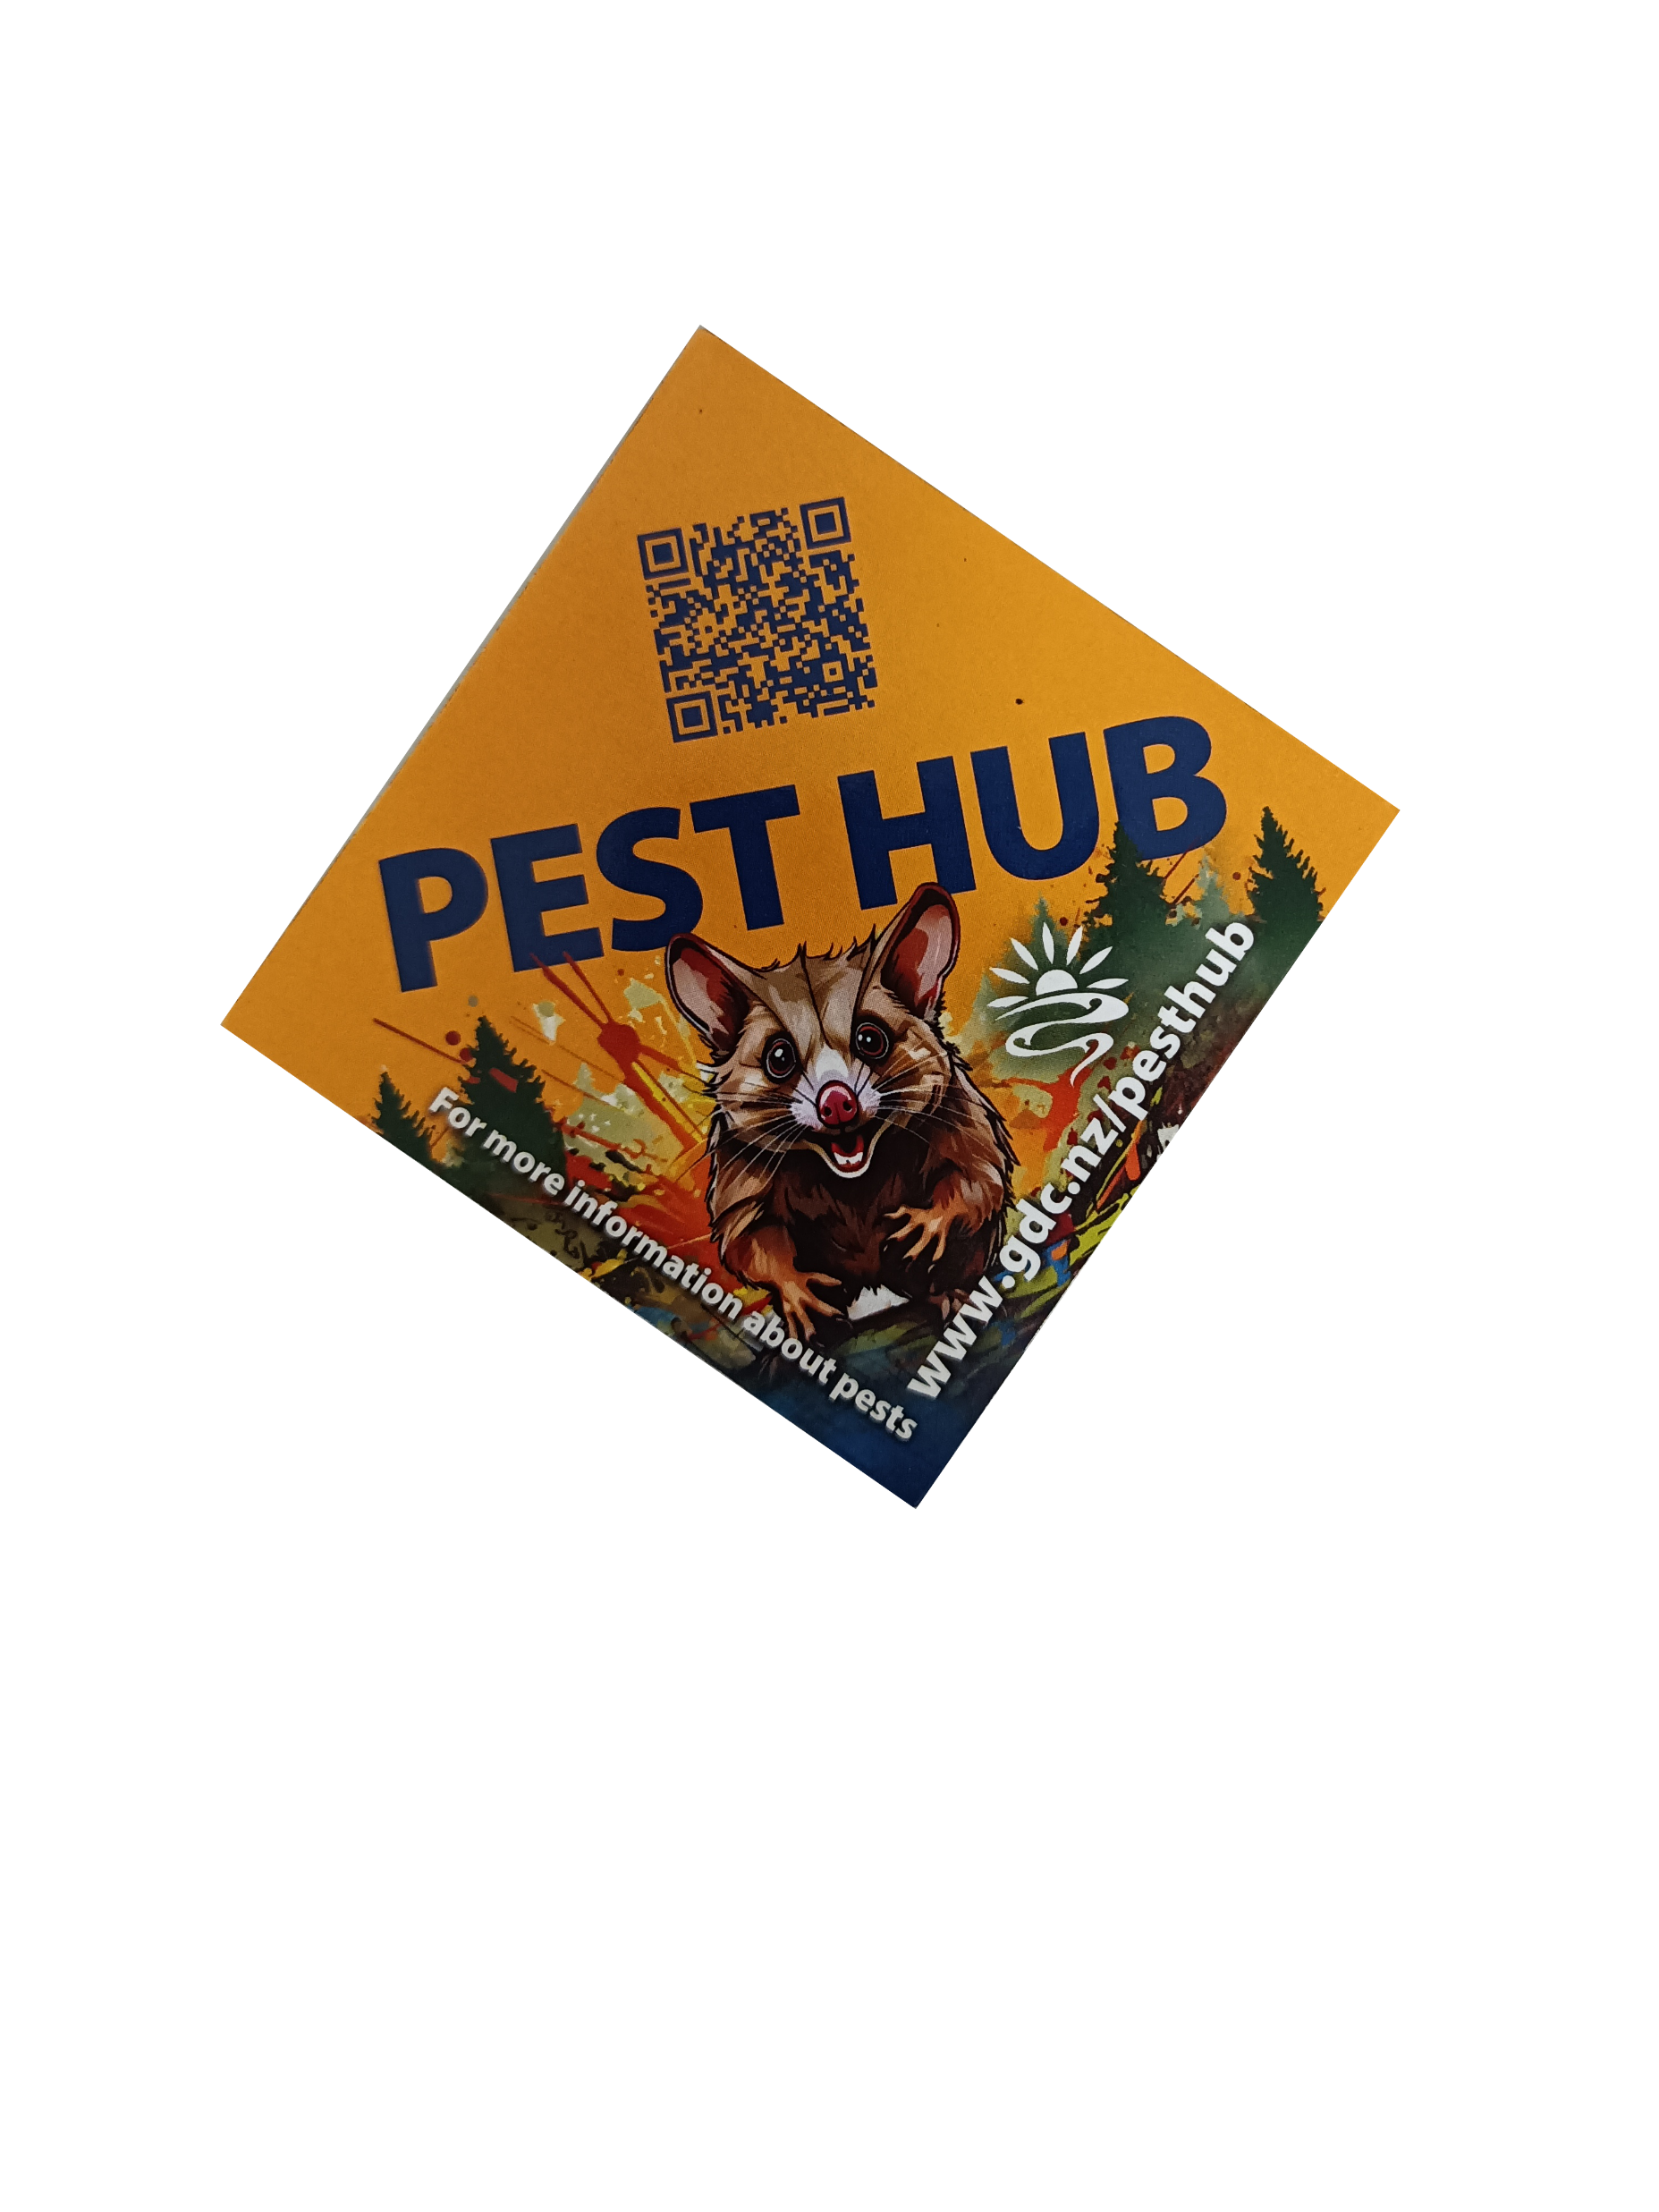
1
Identifying
4
Continued control
Biosecurity advocate/ educate by efficient forms of mediums.
Website ‘Pest Hub’ with info around, how to identify, why is it pesty, how to control.
Instructional guides, include reports and pest specific videos.
3
Methodology
Notes:
What can be a containable household decorative plant can become highly invasive in another environment. GDC Biosecurity apply different methods of informing based a case-by-case basis. The Pest Hub came from challenging previous methods of information that required people to read through the RPMP or pest plant accord list to access the species, however, was inefficient catering towards a broad audience. The Pest Hub tool allows a user to type in a key word (if they don’t know a species) to easily identity and find out how to control.

Slide 8
2
Prioritizing
4
Continued control
1
Identifying
Pest species order of removal based on the method off removal of a plant.
Knowledge of invasiveness of a sp.
The category of a pest sp.
3
Methodology
Notes:
The RPMP list species based on their invasiveness, e.g. moth plant and banana passionfruit cannot be contained due to how they can spread (listed as progressive containment- meaning that no matter where they are located they will be treated as a removal species), however, ivy’s can be contained and are classed as site led (case by case basis)

Slide 9
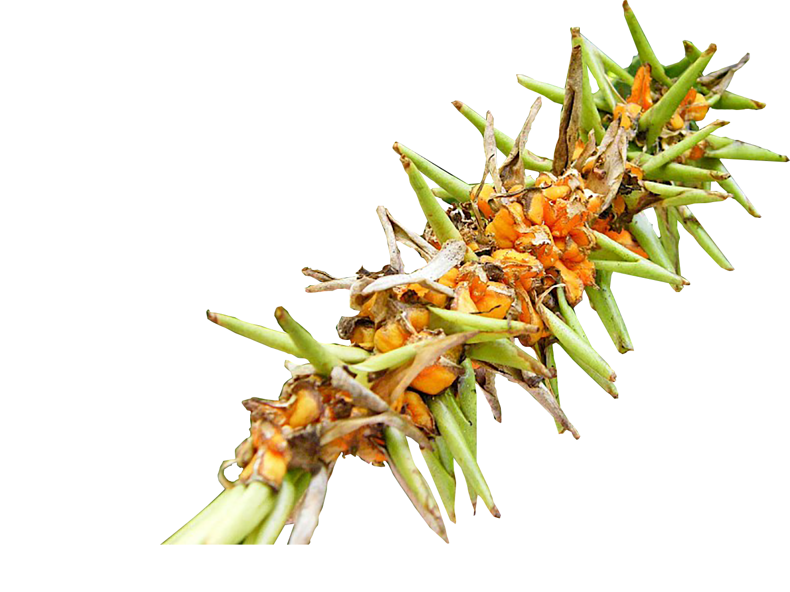
2
Prioritizing
4
Continued control
1
Identifying
Example: Wild ginger, although not widespread throughout Makarori would be advised to be removal first.
If cape ivy were to be prioritized wild ginger could overtake that niche, making the long-term management more labour intensive.
Commonly weeds outcompete other weed species, and if one is removed others quickly spread.
3
Methodology
Notes:
Add image such as wild ginger

Slide 10
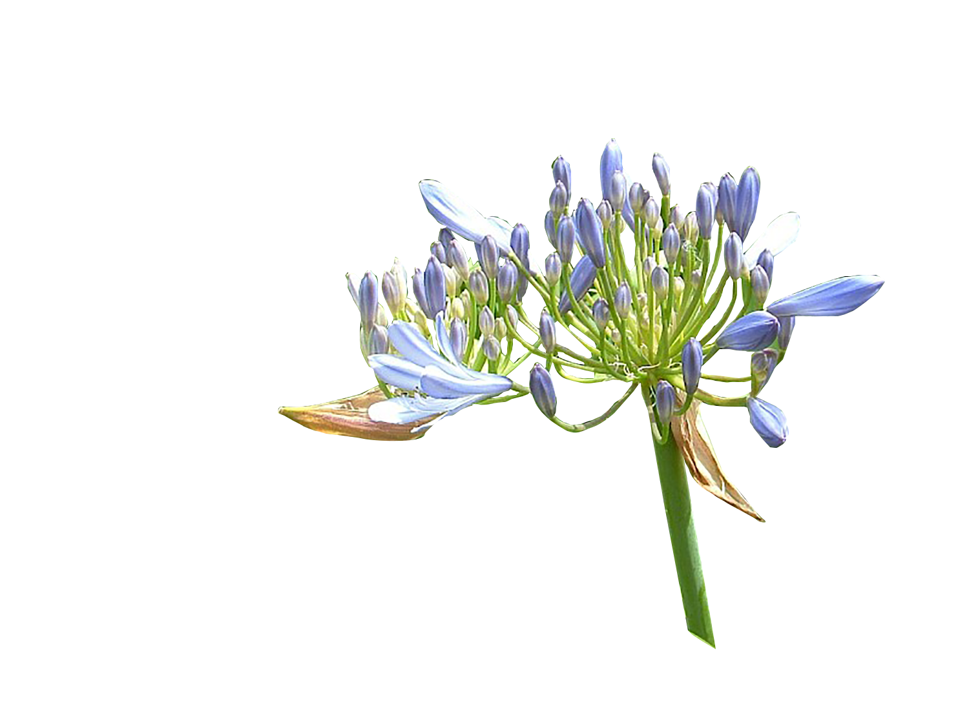
3
Methodology
4
Continued control
Depending on the species, digging, removal & burying/ burning off site is preferable.
Agapanthus requires multi- processed approach, slashing, stump-treatment and dug out.
Cape Ivy in dense thickets can be sprayed in areas away from desirable vegetation.

Slide 11
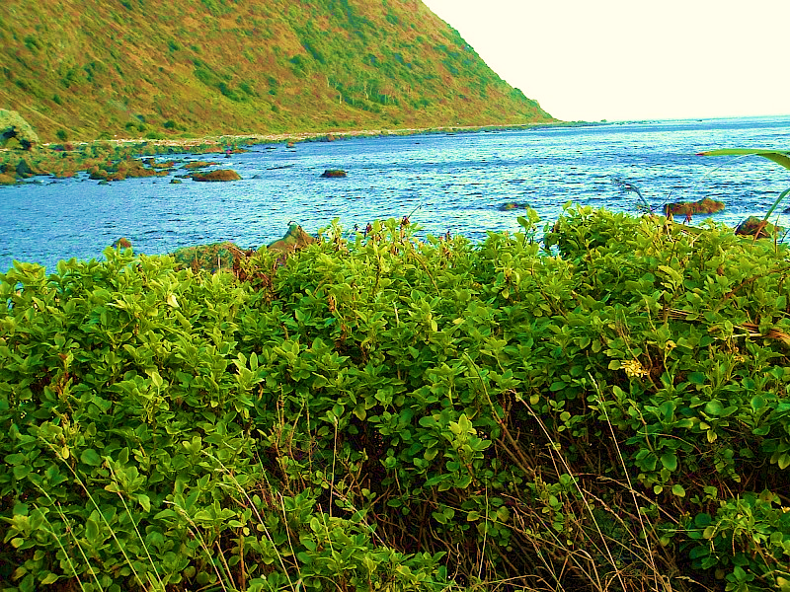
3
Methodology
4
Continued control
Continued monitoring.
Weed removal based on reporting/observations.
Acknowledgment of new invasive species outcompeting native establishments.

Slide 12
4
Continued control
Biosecurity conduct animal control.
Target invasive species that affect native replanting’s such as rabbits.
Response to residents Request For Services

Slide 13


4
Continued control
Rabbits and hares can greatly damage young native species from establishing.
Once established/ mature these have a stronger survival chance.
GDC Biosecurity conduct night shooting post public notification during.
Notes:
12 taken out 1 month back, local residents informed and supportive. They also report to Biosecurity.

Slide 14
4
Continued control
GDC use this method over poison.
Advantages are humane, numbers can be recorded, and no risk to walking dogs or by-kill.
Notes:
Mention GDC are the only known Council that do inhouse firearms control, all officers hold firearms licence. Due to the effectiveness and resources ( not being a large Council with large funding, in-house is the most cost-effective method with proven outcomes).

